Slide 1
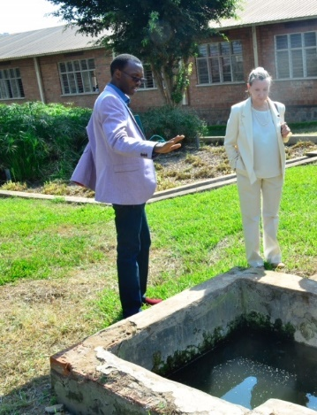
Partnering for Stronger Communities
From San Antonio, Texas
to
Kigali, Rwanda
Summer 2017
Annalisa Peace and
Jacques NSENGIYUMVA

Slide 2
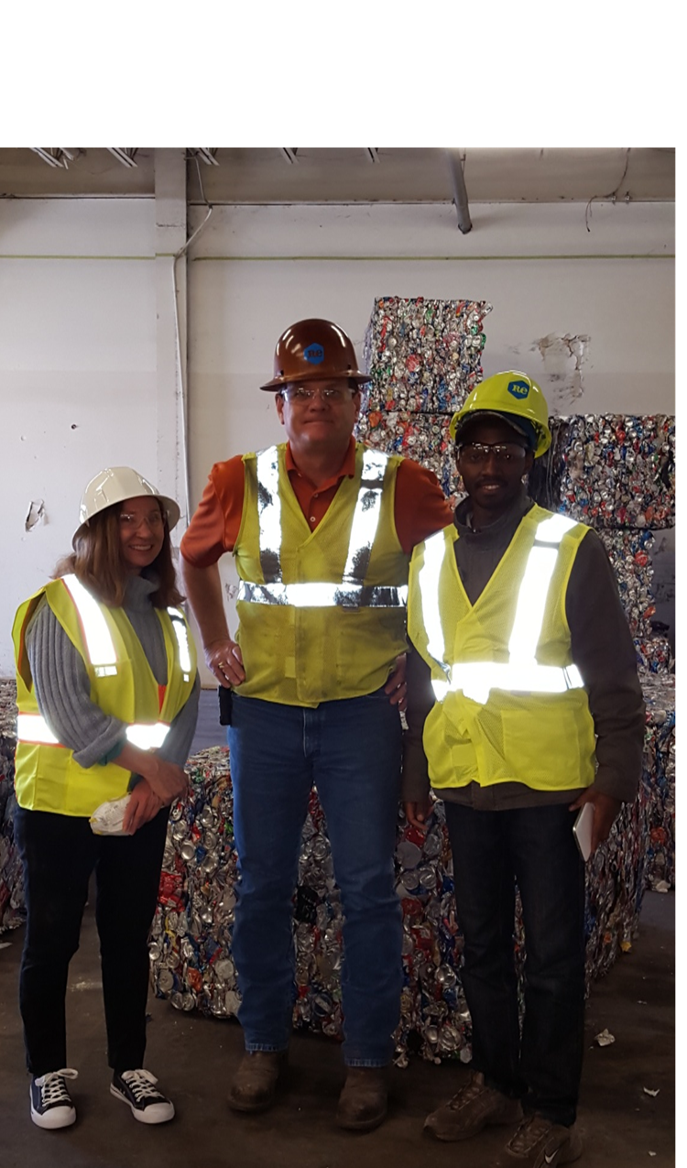
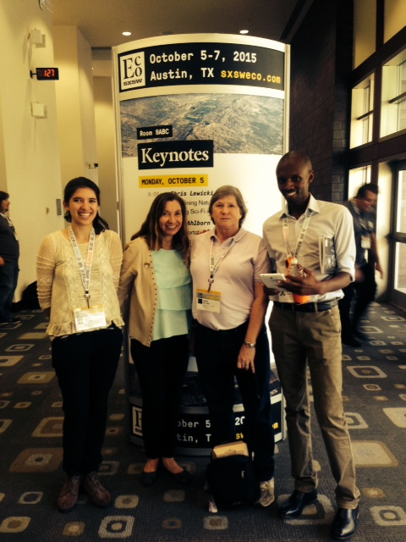
Jacques worked with GEAA in San Antonio, Texas from
August to November 2015

Slide 3
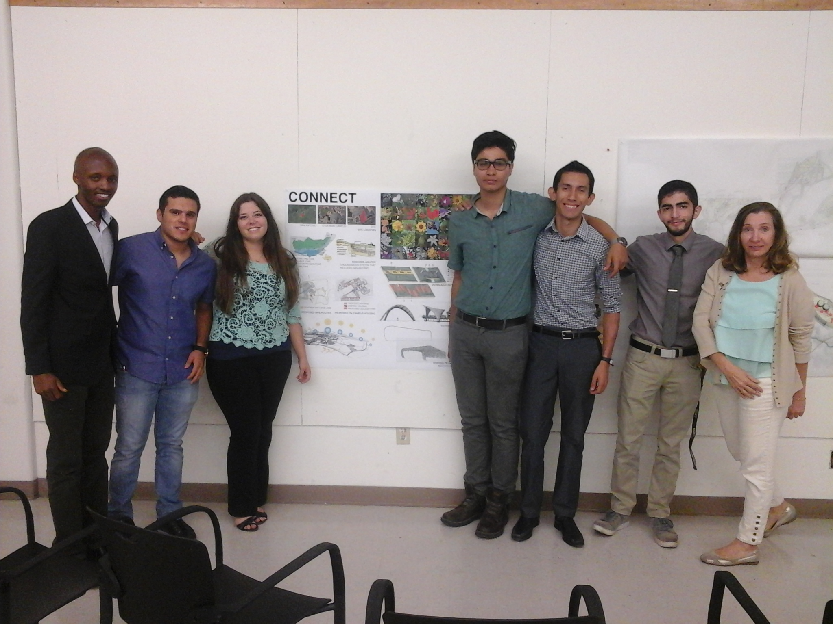
I worked with Dr. Azza Kamal, Annalisa, and Graduate students at the University of Texas College of Architecture researching site selection and design for Low Impact development projects.

Slide 4
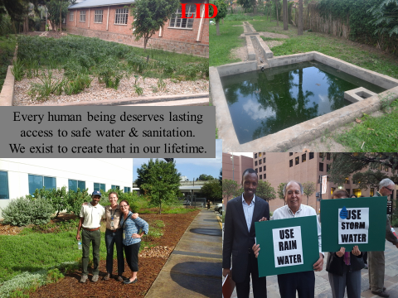
After returning to Rwanda, Jacques built several Artificial Wetland projects to improve water quality using Low Impact Development techniques.
Now, Annalisa got the opportunity to visit those projects …

Slide 5
Projects
University of Lay Adventists of Kigali – Septic Mitigation
NDUBA Dump Site – Mitigation of Raw Sewage at Sludge Fertilizer Plant
Nyanza Milk Processing Plant – Mitigation of Point Source Industrial Effluent
Excella Cambridge International School – Septic Mitigation
AGAHOZI SHALOOM High School – Septic Mitigation
New Palace Resort Hotel – Septic and Kitchen Discharge Mitigation

Slide 6
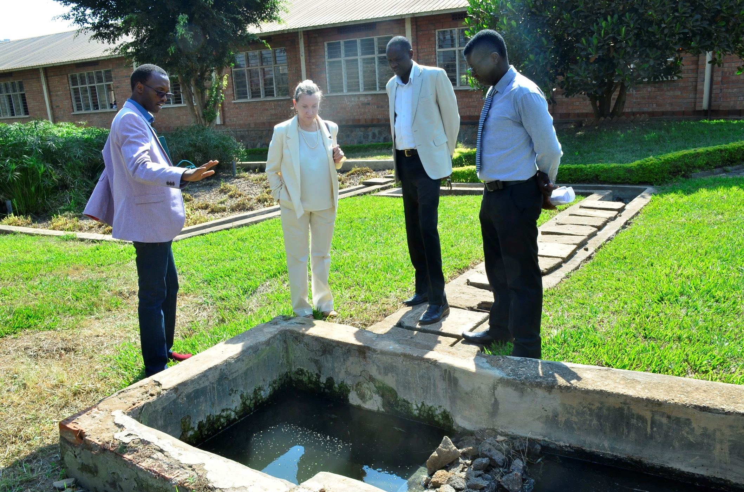
University of Lay Adventists of Kigali – Septic Mitigation

Slide 7
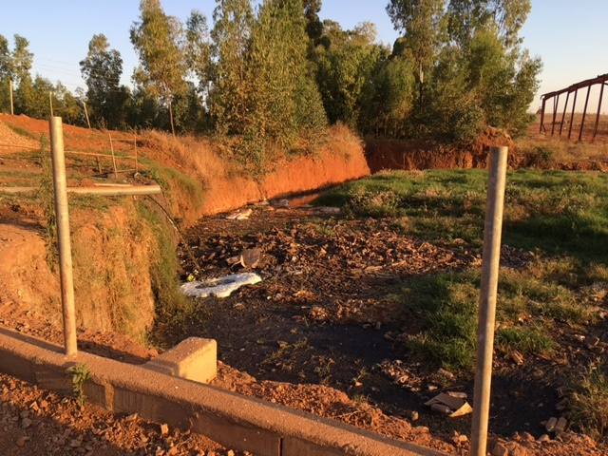
NDUBA Dump Site – Mitigation of Raw Sewage at Sludge Fertilizer Plant

Slide 8
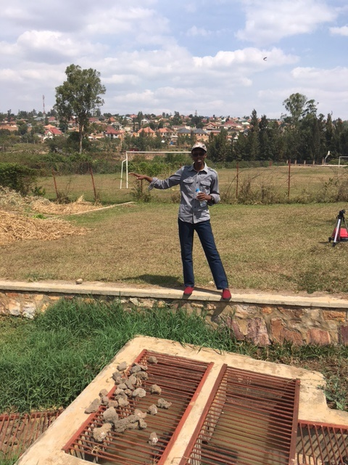
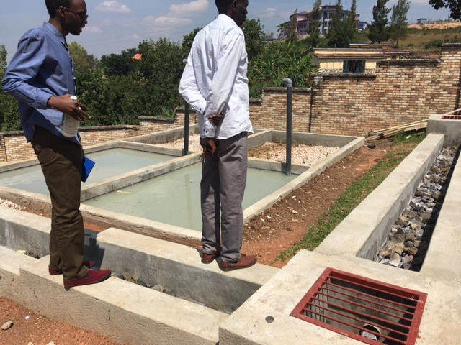
Nyanza Milk Processing Plant – Mitigation of
Point Source Industrial Effluent

Slide 9
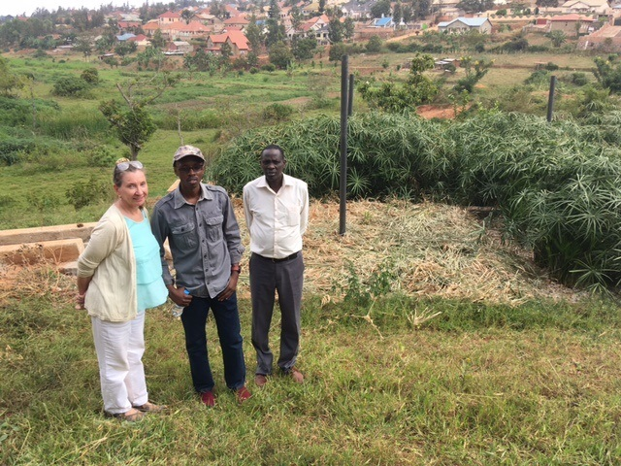
Excella Cambridge International School – Septic Mitigation

Slide 10
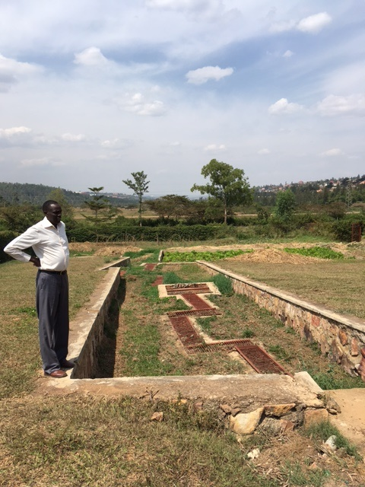
AGAHOZI SHALOOM High School – Septic Mitigation

Slide 11
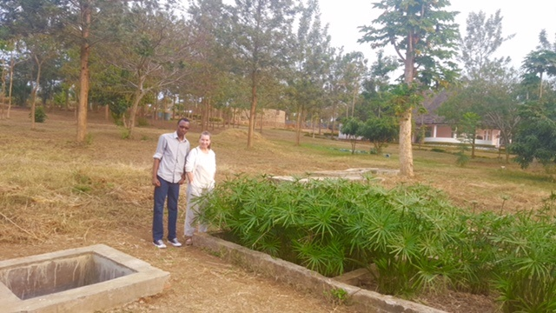
New Palace Resort Hotel – Septic and Kitchen Discharge Mitigation

Slide 12
Annalisa’s Presentations, Meetings, Research, and Collaborations
Worked with Staff and Students at University of Lay Adventists of Kigali
Presented:
An Overview of Low Impact Techniques and Applications at UNILAK
Incorporating LID techniques into Municipal Development Codes and city planning at Rwandan Ministry of Infrastructure
Researched local issues and funding resources to address specific concerns
Shared LID and other resource information
Met and collaborated with:
Coletha Ruhamya, Director General of Rwanda Environmental Management Authority
Jean NGAMIJE, President of UNILAK
Augustine RUTAMU, Dean of Faculty of Economic Science and Management at UNILAK
Immaculate MBABAZI RUGEMA, Social Development Planner Senior Engineer,
Rwanda Ministry of Infrastructure
Michiel Verweij, Water for Growth (collaborative effort between Rwanda and the Netherlands to preserve the Nile Watershed
Headmaster of Excella School & staff of Independent University of Kigali – curriculum development

Slide 13
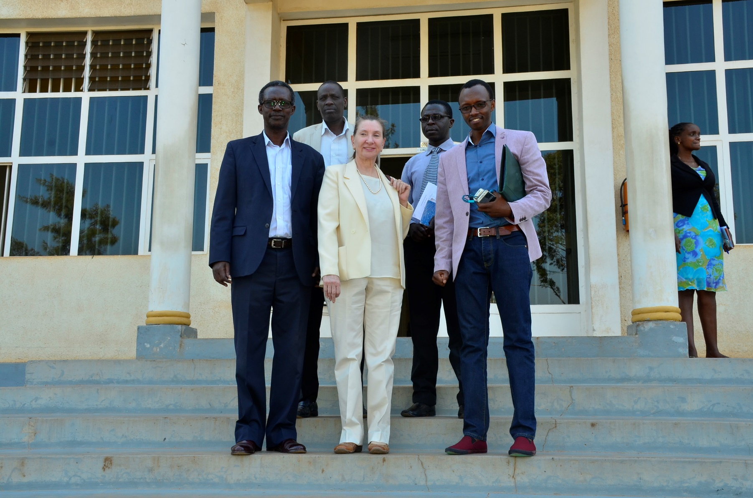
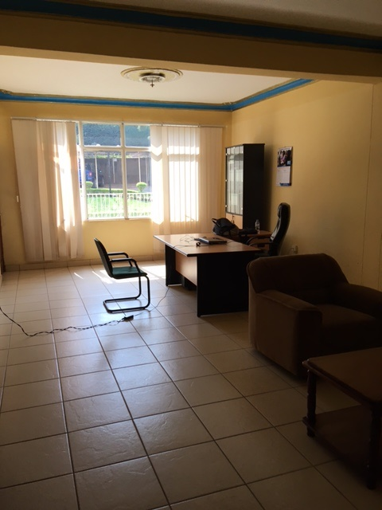
Worked with Staff and Students at University of Lay Adventists of Kigali
They gave me a beautiful office!

Slide 14
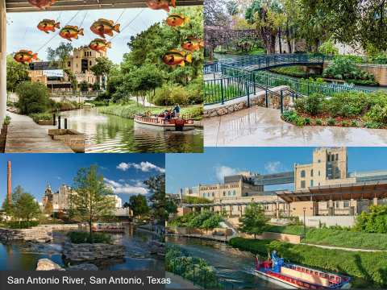
Presented:
An Overview of Low Impact Techniques and Applications at UNILAK
Incorporating LID techniques into Municipal Development Codes and City Planning at Rwandan Ministry of Infrastructure

Slide 15
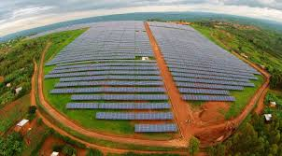
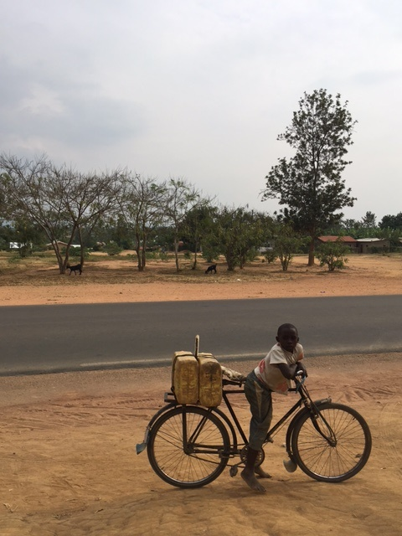
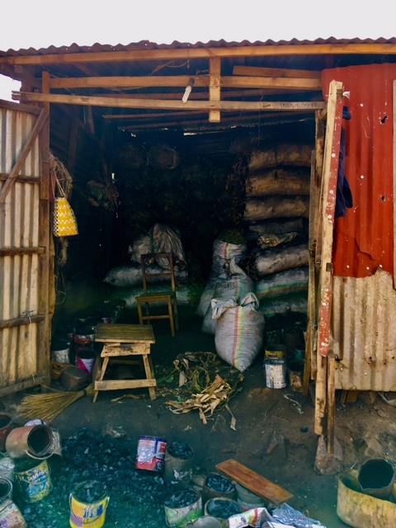
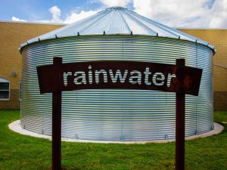
Solar Energy
&
Rainwater
Harvesting

Slide 16
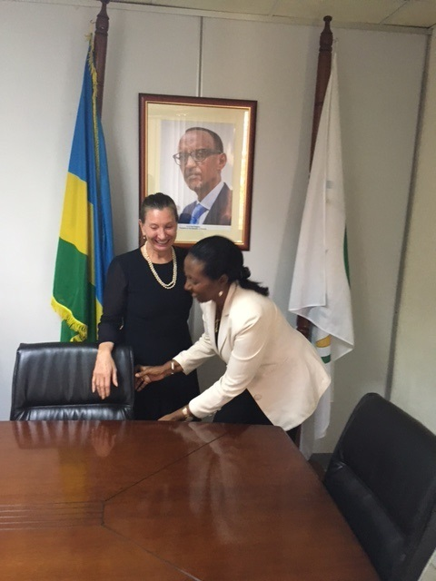
Met with Coletha Ruhamya,
Director General,
Rwanda Environmental Management Authority
(A great honor!)

Slide 17
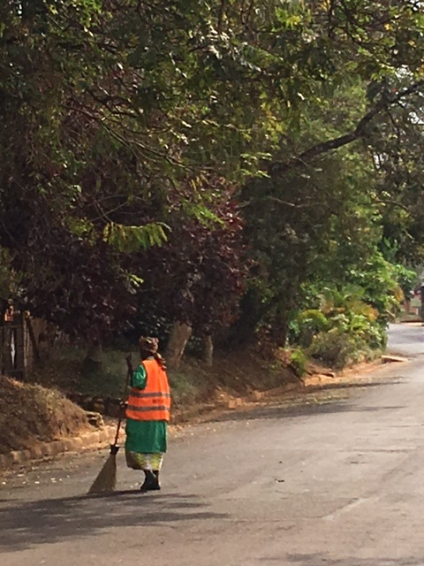
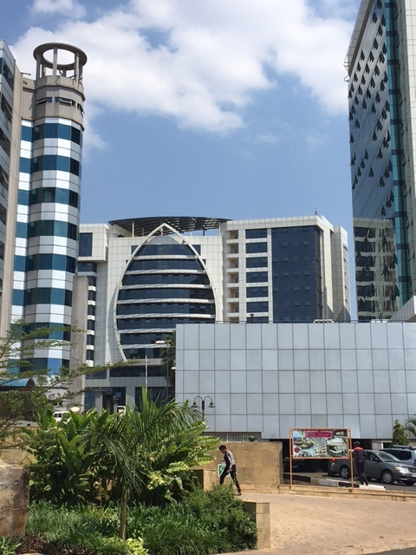
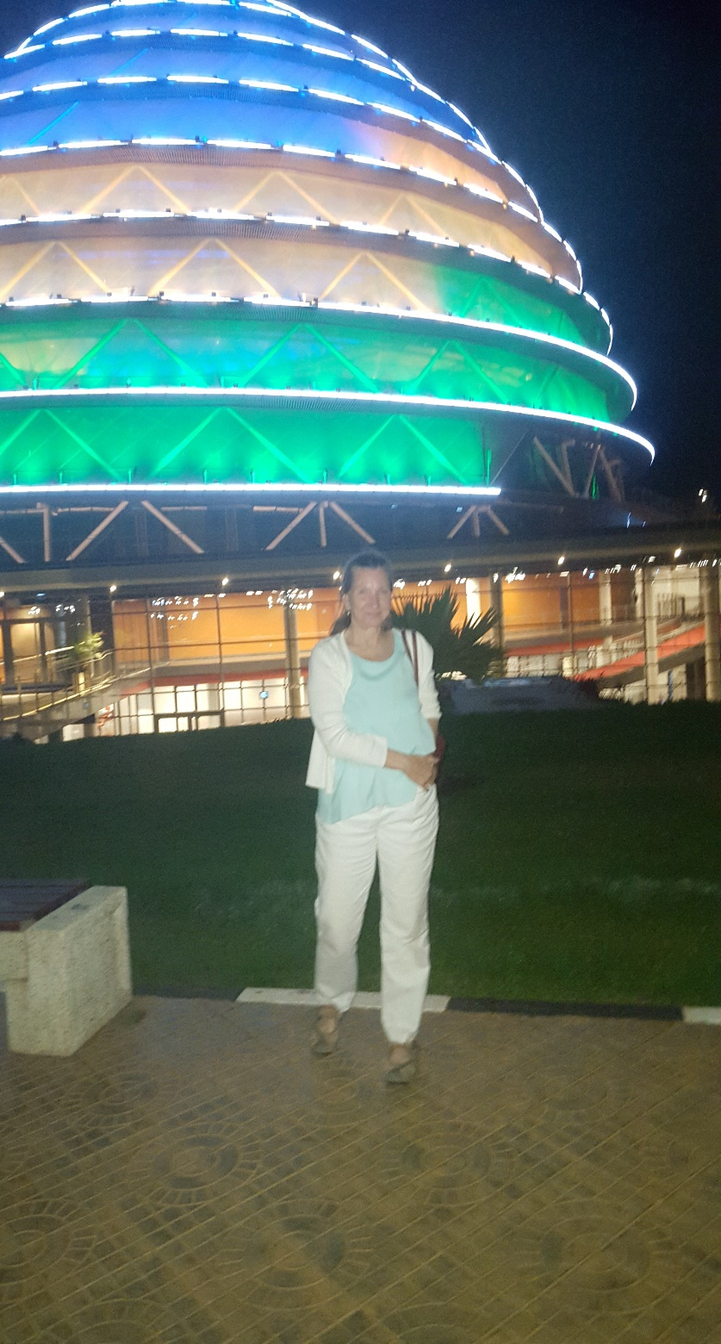
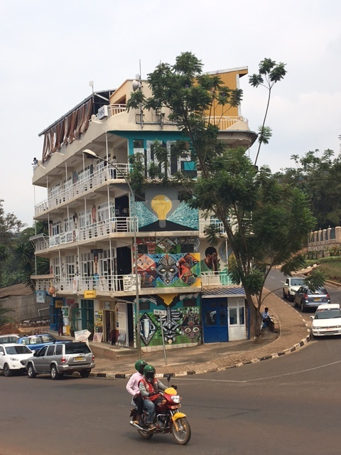
Kigali

Slide 18
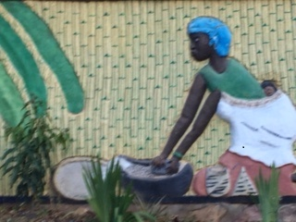
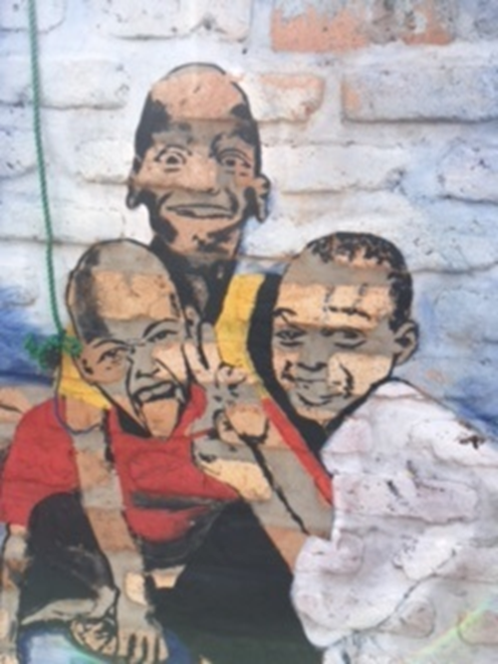
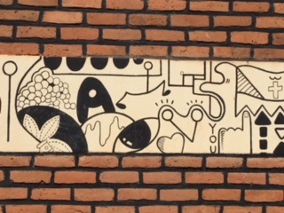
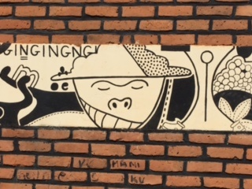
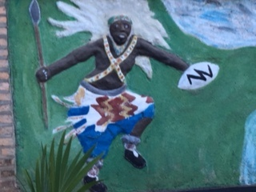
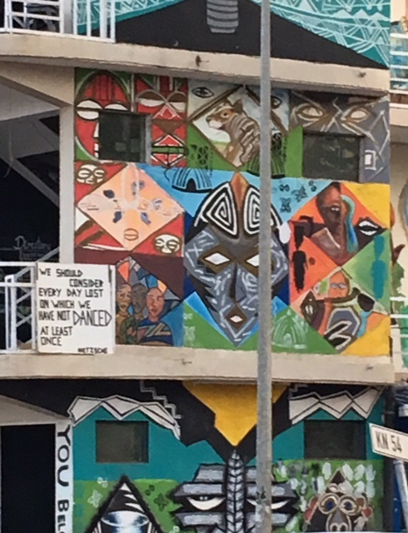
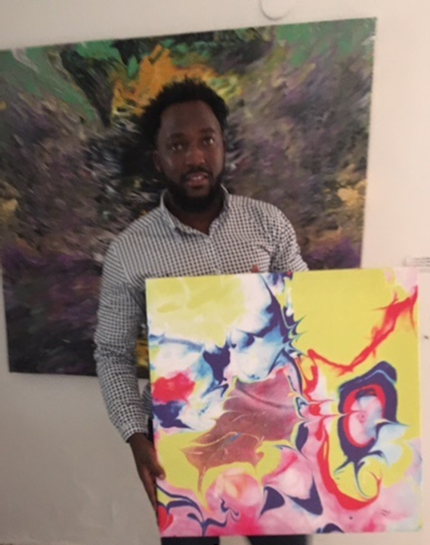
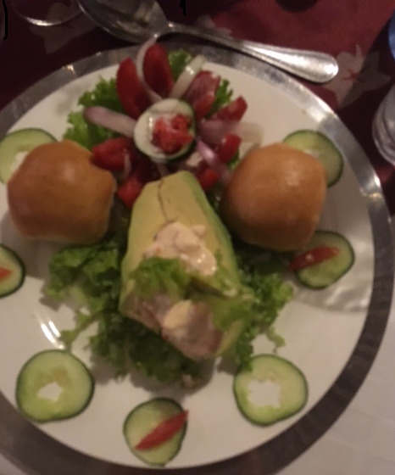
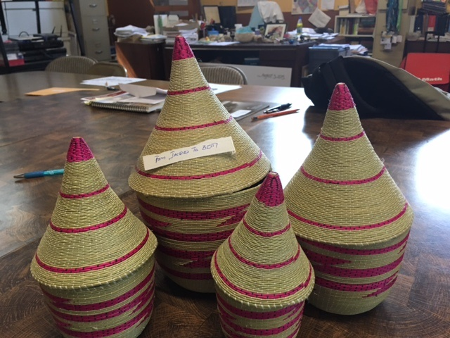
Art!

Slide 19
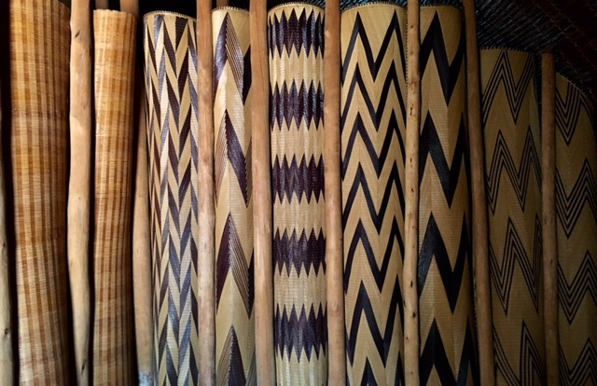
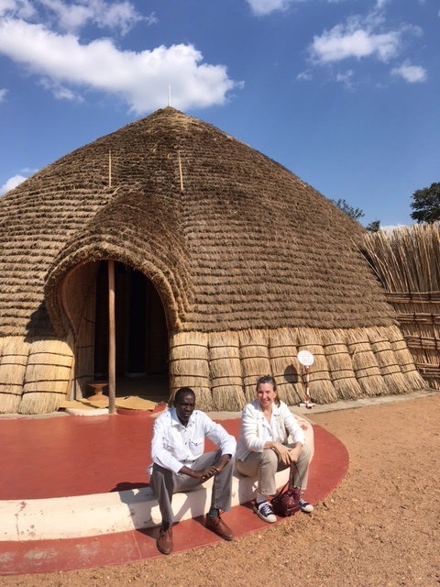
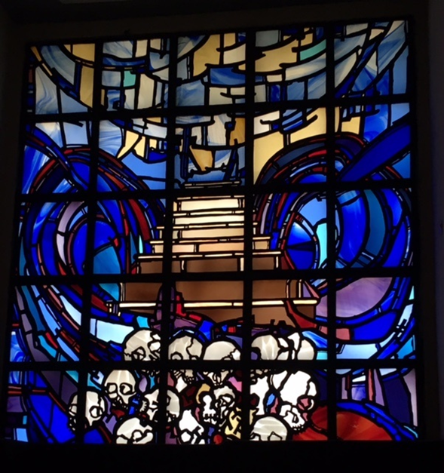
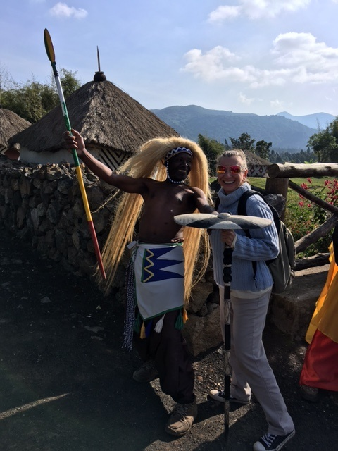
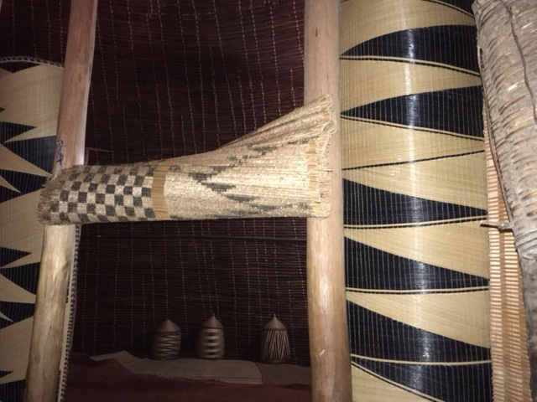
History

Slide 20
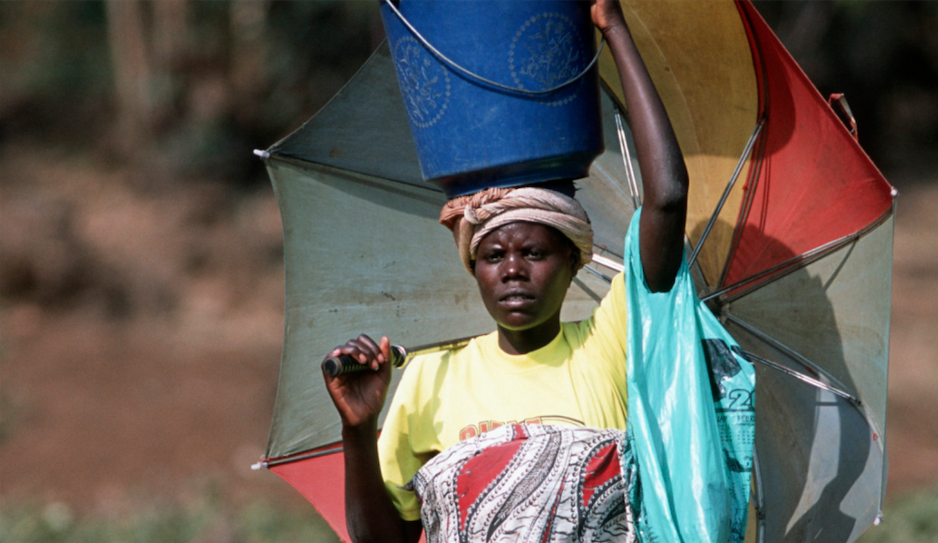
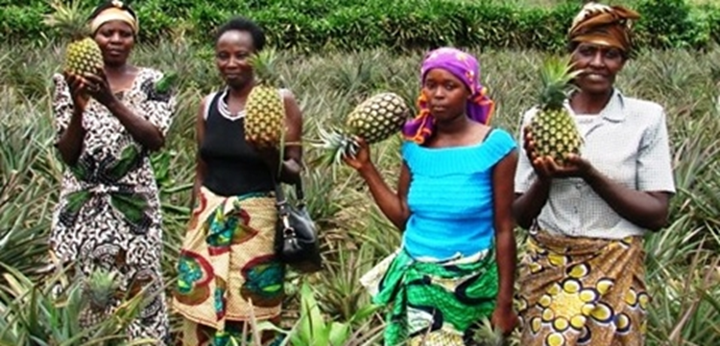
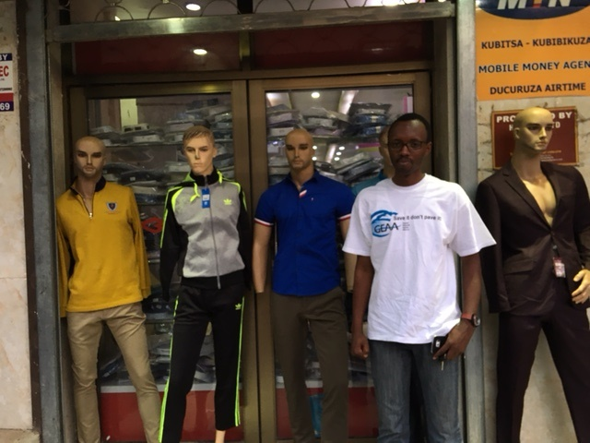
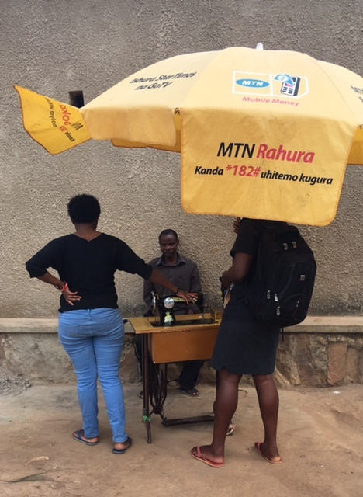
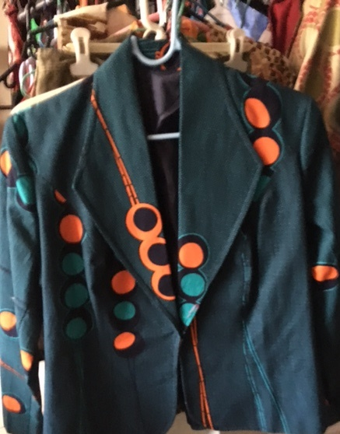
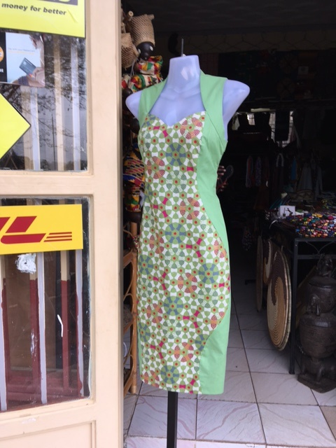
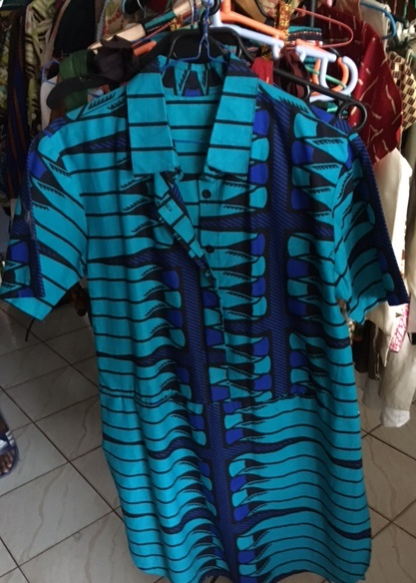
Clothes!

Slide 21
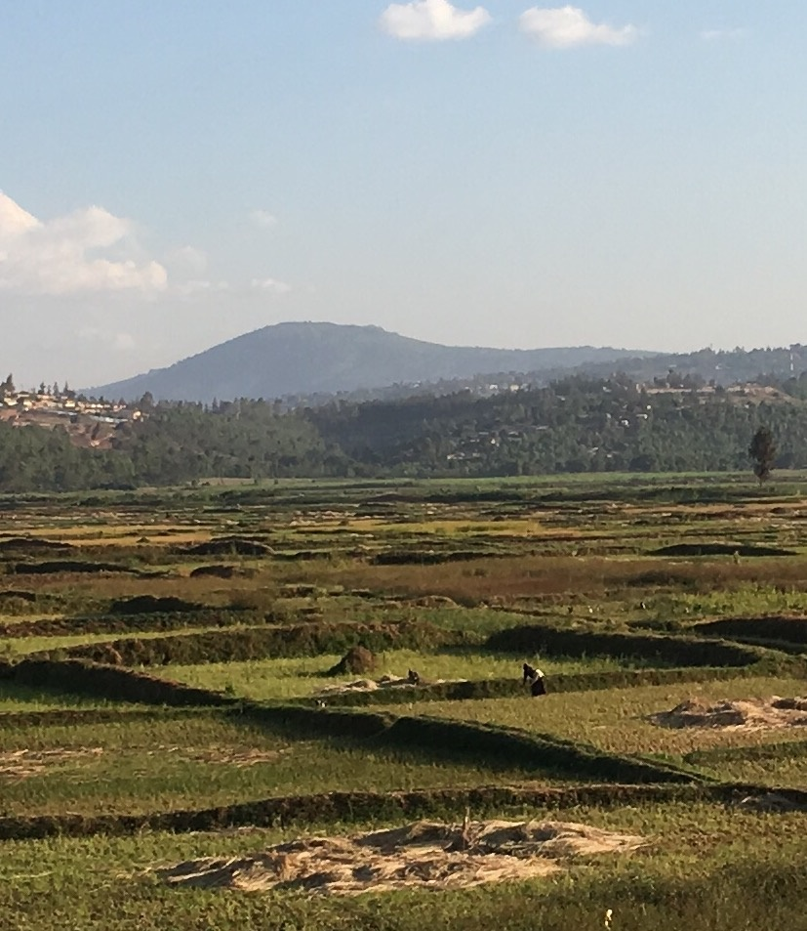
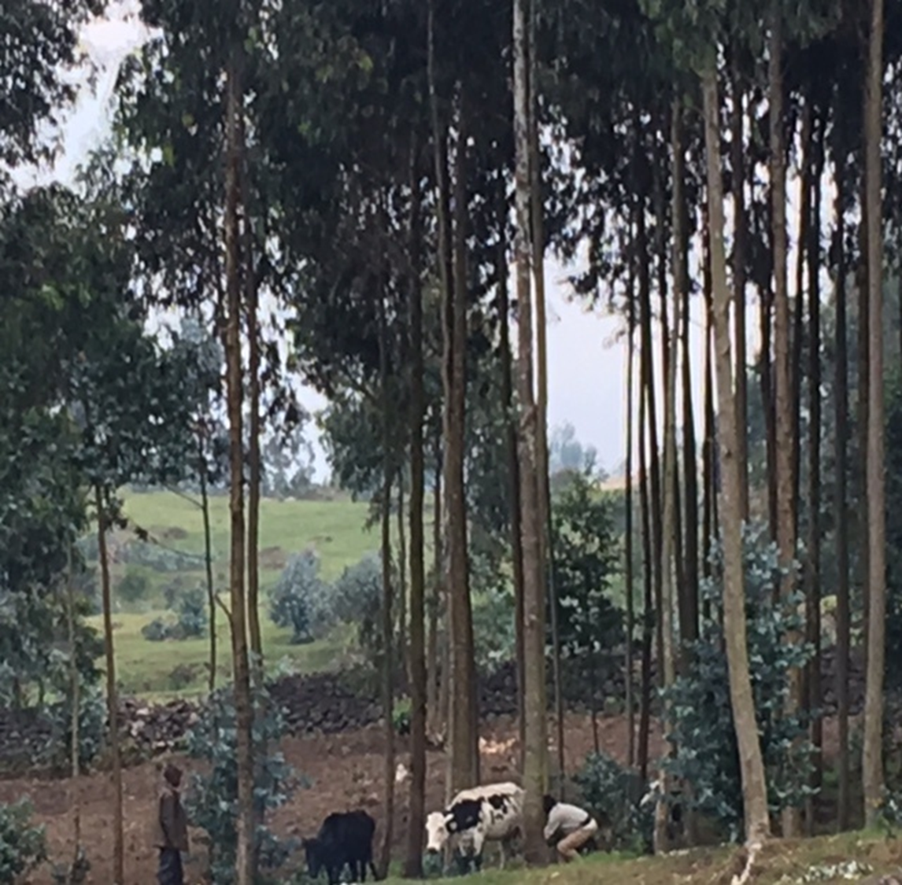
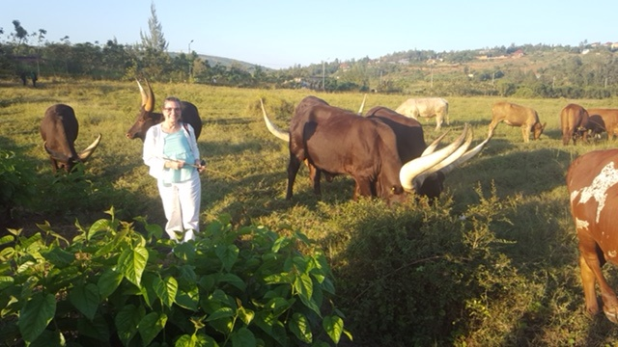
Agriculture

Slide 22
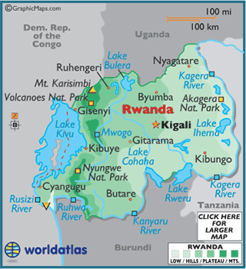
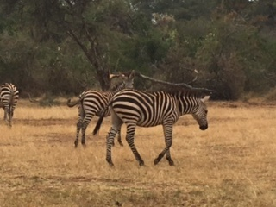
Game Preserves – Akagera & Volcano National Park

Slide 23
Farewell, Rwanda… and a very special thanks to IREX Community Solutions and the
U.S. Department of State!

Slide 24
Kigali Neighborhoods - Nyamirambo

