Slide 1
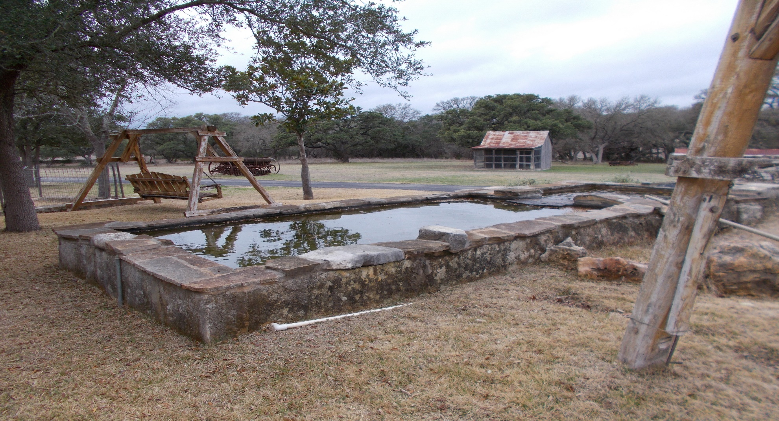
Photograph Log RN110389046 Honey Creek Ranch Wastewater Treatment Facility
Photograph No. 1
Photograph Date: 01/09/2020, taken by Investigator Kimberly Brady.
Description: Decorative well & pond at home located east of application field 9

Slide 2
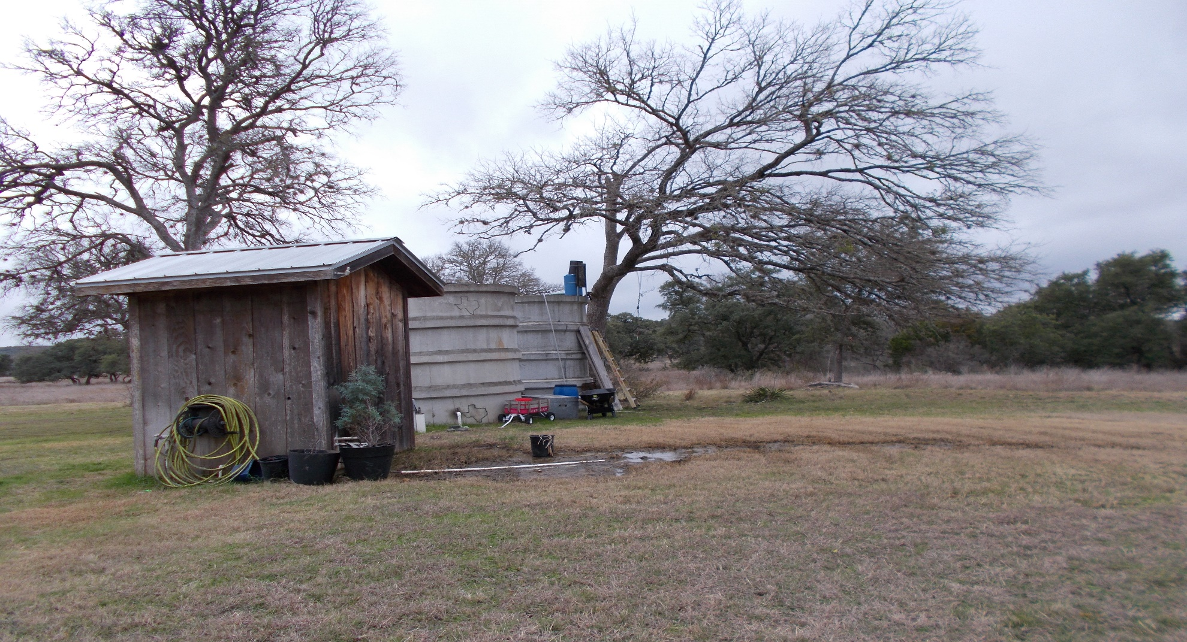
Photograph Log RN110389046 Honey Creek Ranch Wastewater Treatment Facility
Photograph No. 2
Photograph Date: 01/09/2020, taken by Investigator Kimberly Brady.
Description: Well & storage tank at home located east of application field 9

Slide 3
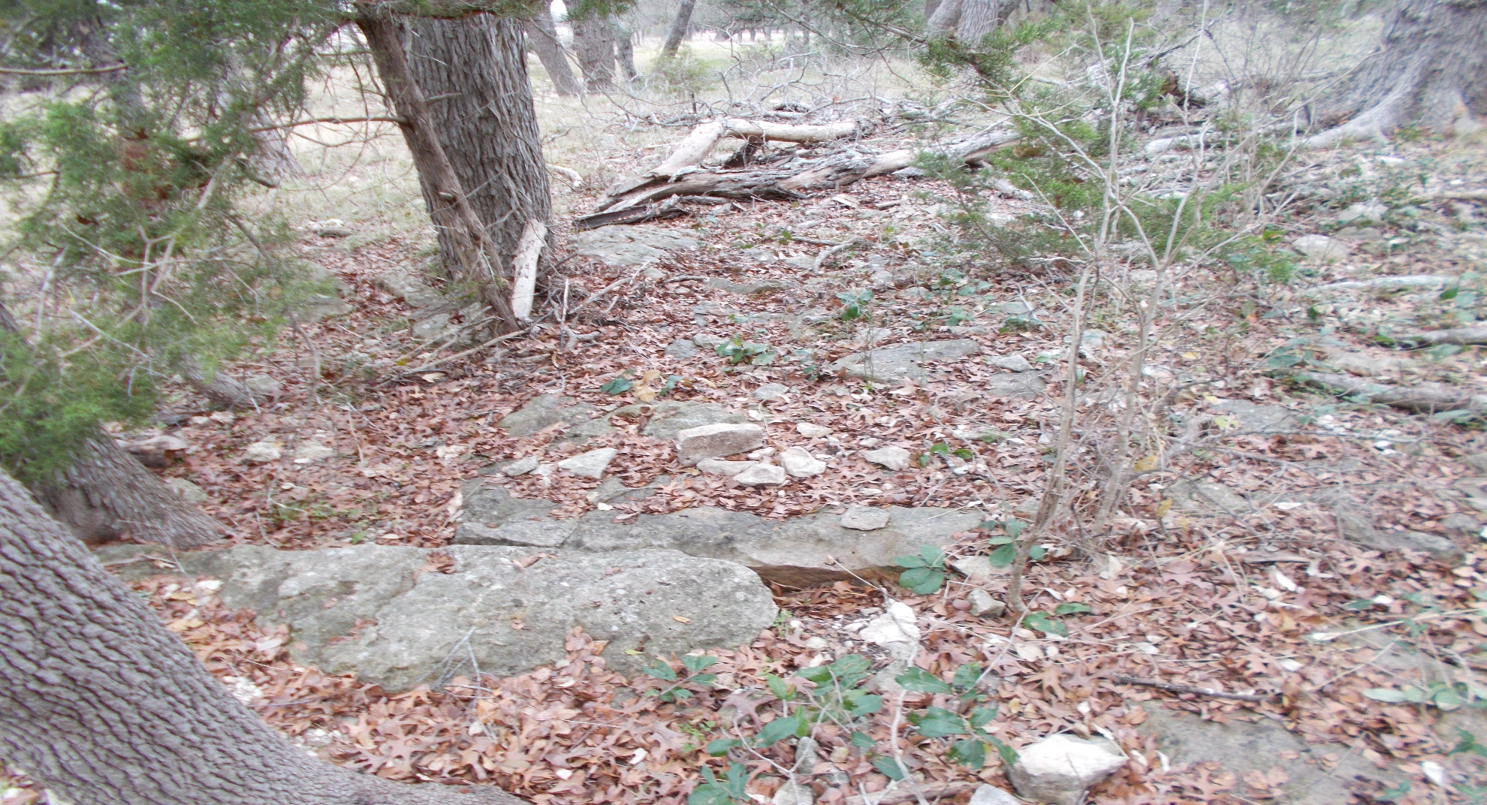
Photograph Log RN110389046 Honey Creek Ranch Wastewater Treatment Facility
Photograph No. 3
Photograph Date: 01/09/2020, taken by Investigator Kimberly Brady.
Description: Feature HC-02 located in buffer zone of field 11

Slide 4
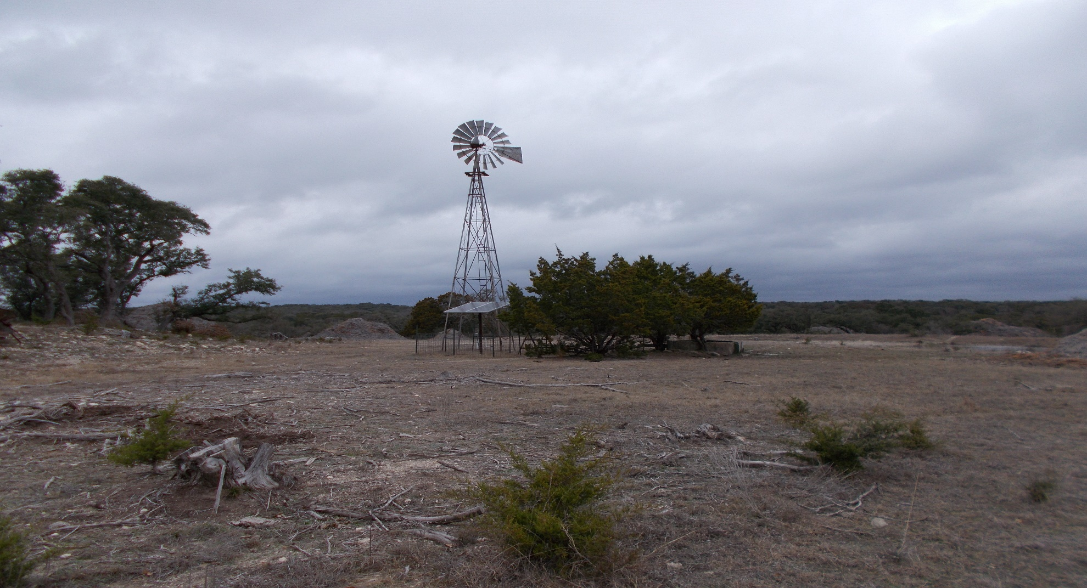
Photograph Log RN110389046 Honey Creek Ranch Wastewater Treatment Facility
Photograph No. 4
Photograph Date: 01/09/2020, taken by Investigator Kimberly Brady.
Description: Livestock well located just northwest of application field 11

Slide 5
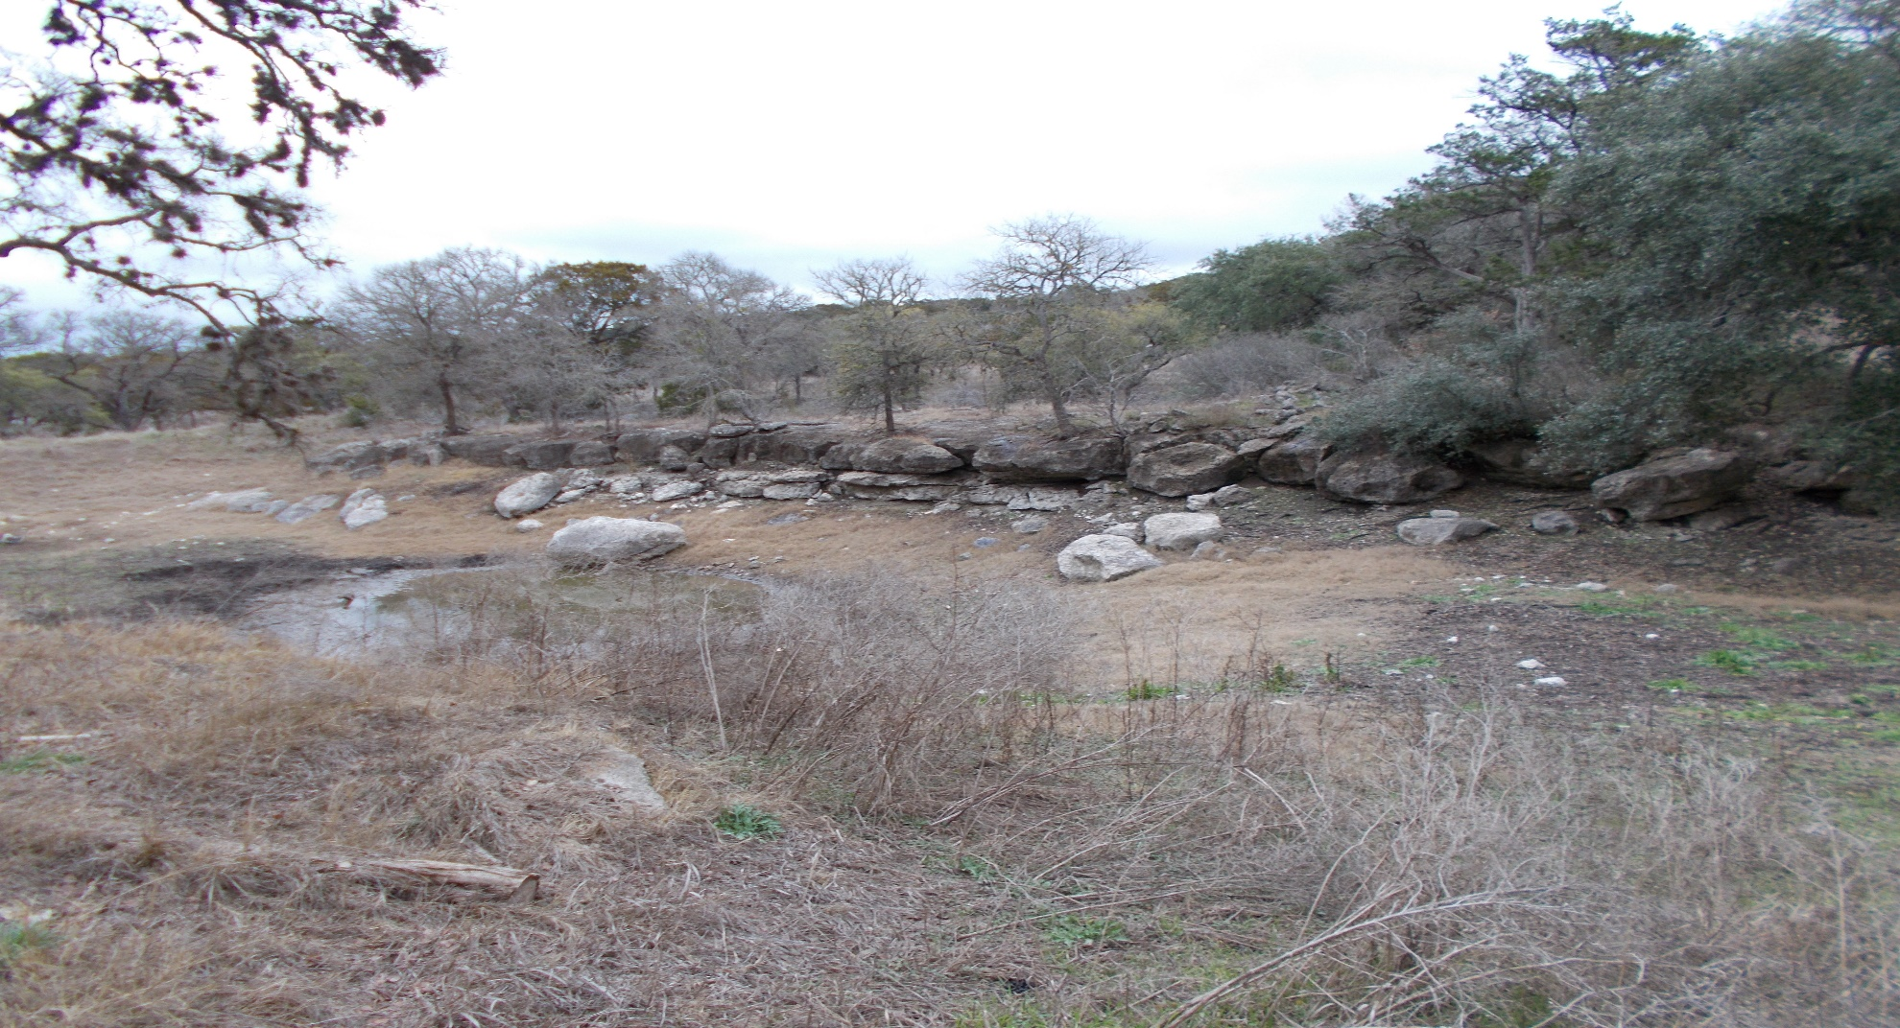
Photograph Log RN110389046 Honey Creek Ranch Wastewater Treatment Facility
Photograph No. 5
Photograph Date: 01/09/2020, taken by Investigator Kimberly Brady.
Description: Pond located in the east portion of application field 11, not listed as feature

Slide 6
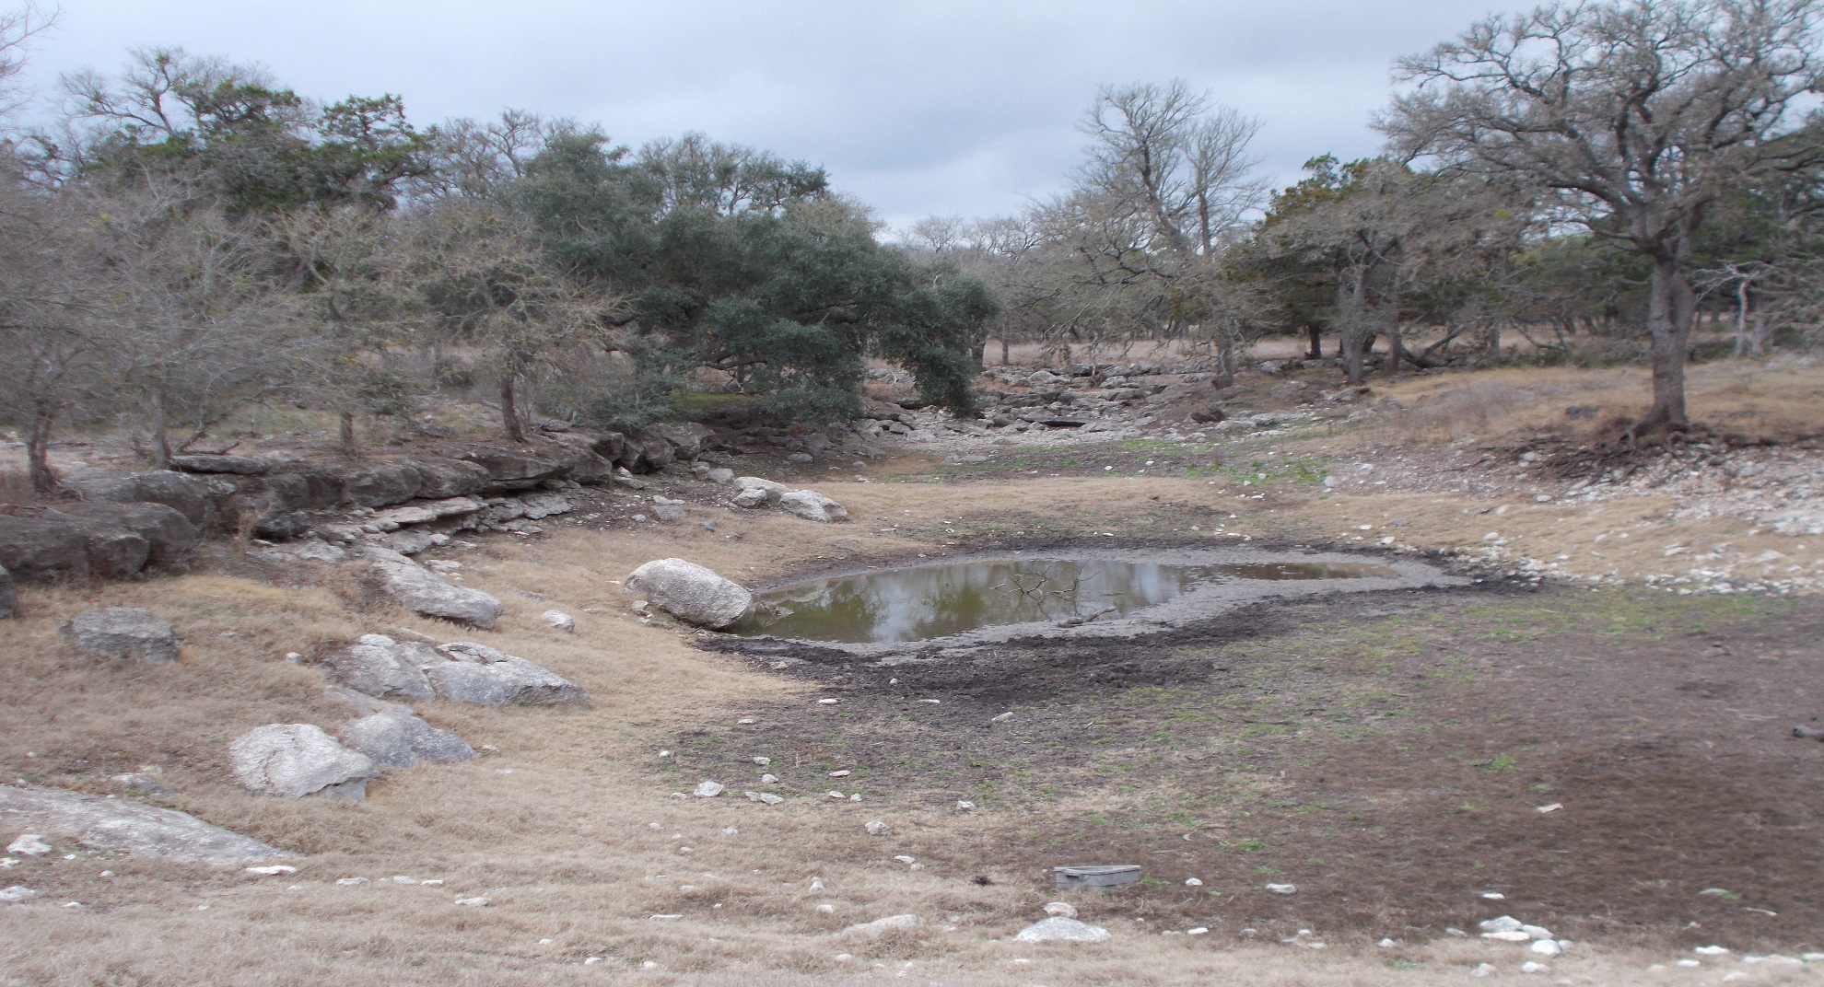
Photograph Log RN110389046 Honey Creek Ranch Wastewater Treatment Facility
Photograph No. 6
Photograph Date: 01/09/2020, taken by Investigator Kimberly Brady.
Description: Pond located in the east portion of application field 11, not listed as feature

Slide 7
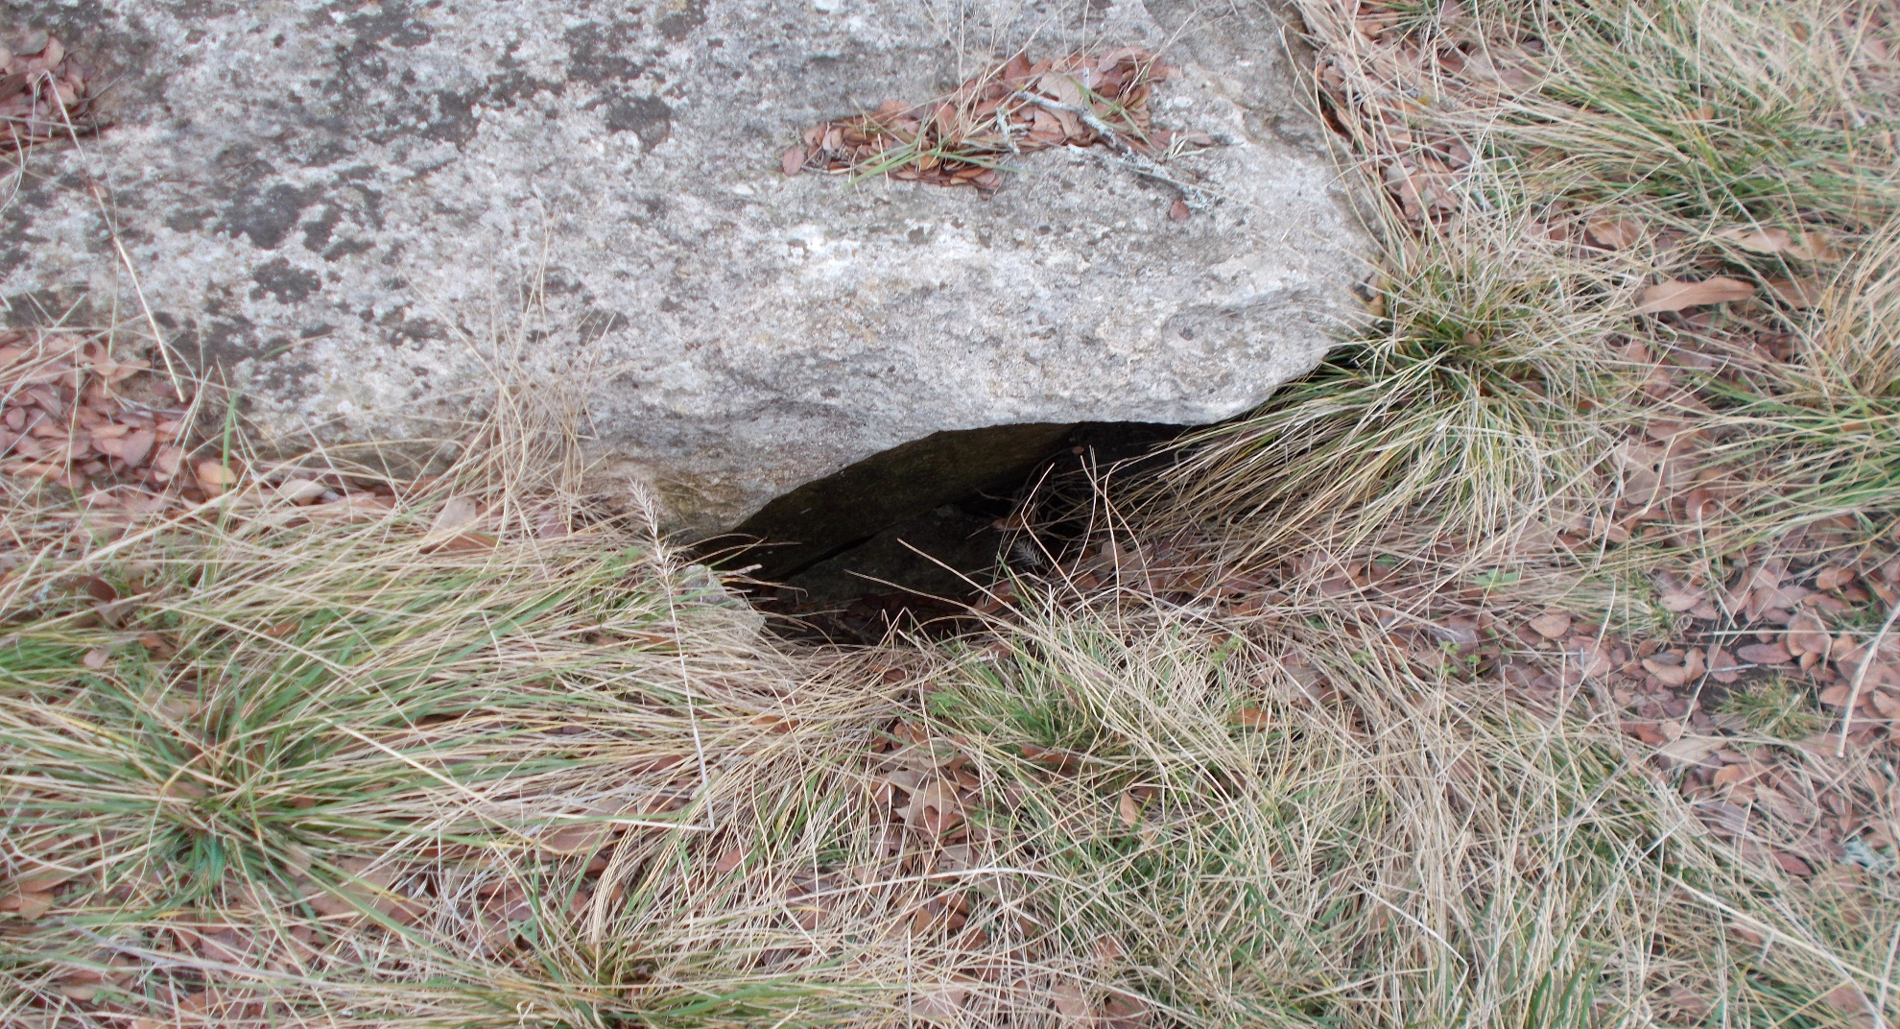
Photograph Log RN110389046 Honey Creek Ranch Wastewater Treatment Facility
Photograph No. 7
Photograph Date: 01/09/2020, taken by Investigator Kimberly Brady.
Description: Feature HC-08, located on east edge of application field 11’s buffer zone

Slide 8
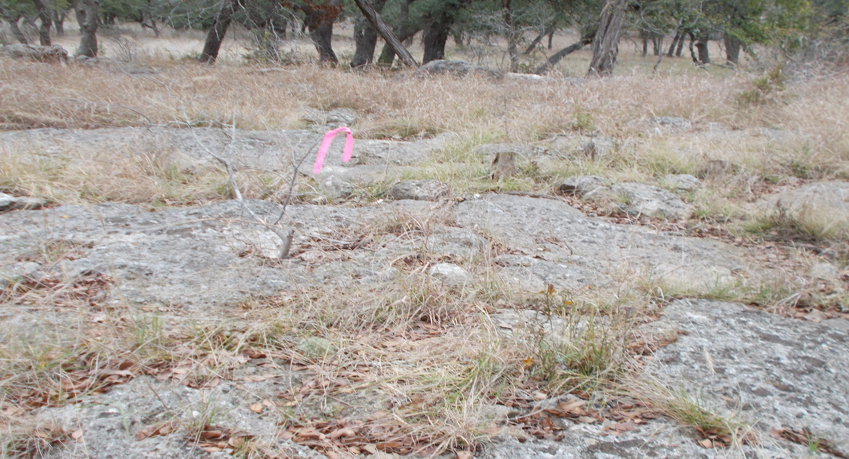
Photograph Log RN110389046 Honey Creek Ranch Wastewater Treatment Facility
Photograph No. 8
Photograph Date: 01/09/2020, taken by Investigator Kimberly Brady.
Description: Feature HC-09, located on east edge of application field 11’s buffer zone

Slide 9
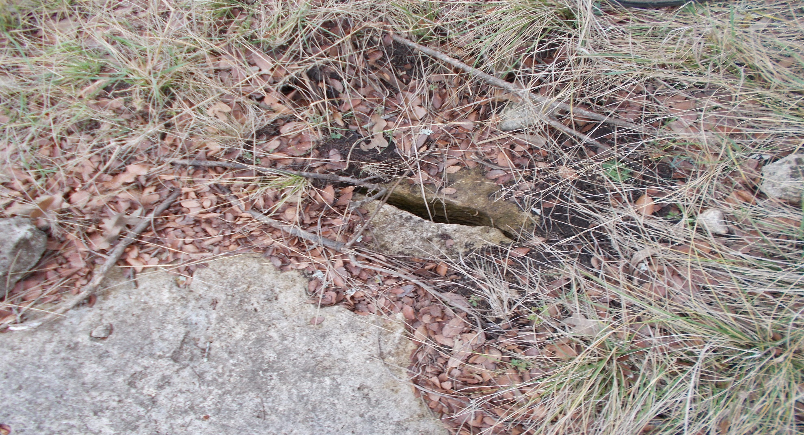
Photograph Log RN110389046 Honey Creek Ranch Wastewater Treatment Facility
Photograph No. 9
Photograph Date: 01/09/2020, taken by Investigator Kimberly Brady.
Description: Feature HC-09, located on east edge of application field 11’s buffer zone

Slide 10
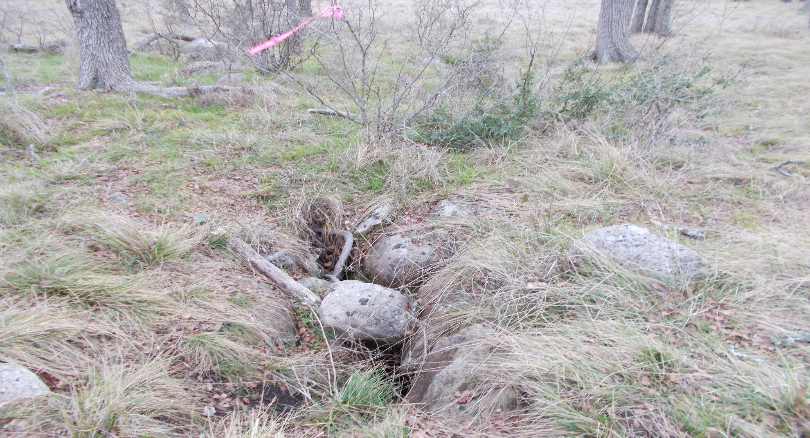
Photograph Log RN110389046 Honey Creek Ranch Wastewater Treatment Facility
Photograph No. 10
Photograph Date: 01/09/2020, taken by Investigator Kimberly Brady.
Description: Possible feature found by investigators during site inspection, located in buffer zone of application field 11. Was labeled HC-20

Slide 11
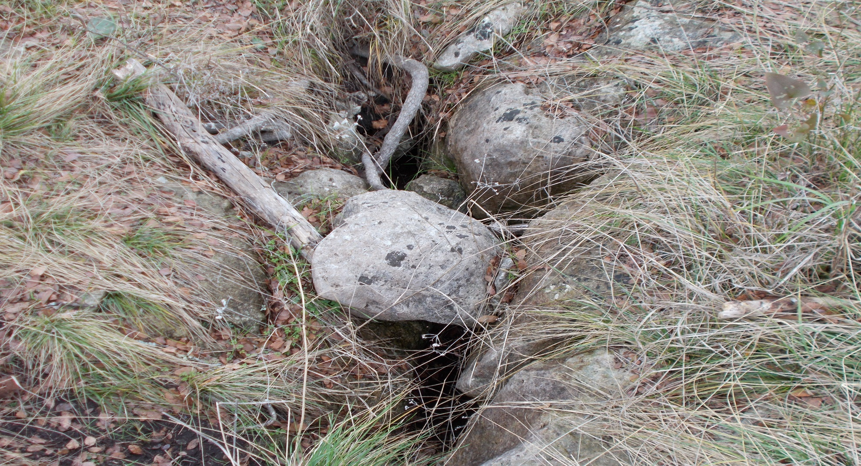
Photograph Log RN110389046 Honey Creek Ranch Wastewater Treatment Facility
Photograph No. 11
Photograph Date: 01/09/2020, taken by Investigator Kimberly Brady.
Description: Possible feature found by investigators during site inspection, located in buffer zone of application field 11. The consultant added pink tape and labeled this possible feature as HC-20.

Slide 12
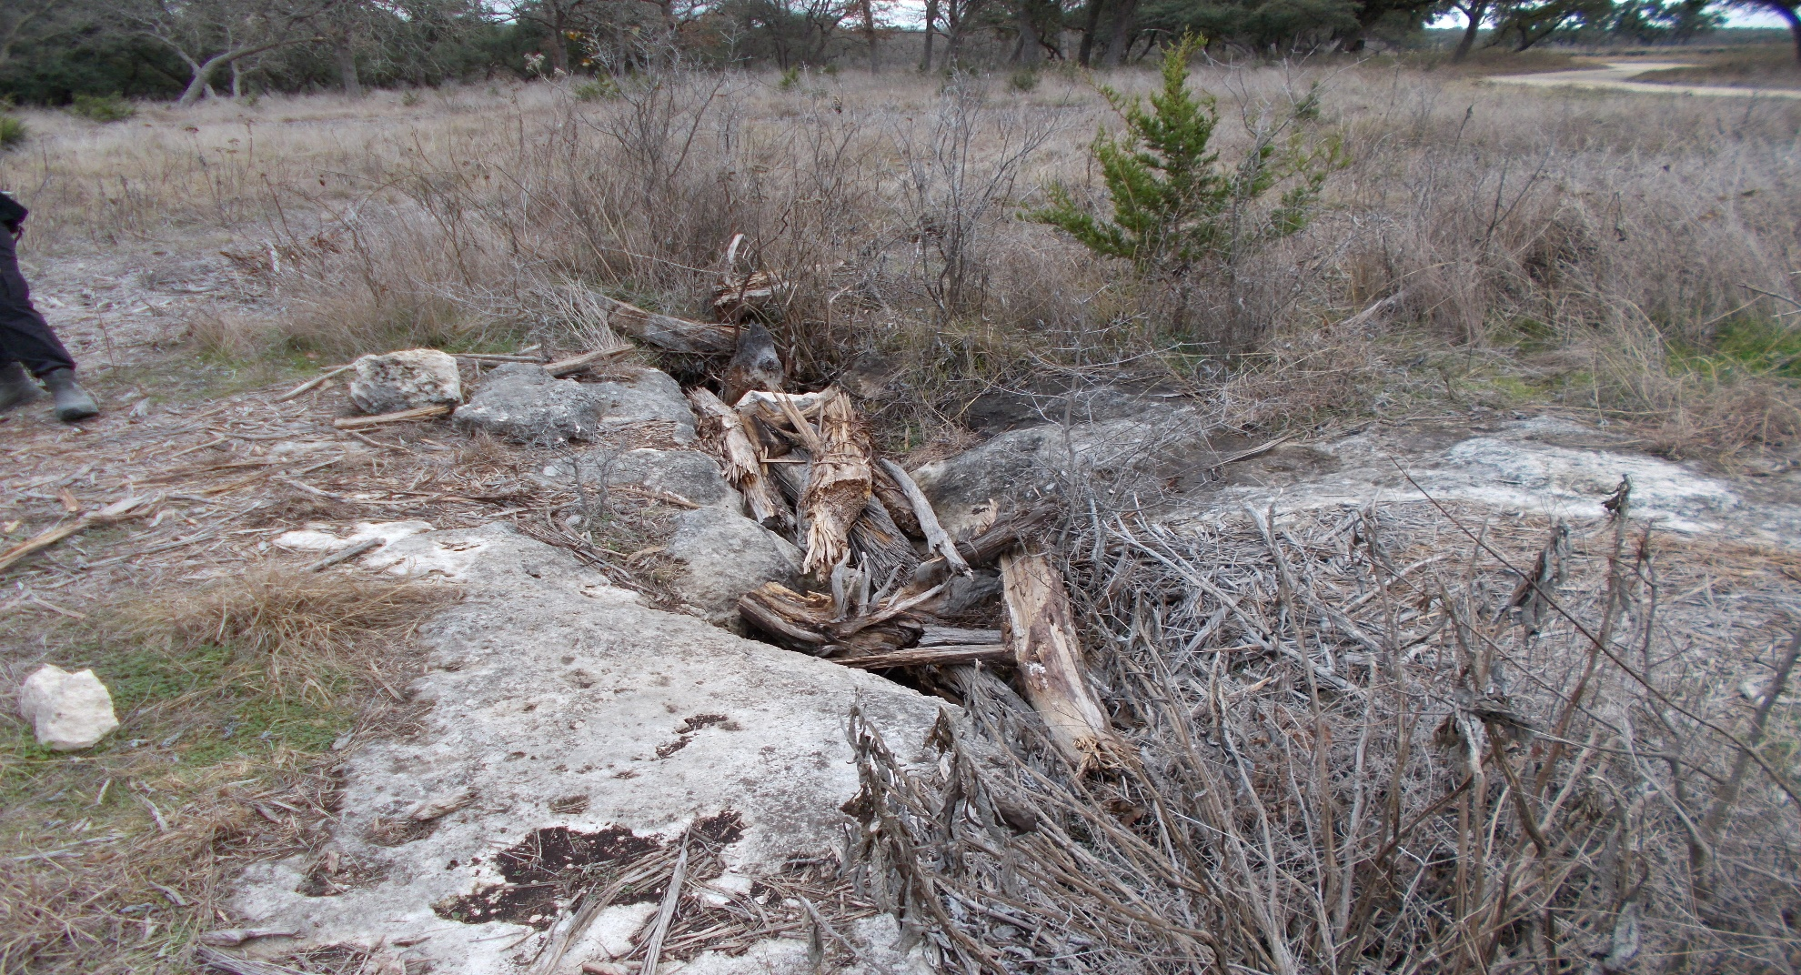
Photograph Log RN110389046 Honey Creek Ranch Wastewater Treatment Facility
Photograph No. 12
Photograph Date: 01/09/2020, taken by Investigator Kimberly Brady.
Description: Feature HC-011 A located in buffer on north-east side of application field 11

Slide 13
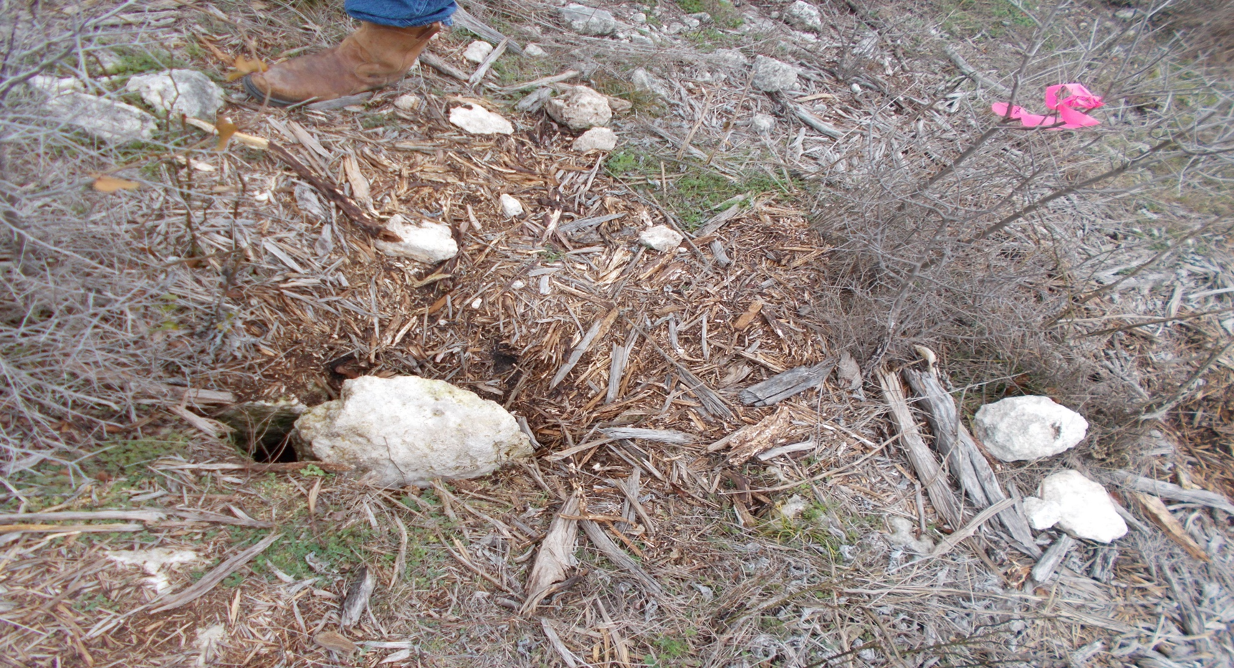
Photograph Log RN110389046 Honey Creek Ranch Wastewater Treatment Facility
Photograph No. 13
Photograph Date: 01/09/2020, taken by Investigator Kimberly Brady.
Description: Feature HC-011 B located in buffer on north-east side of application field 11

Slide 14
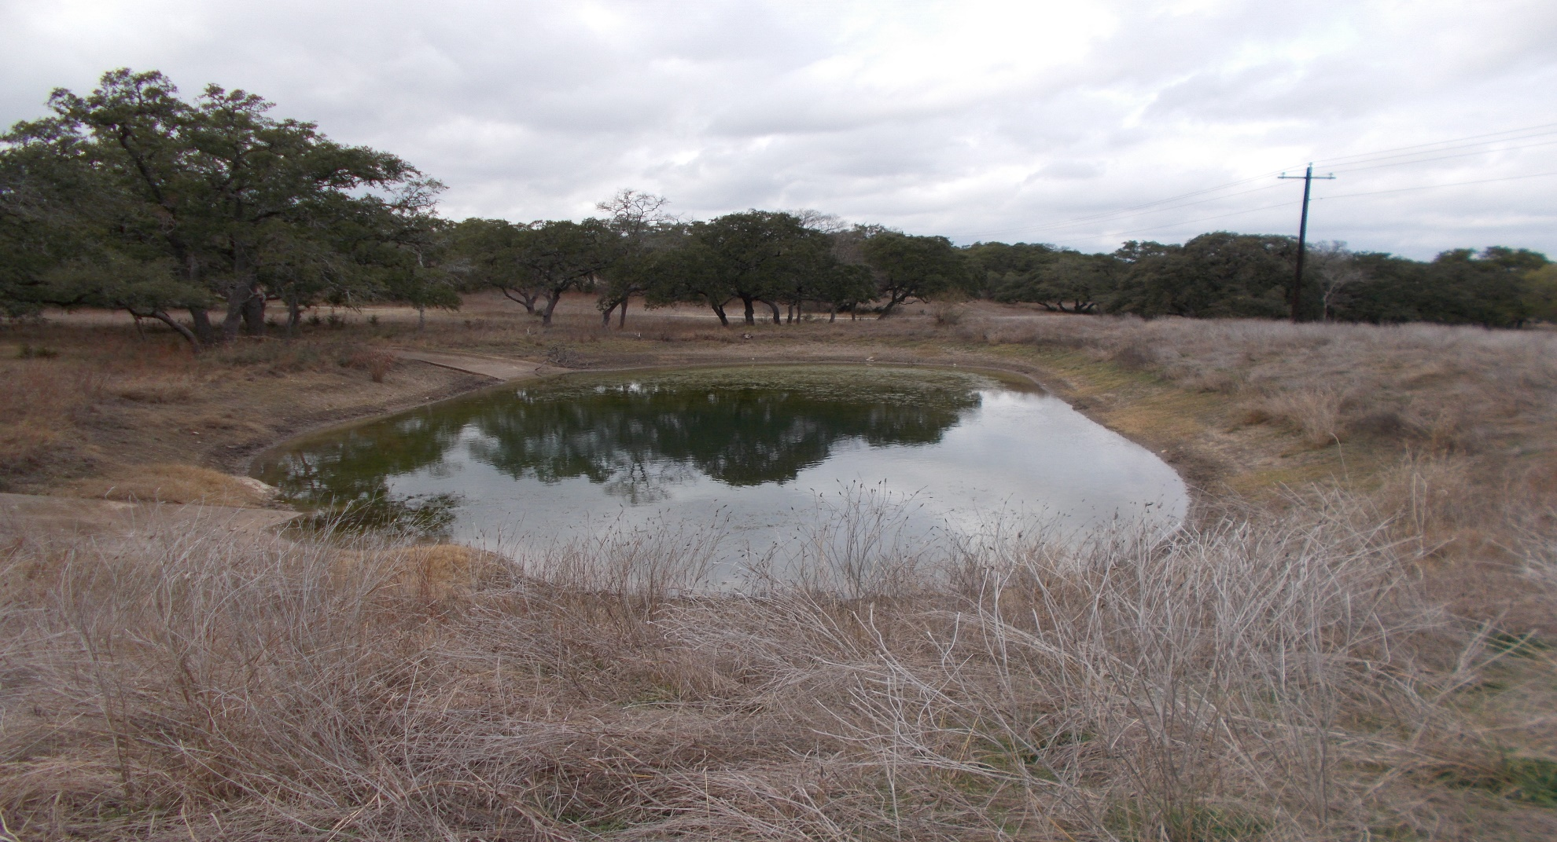
Photograph Log RN110389046 Honey Creek Ranch Wastewater Treatment Facility
Photograph No. 14
Photograph Date: 01/09/2020, taken by Investigator Kimberly Brady.
Description: Pond located between application fields 5 and 3

Slide 15
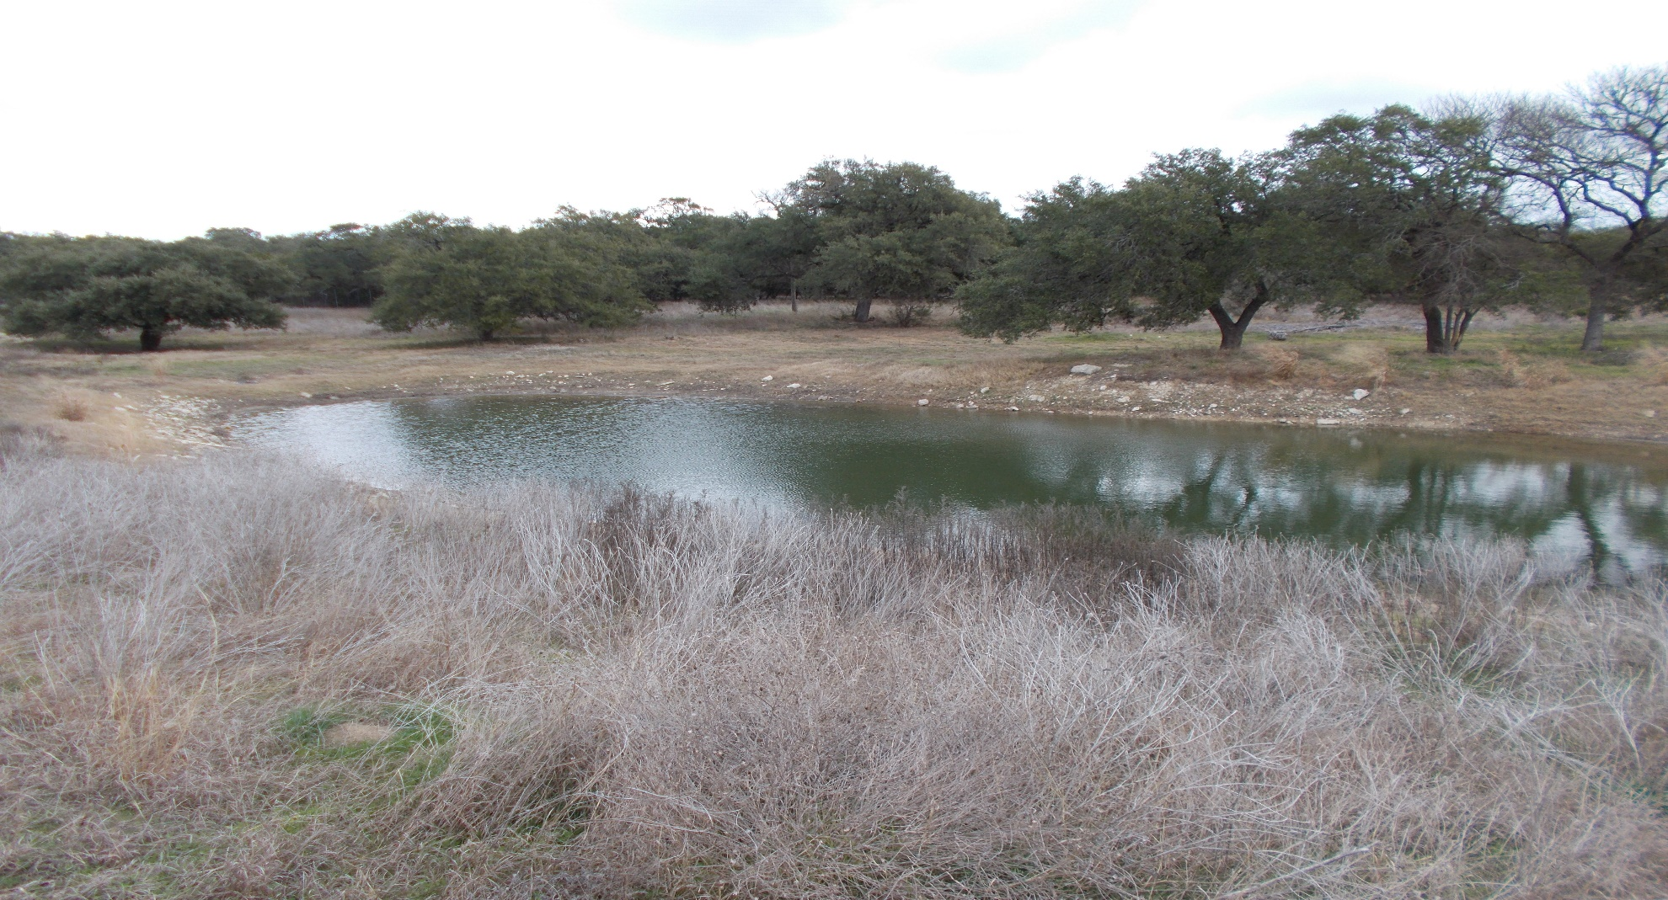
Photograph Log RN110389046 Honey Creek Ranch Wastewater Treatment Facility
Photograph No. 15
Photograph Date: 01/09/2020, taken by Investigator Kimberly Brady.
Description: Pond on south-east edge of application field 5

Slide 16
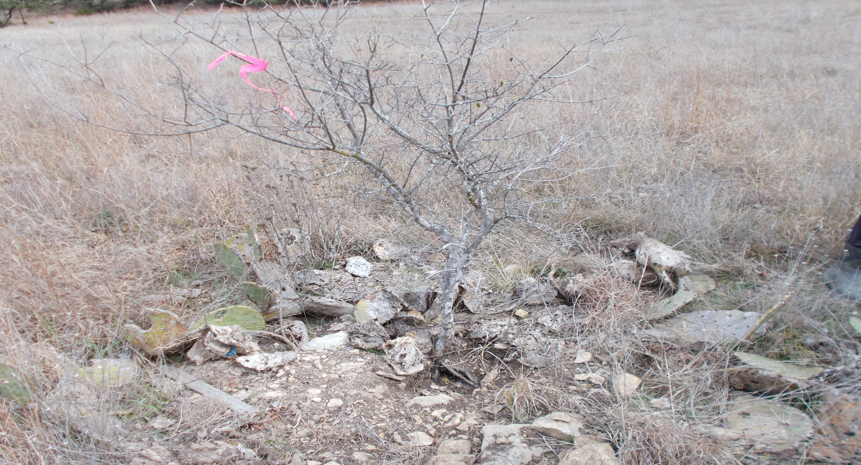
Photograph Log RN110389046 Honey Creek Ranch Wastewater Treatment Facility
Photograph No. 16
Photograph Date: 01/09/2020, taken by Investigator Kimberly Brady.
Description: HC-16, a feature but not a sensitive feature located between application fields 5 and 3

Slide 17
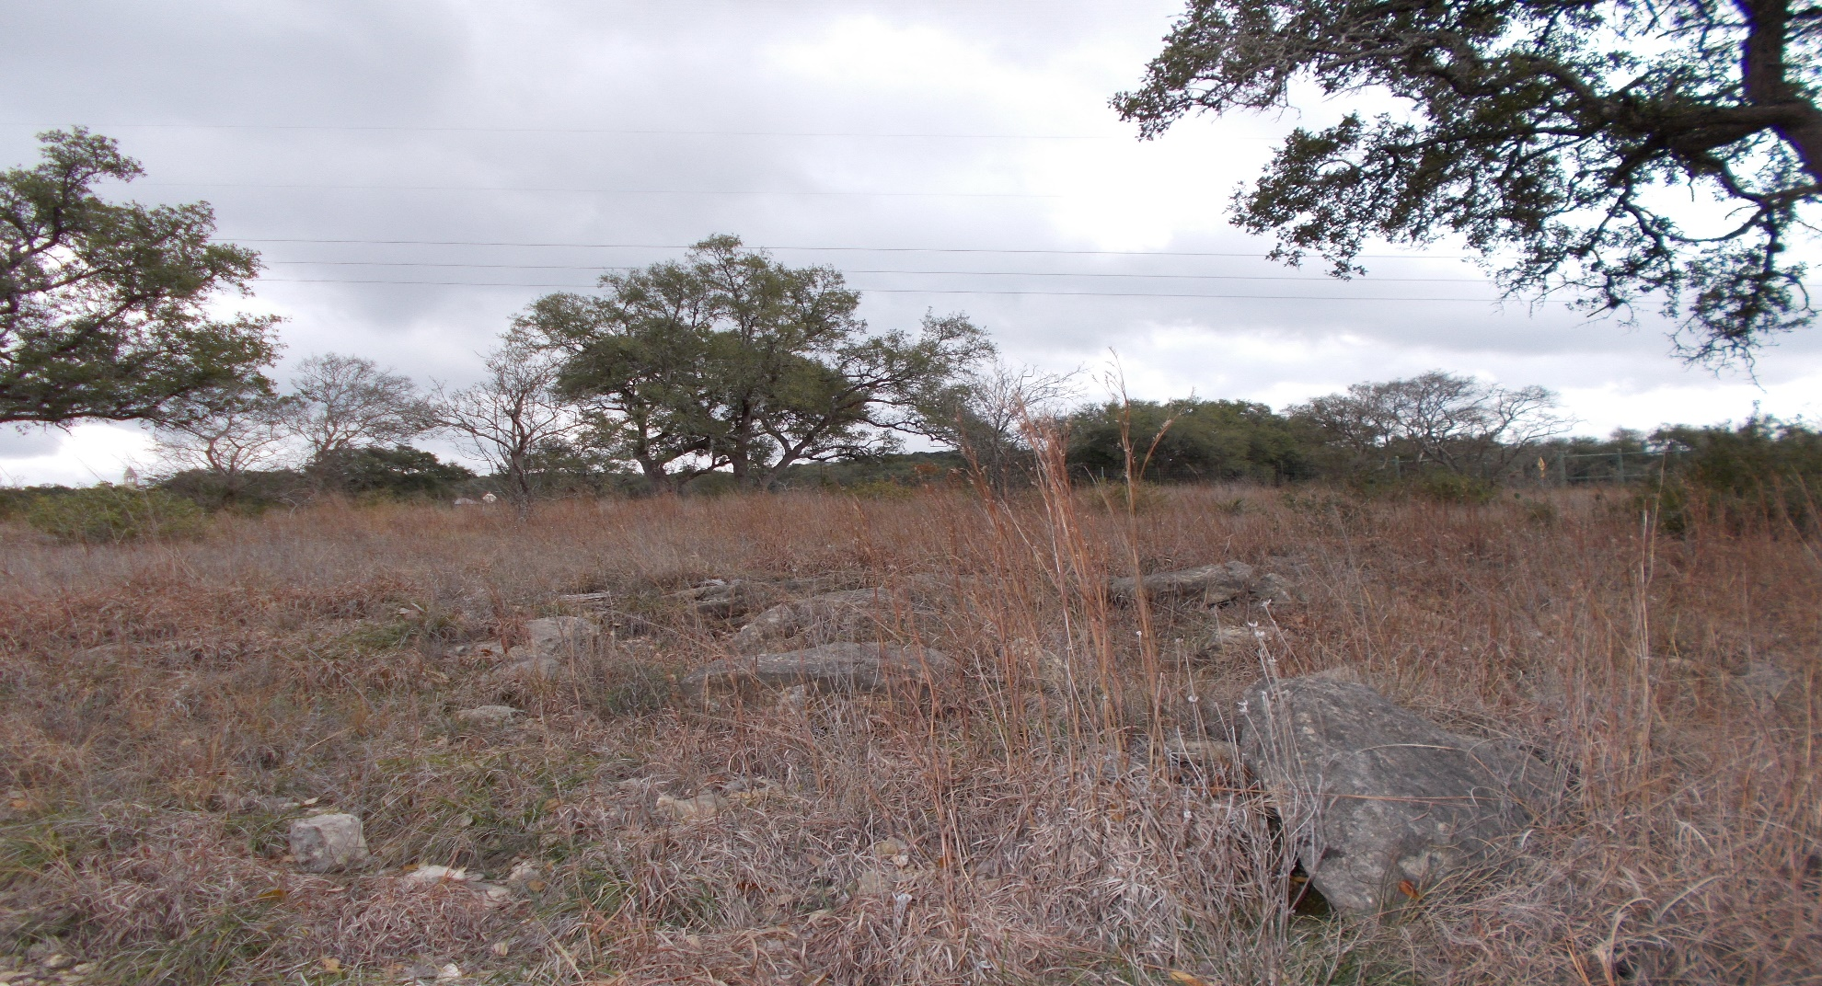
Photograph Log RN110389046 Honey Creek Ranch Wastewater Treatment Facility
Photograph No. 17
Photograph Date: 01/09/2020, taken by Investigator Kimberly Brady.
Description: Rocky outcrop of limestone located in application field 4, Highway 46 in the background

Slide 18
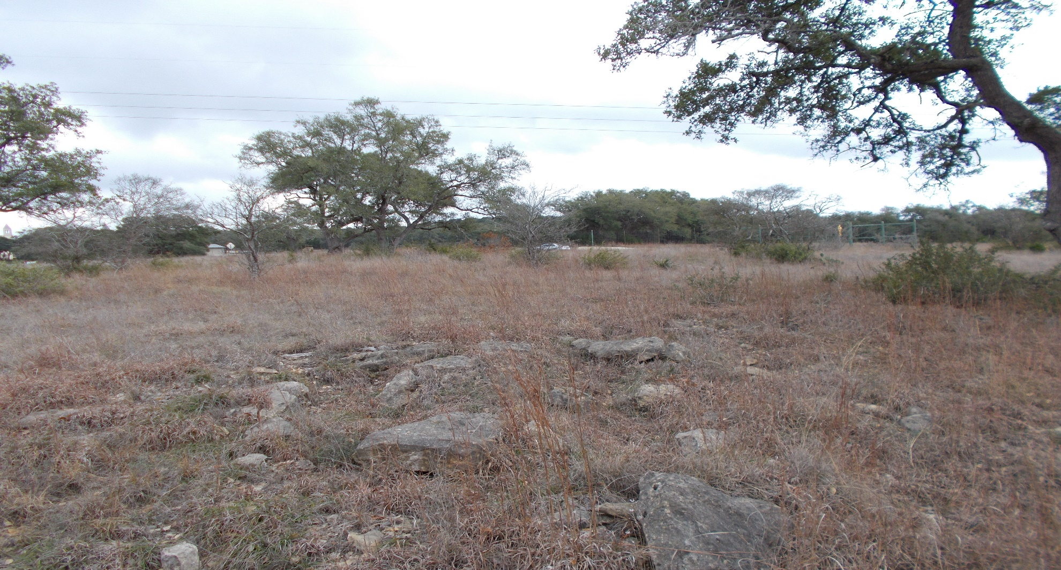
Photograph Log RN110389046 Honey Creek Ranch Wastewater Treatment Facility
Photograph No. 18
Photograph Date: 01/09/2020, taken by Investigator Kimberly Brady.
Description: Rocky outcrop of limestone located in application field 4, Highway 46 in the background

Slide 19
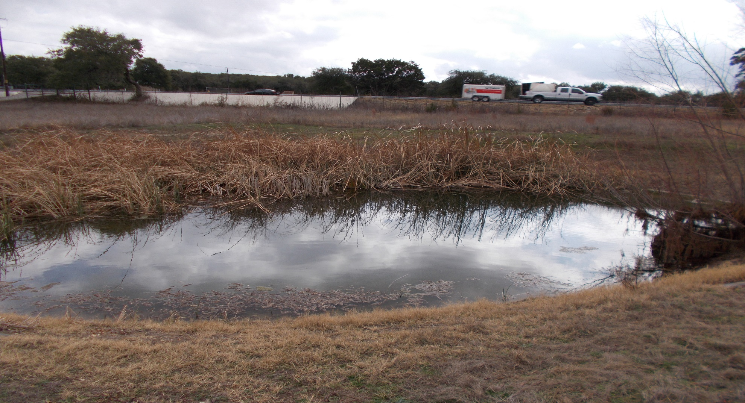
Photograph Log RN110389046 Honey Creek Ranch Wastewater Treatment Facility
Photograph No. 19
Photograph Date: 01/09/2020, taken by Investigator Kimberly Brady.
Description: Pond at the south-east end of application field 4, located half in and half out of the buffer zone

Slide 20
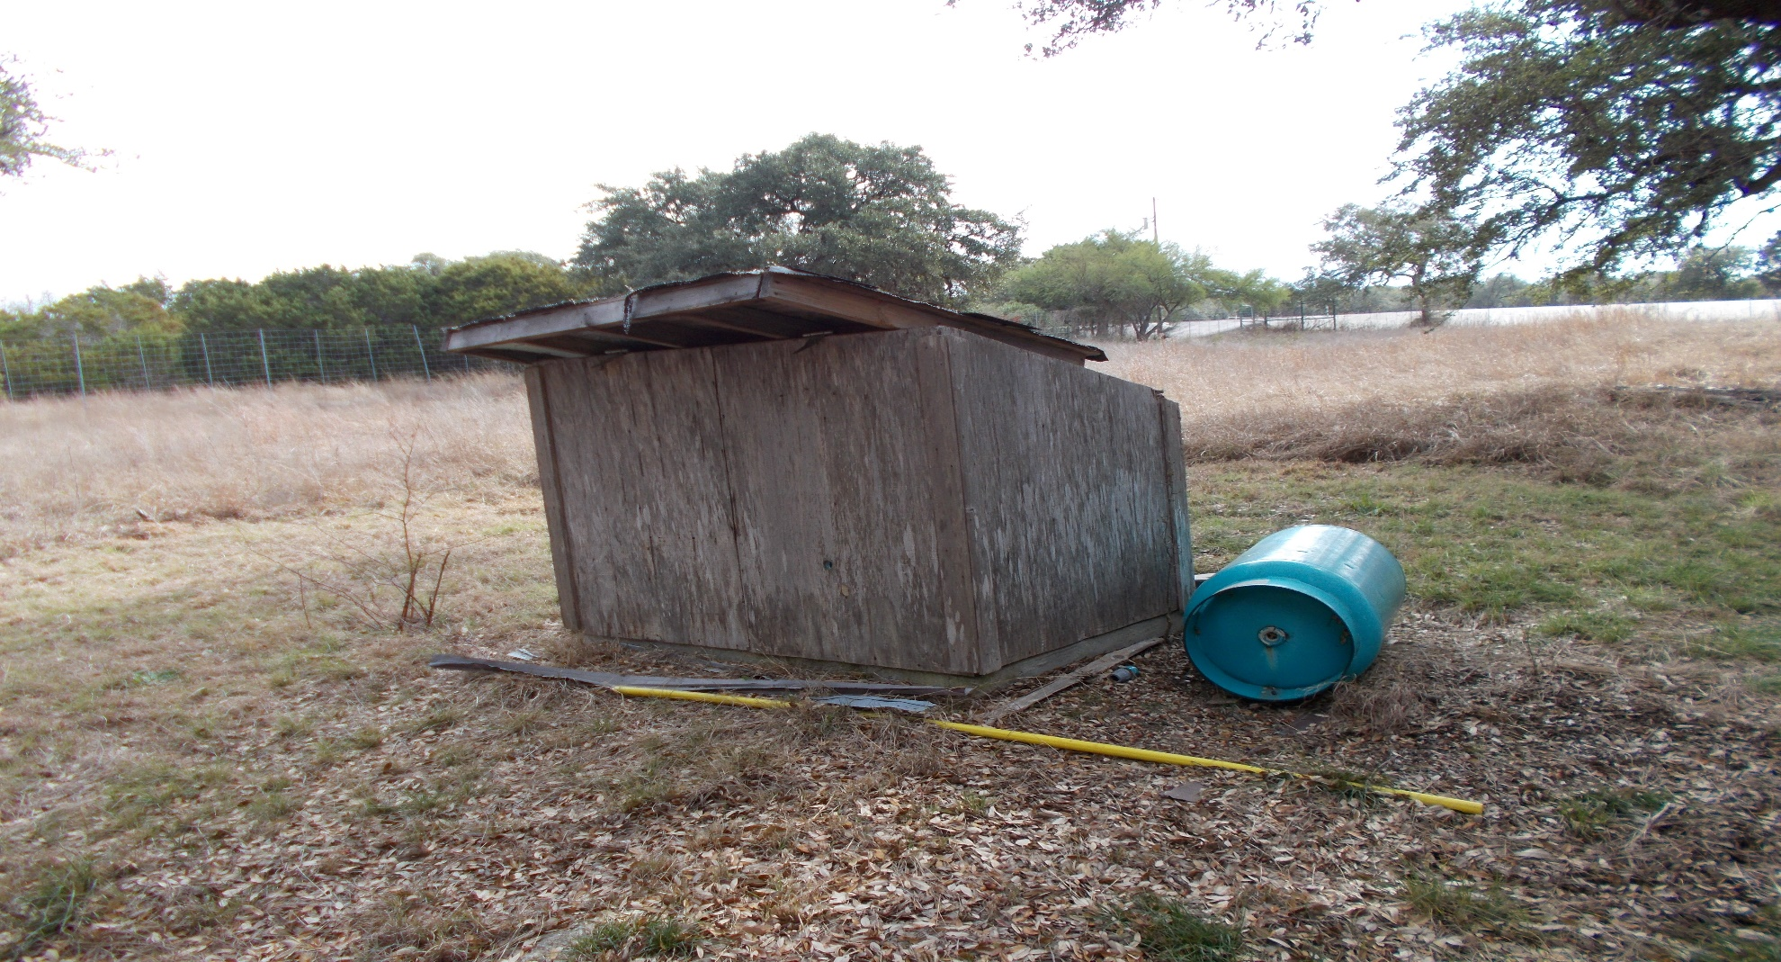
Photograph Log RN110389046 Honey Creek Ranch Wastewater Treatment Facility
Photograph No. 20
Photograph Date: 01/09/2020, taken by Investigator Kimberly Brady.
Description: : Possible well located in the south-east corner of field 4, slightly north of pond.

Slide 21
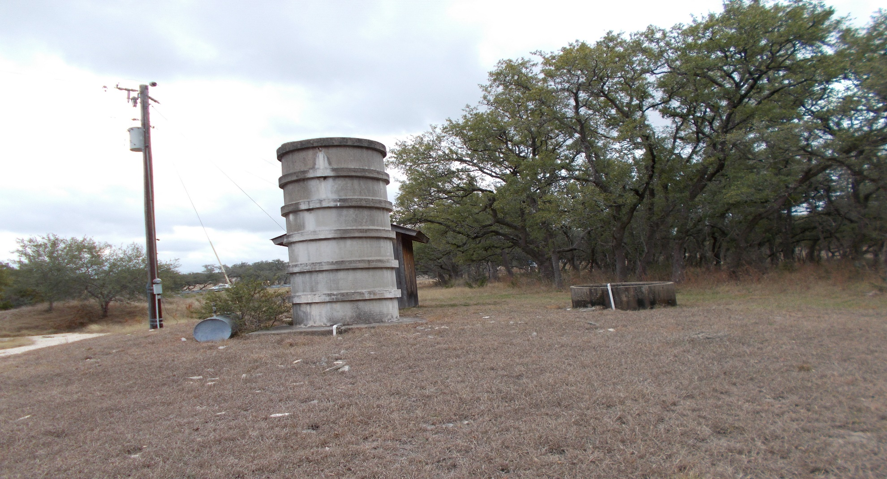
Photograph Log RN110389046 Honey Creek Ranch Wastewater Treatment Facility
Photograph No. 21
Photograph Date: 01/09/2020, taken by Investigator Kimberly Brady.
Description: Well located on south-east edge of application field 2.

Slide 22
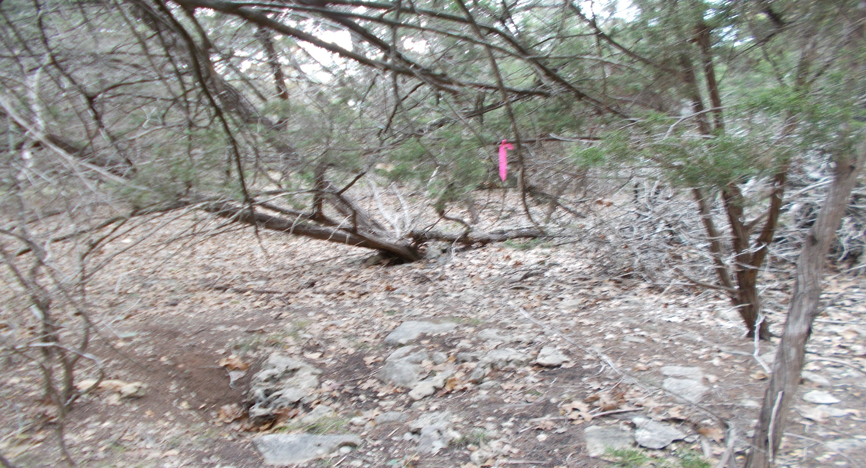
Photograph Log RN110389046 Honey Creek Ranch Wastewater Treatment Facility
Photograph No. 22
Photograph Date: 01/09/2020, taken by Investigator Kimberly Brady.
Description: Feature HC-17 located in application field 1, possibly made by an animal

