Slide 1
Importance of the Contributing Zone when Protecting the Edwards Aquifer
Bexar Audubon Society
Ronald T. Green, Ph.D., P.G.
Southwest Research Institute®
July 22, 2020

Slide 2
Edwards Aquifer Protection Plan
Background

Slide 3
City of San Antonio Edwards Aquifer Protection Program
Residents of San Antonio have passed four propositions:
Proposition 3: 2000: 1/8 cent sales tax ($45M) to buy sensitive properties over Edwards Aquifer Recharge Zone in Bexar County, established SET and CAB
Proposition 1: 2005: 1/8 cent sales tax ($90M) continuation, added other counties
Proposition 1: 2010: 1/8 cent sales tax ($90M) continuation
Proposition 1: 2015: 1/8 cent sales tax ($90M+10M) continuation, add $10M for Demonstrations Projects within Bexar County
Future ?????

Slide 4
How are properties identified and acquired in EAPP?
Scientific Evaluation Team (SET)
Conservation Advisory
Board (CAB)
COSA City Council
Land Acquisition
Team (LAT)

Slide 5
City of San Antonio Edwards Aquifer Protection Program
Scientific Evaluation Team (SET): scientific experts prioritize properties based on their environmental characteristics to achieve maximum value for voter-approved dollars. → SET Model

Slide 6
City of San Antonio Edwards Aquifer Protection Program
Land Acquisition Team (LAT) visits properties identifying that may be considered for the conservation easement program.

Slide 7
City of San Antonio Edwards Aquifer Protection Program
Conservation Advisory Board (CAB) Takes all information, including SET Model and makes decision on which properties to protect by purchase or conservation easement.
Makes recommendation to COSA City Council

Slide 8
City of San Antonio Edwards Aquifer Protection Program
COSA City Council votes whether to approve CAB recommendation

Slide 9
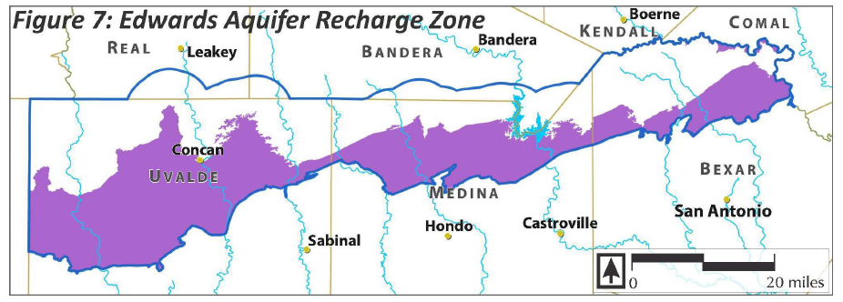
Mostly Exclusive to the Edwards Aquifer Recharge Zone: Limited Extension into the Contributing Zone

Slide 10
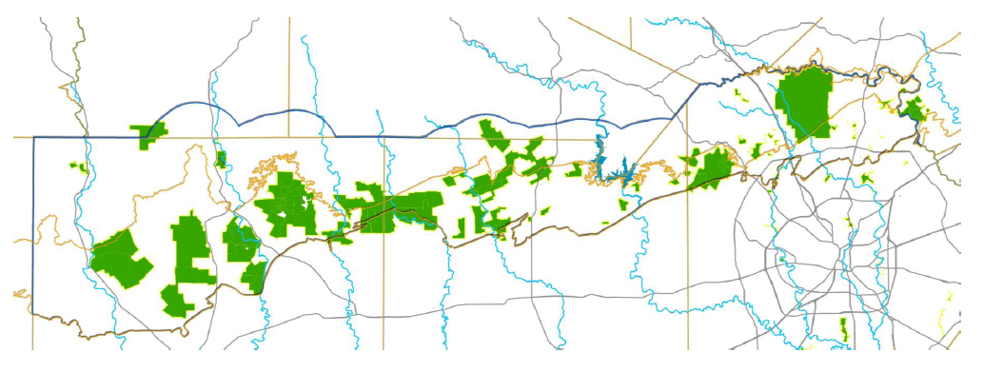
Properties Protected by the Edwards Aquifer Protection Plan (EAPP)

Slide 11
City of San Antonio Edwards Aquifer Protection Program
Contentious Debate on the EAPP

Slide 12
City of San Antonio Edwards Aquifer Protection Program
Contentious Debate on the EAPP
Has the EAPP done all it was meant to do?

Slide 13
City of San Antonio Edwards Aquifer Protection Program
Contentious Debate on the EAPP
Has the EAPP done all it was meant to do?
Is there more that the EAPP should do?

Slide 14
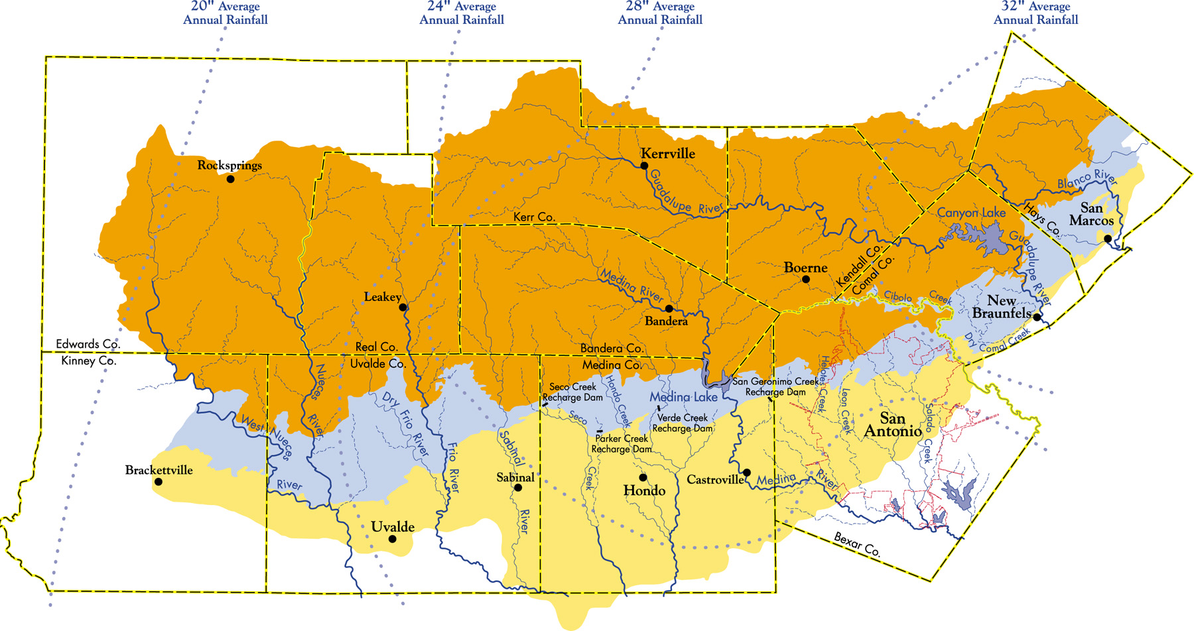
Edwards Aquifer
Source: Edwards Aquifer Authority 2008

Slide 15
Edwards Aquifer
Contributing Zone
Recharge Zone
Confined Zone
Source: Edwards Aquifer Authority 2008

Slide 16
The Real Question
How important is protecting the Edwards Aquifer Contributing Zone to protecting the quality of recharge to the Edwards Aquifer?

Slide 17
Answer
If the Contributing Zone is (critically) important to protecting the recharge to the Edwards Aquifer…

Slide 18
Answer
If the Contributing Zone is (critically) important to protecting the recharge to the Edwards Aquifer…
…then if you aren’t protecting the Contributing Zone, you aren’t protecting the Edwards Aquifer

Slide 19
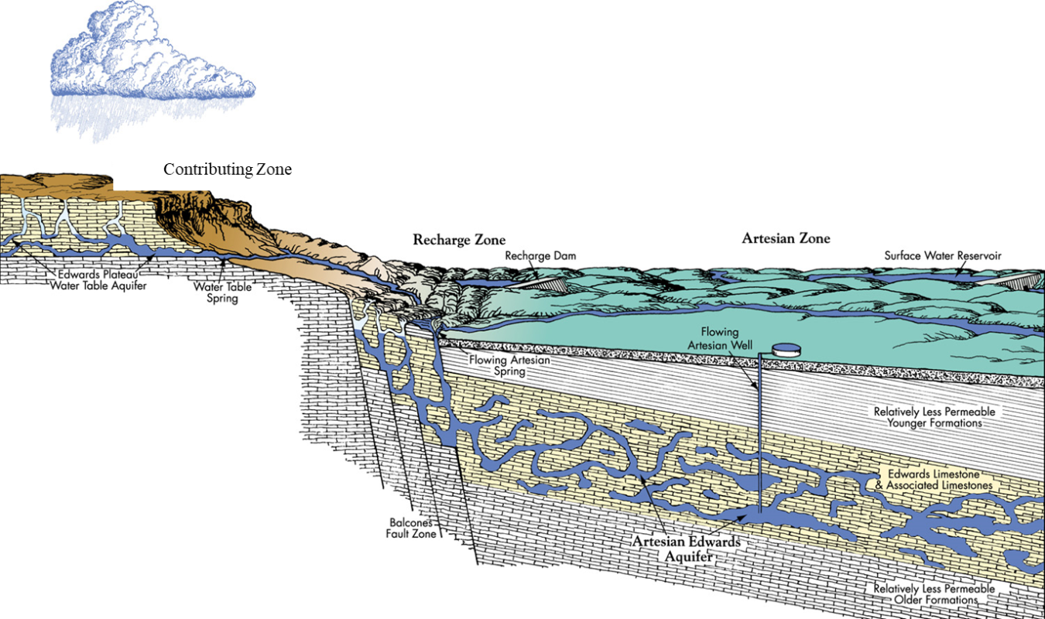
Edwards Aquifer
Conventional Conceptualization
Source: Edwards Aquifer Authority 2008

Slide 20
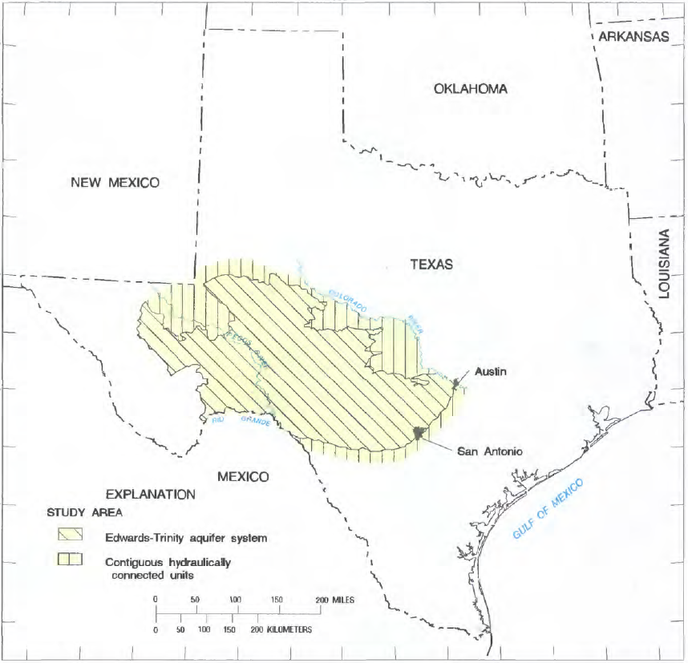
The Edwards Plateau Was Formed by Sea Sediments that Solidified Then Lifted Over 10s of Millions of Years

Slide 21
Edwards Aquifer
Conventional Conceptualization
Source: Edwards Aquifer Authority 2008

Slide 22
Autogenic Recharge (Derived from Within)
Contributing Zone
Recharge Zone
Confined Zone

Slide 23
Allogenic Recharge (Derived from Yonder)
Contributing Zone
Recharge Zone
Confined Zone

Slide 24
Allogenic + Autogenic Recharge (Derived from Within and from Yonder)
Contributing Zone
Recharge Zone
Confined Zone

Slide 25
Allogenic + Autogenic Recharge (Derived from Within and from Yonder)
Conventional
Conceptualization
Contributing Zone
Recharge Zone
Confined Zone

Slide 26
There is considerable evidence that the
Contributing Zone is way more important than previously believed

Slide 27
There is considerable evidence that the
Contributing Zone is way more important than previously believed
A quick demonstration…Helotes Creek watershed

Slide 28
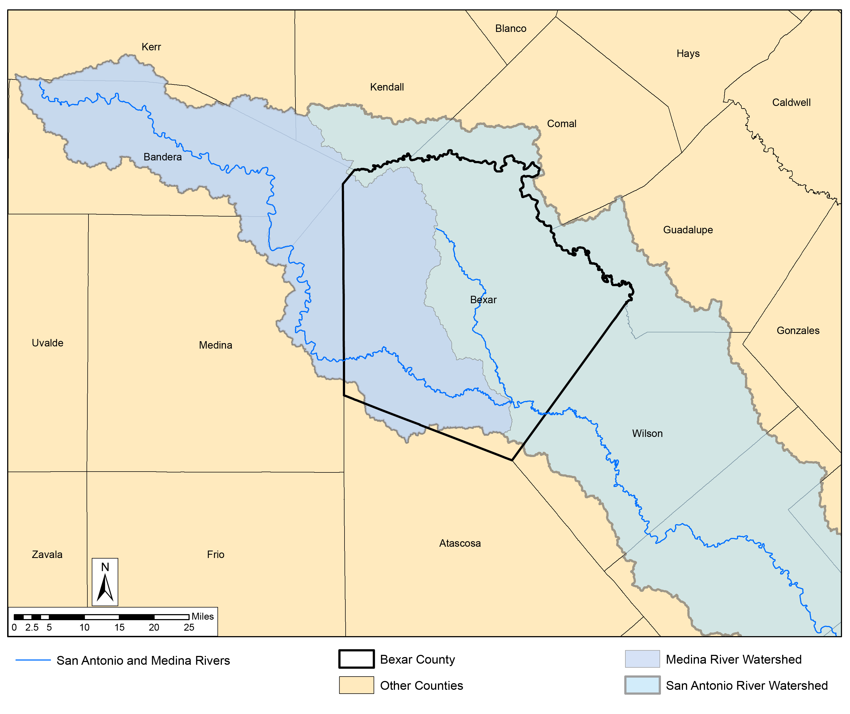
Medina River
Watershed
San Antonio River
Watershed

Slide 29
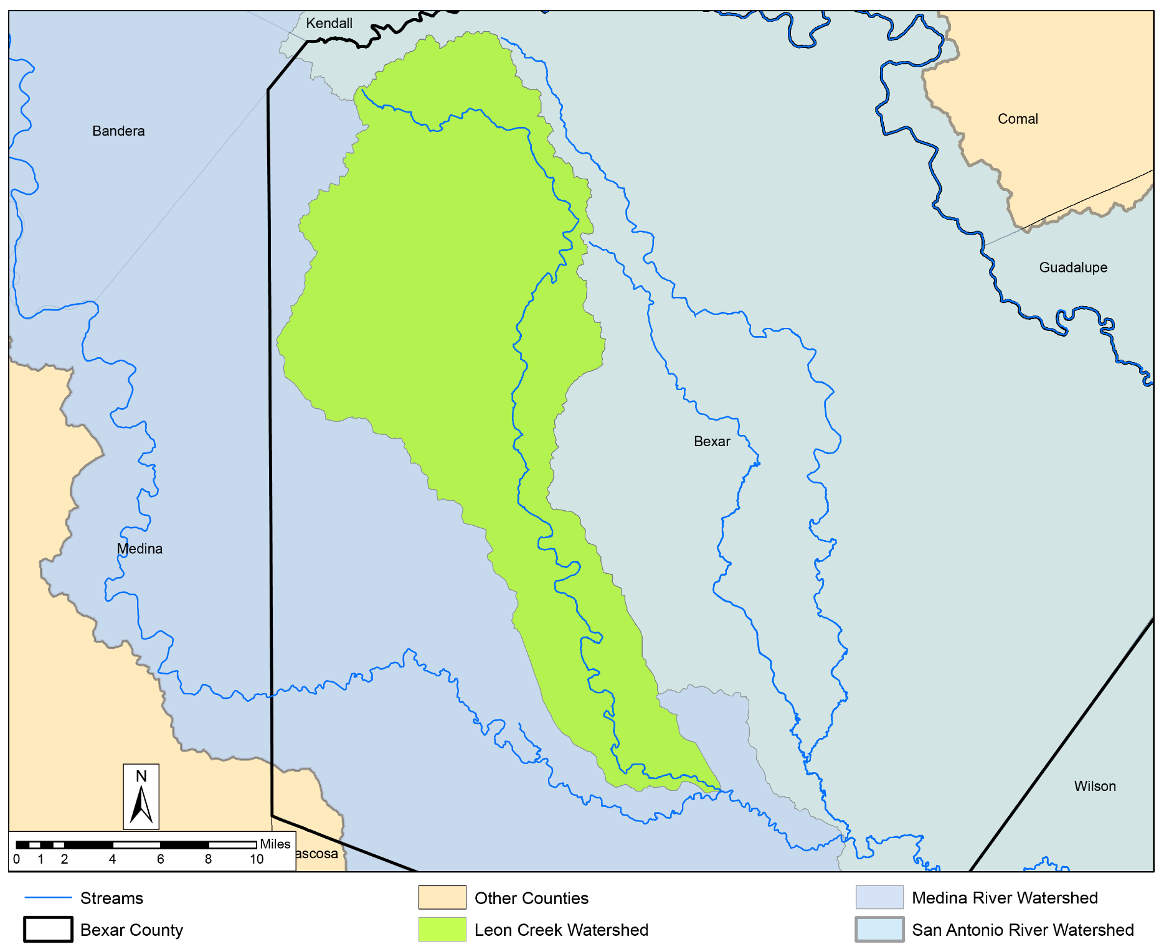
Leon Creek
Watershed

Slide 30
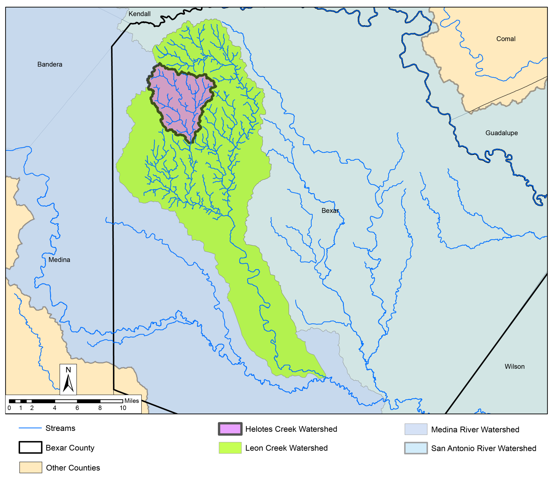
Helotes Creek
Watershed

Slide 31
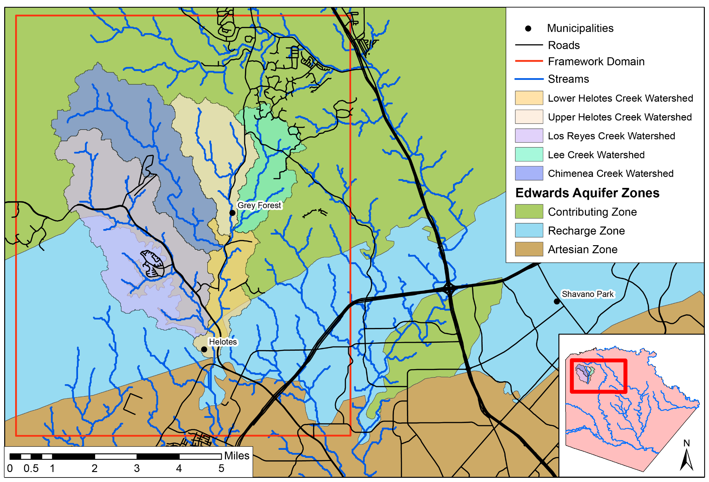
Contributing
Zone
I-10
Recharge
Zone
1604
Artesian
Zone
Hwy 16

Slide 32
Conducted Gain/Loss Study of Helotes Creek

Slide 33
Lower Helotes Creek Sub-Basin
Helotes Creek
Chimenia
Creek
Lee Creek
Edwards Aquifer
Contributing Zone
Los Reyes
Creek
0.94 cfs
3.05 cfs
2.47 cfs
4.24 cfs
1.06 cfs
0.00 cfs
Edwards Aquifer
Recharge Zone
Helotes Creek

Slide 34
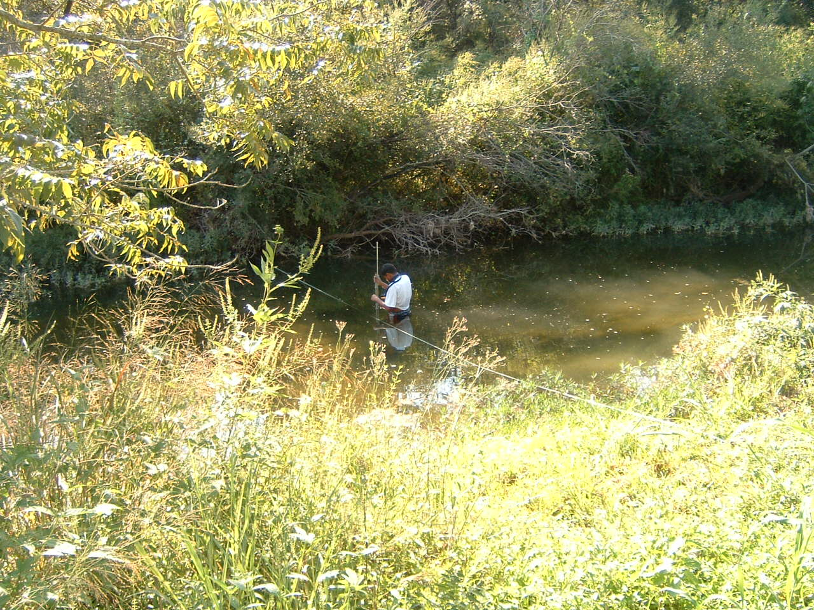
Lower Helotes Creek Sub-Basin
Helotes Creek Contributing Zone
Helotes Creek
Chimenia
Creek
Lee Creek
Edwards Aquifer
Contributing Zone
Los Reyes
Creek
0.94 cfs
3.05 cfs
2.47 cfs
4.24 cfs
1.06 cfs
0.00 cfs
Edwards Aquifer
Recharge Zone
Helotes Creek

Slide 35
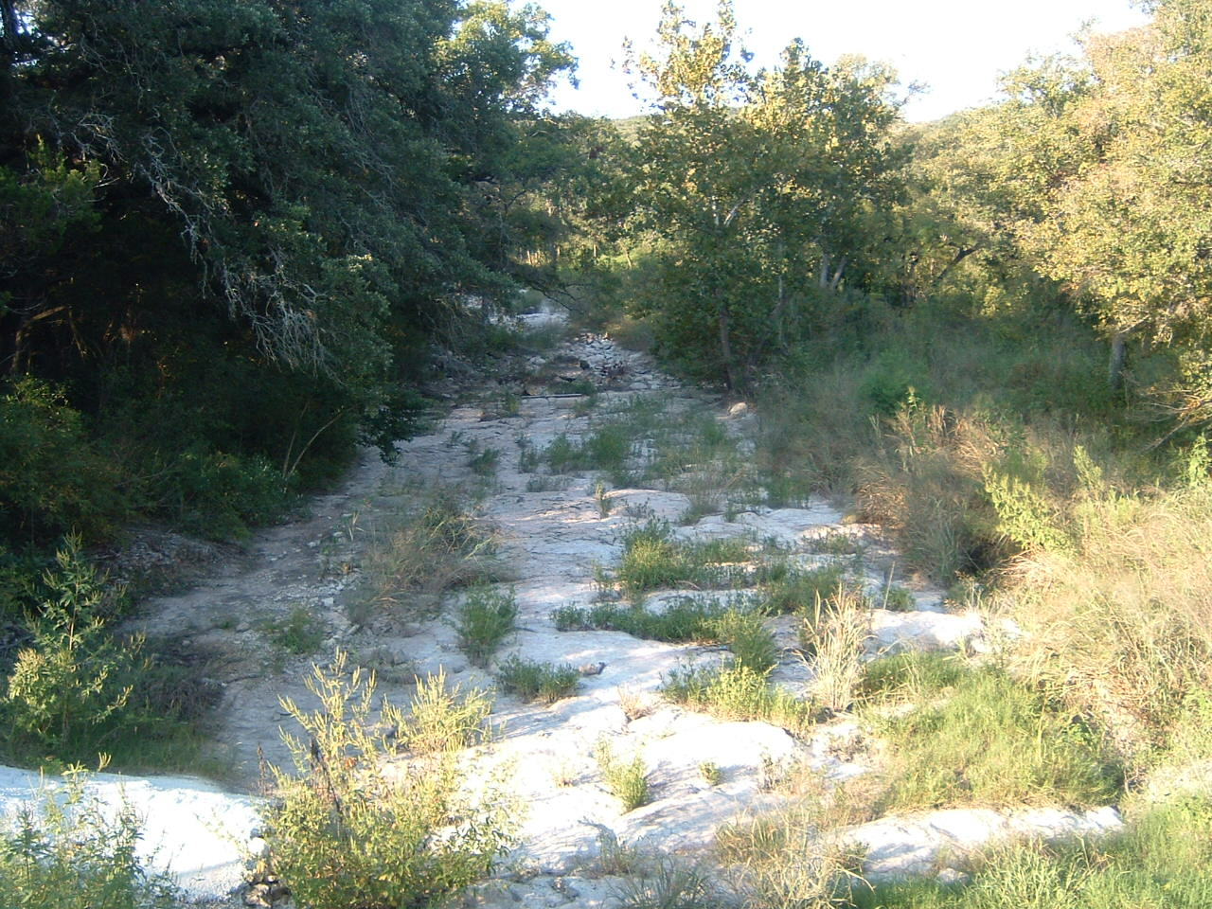
Lower Helotes Creek Sub-Basin
Helotes Creek Contributing Zone
Helotes Creek
Chimenia
Creek
Lee Creek
Edwards Aquifer
Contributing Zone
Los Reyes
Creek
0.94 cfs
3.05 cfs
Helotes Creek looking downstream toward
Recharge Zone
2.47 cfs
4.24 cfs
1.06 cfs
0.00 cfs
Edwards Aquifer
Recharge Zone
Helotes Creek
Location of USGS river gauging station

Slide 36
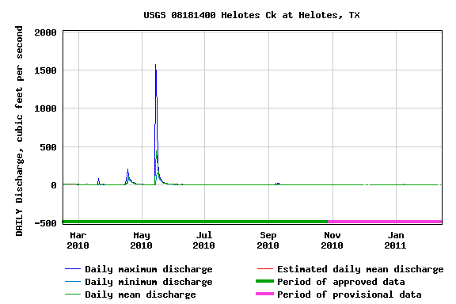
USGS River Gage on Helotes Creek Upstream of Recharge Zone (cfs) 2010-2011
Date of
gain/loss
survey
Helotes Creek has continuous flow in the Contributing
Zone except for drying out once every 5-7 years.
Flow in Helotes Creek only reaches the Recharge Zone
during periods of heavy precipitation.

Slide 37
Helotes Creek is not an outlier…

Slide 38
Helotes Creek is not an outlier…
…there is considerable evidence that considerable
recharge to the Edwards Aquifer occurs in the Contributing Zone

Slide 39
Allogenic + Autogenic Recharge (Derived from Within and from Yonder)
Conventional
Conceptualization
Contributing Zone
Recharge Zone
Confined Zone

Slide 40
Autogenic + Allogenic Recharge
Contributing Zone
Recharge Zone
Confined Zone

Slide 41
Autogenic + Allogenic Recharge
Refined
Conceptualization
Contributing Zone
Recharge Zone
Confined Zone

Slide 42
Edwards Aquifer
Conventional Conceptualization
Source: Edwards Aquifer Authority 2008

Slide 43
Edwards Aquifer
Refined Conceptualization
Source: Edwards Aquifer Authority 2008

Slide 44
Edwards Aquifer
Refined Conceptualization
Source: Edwards Aquifer Authority 2008

Slide 45
How does water get from the Contributing Zone to the Edwards Aquifer

Slide 46
Edwards Aquifer
Source: Edwards Aquifer Authority 2008

Slide 47
Rain Water Is Focused into River Beds and Acts as a Mild Acid That Dissolves the Limestone
Incised River Channels
Preferential Flow Paths
Woodruff and Abbott, 1970s, 1980s
The preferential flow paths that are formed may be a “pipe”, but it is more likely the flow paths are simply zones of enhanced permeability

Slide 48
Development of karst conduits in carbonate aquifers
Woodruff and Abbott, 1979, 1986

Slide 49
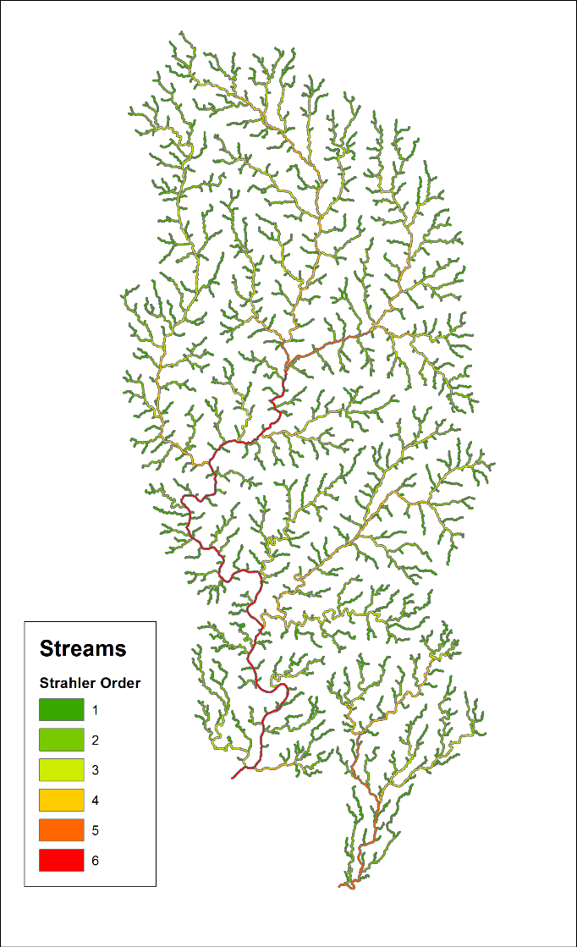
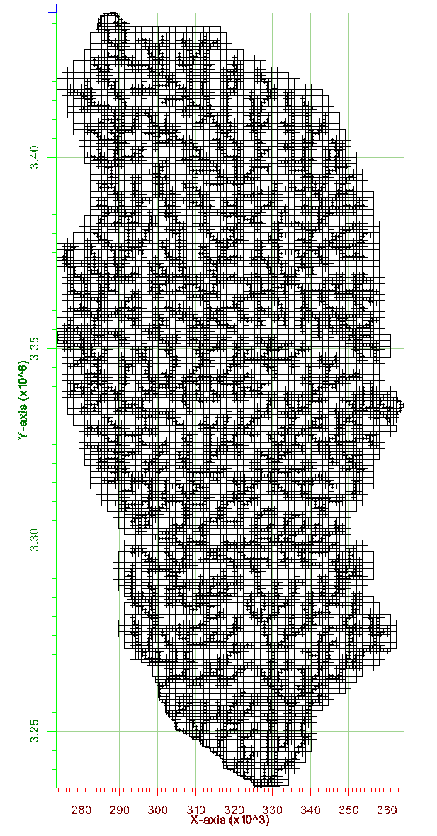
Fast groundwater flow occurs in preferential flow paths aligned with river channels in the Contributing Zone
Streams
Preferential Flow Paths

Slide 50
…back to the SET Model

Slide 51
During the first three SETs properties in the Contributing Zone were given little weight in the SET Model

Slide 52
This changed in 2015, when the 4th SET took into consideration recent science that documented the importance of the Contributing Zone

Slide 53
Refined Contributing Zone weighting by 4th SET is based on: 1) watershed basin 2) distance from the Recharge Zone 3) distance from the river channel

Slide 54
Composite weighting assigned to each parcel
$$W^{Total}=W_{}^{WS}{+ W}_{}^{RZ}+ W^{RC}$$
$W^{Total}$= Total weighting assigned to a parcel [0-30]
$W_{}^{WS}$= Watershed weighting [0-10]
${ W}_{}^{RZ}$= Distance from recharge zone weighting [0-10]
$W^{RC}$= Distance from river channel weighting [0-10]
Parcel center is determined using ARCGIS (center of gravity)

Slide 55
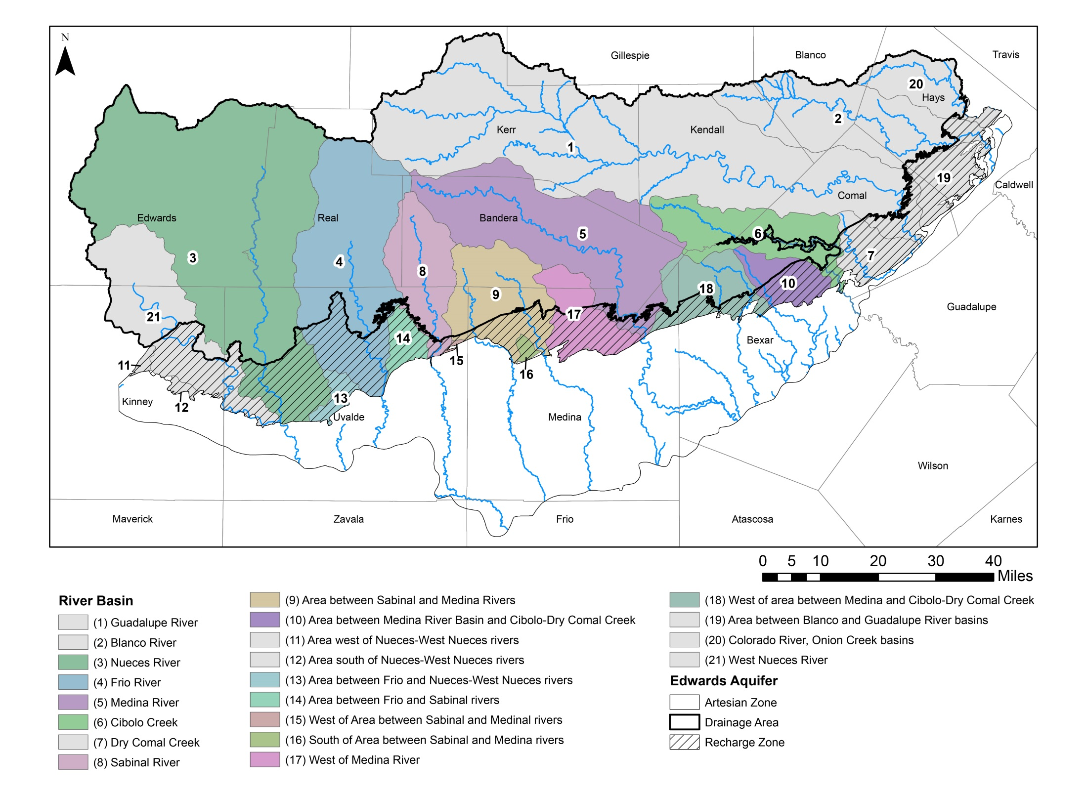
Consideration of Contributing Zone

Slide 56
The SET recommended extending the EAPP into the Contributing Zone The CAB has been reluctant extending the EAPP into the Contributing Zone

Slide 57
The <policy maker> has been reluctant extending the EAPP into the Contributing Zone The <technical advisor> continues to recommend extending the EAPP into the Contributing Zone

Slide 58
Properties Protected by the Edwards Aquifer Protection Plan (EAPP)

Slide 59
Considerable properties in the Contributing Zone merit protection from development

Slide 60
Basins are weighted according to impact on San Antonio
No. | Watershed | Weighting
1 | Guadalupe River | 0
2 | Blanco River | 0
3 | Nueces River | 5
4 | Frio River | 6
5 | Medina River | 9
6 | Cibolo Creek | 6
7 | Dry Comal Creek | 5
8 | Sabinal River | 6
9 | Area between Sabinal and Medina rivers | 7
10 | Area between Medina River and Cibolo-Dry Comal Creek | 10
11 | Area west of Nueces-West Nueces rivers | 0
12 | Area south of Nueces-West Nueces rivers | 0
13 | Area between Frio and Nueces rivers | 6
14 | Area between Frio and Sabinal rivers | 6
15 | West of area between Sabinal and Medina rivers | 5
16 | South of area between Sabinal and Medina rivers | 5
17 | West of Medina River | 8
18 | West of area between Medina and Cibolo-Dry Comal Creek | 10
19 | Area between Blanco and Guadalupe rivers | 0
20 | Colorado River-Onion Creek | 0
21 | West Nueces River | 0

Slide 61
Basins are weighted according to impact on San Antonio
No. | Watershed | Weighting
1 | Guadalupe River | 0
2 | Blanco River | 0
3 | Nueces River | 5
4 | Frio River | 6
5 | Medina River | 9
6 | Cibolo Creek | 6
7 | Dry Comal Creek | 5
8 | Sabinal River | 6
9 | Area between Sabinal and Medina rivers | 7
10 | Area between Medina River and Cibolo-Dry Comal Creek | 10
11 | Area west of Nueces-West Nueces rivers | 0
12 | Area south of Nueces-West Nueces rivers | 0
13 | Area between Frio and Nueces rivers | 6
14 | Area between Frio and Sabinal rivers | 6
15 | West of area between Sabinal and Medina rivers | 5
16 | South of area between Sabinal and Medina rivers | 5
17 | West of Medina River | 8
18 | West of area between Medina and Cibolo-Dry Comal Creek | 10
19 | Area between Blanco and Guadalupe rivers | 0
20 | Colorado River-Onion Creek | 0
21 | West Nueces River | 0

Slide 62
Primary focus on Contributing Zone to be protected

Slide 63
City of San Antonio Edwards Aquifer Protection Program
Contentious Debate on the EAPP
Has the EAPP done all it was meant to do?
Is there more that the EAPP should do?

Slide 64
City of San Antonio Edwards Aquifer Protection Program
Contentious Debate on the EAPP
Has the EAPP done all it was meant to do?
NO
Is there more that the EAPP should do?

Slide 65
City of San Antonio Edwards Aquifer Protection Program
Contentious Debate on the EAPP
Has the EAPP done all it was meant to do?
NO
Is there more that the EAPP should do?
YES

Slide 66
Contact Information
Ronald T. Green, Ph.D., P.G.
Technical Advisory
Earth Science Section
Space Sciences and Engineering Division
Southwest Research Institute
6220 Culebra
San Antonio, Texas 78238
1.210.522.5305 (office)
1.210.316.9242 (cell)
rgreen@swri.edu

