Slide 1
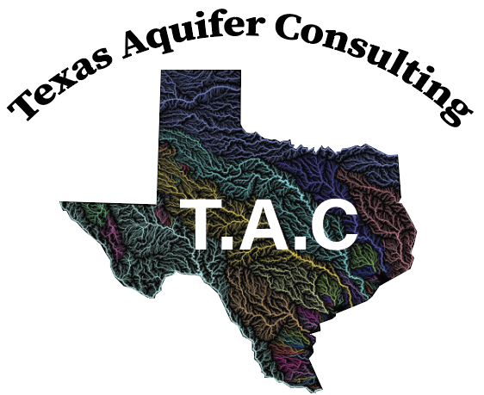
Identifying Risk Areas in the Edwards Aquifer Recharge Zone
Sandy Hernandez- Project Manager
Erica Hutchings- Web Developer & Editor
Caleb Cavender- GIS Analyst & Designer
Eli Williams- GIS Analyst

Slide 2
Introduction
Data
Methodology
Results
Discussion
Conclusions
Metadata & References

Slide 3
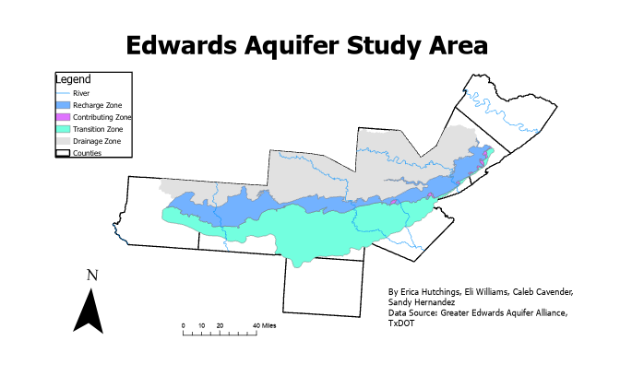
Introduction
Aquifer services a growing population
Numerous factors put the aquifer at risk
Risks affect public health, agriculture, industry, wildlife

Slide 4
Introduction
Project initially utilized TCEQ data
Delivery delays required a change in plans
New plan utilizes more easily accessible data
Goal is to determine WWTP locations that pose the highest theoretical risk

Slide 5
DATA
WWTP Locations
Inaccuracies?
Census Tracts
Population Density
Aquifer Zones
Hydrology

Slide 6
 | Attributes | Spatial Object | Status | Source
Texas Census Tracts | Population | Polygon | Available | Capitol Data Portal
Texas Rivers | Length, Name | Polyline | Available | TNRIS
Edwards Aquifer | Zones, Area: Acres, Sq. Feet, Sq. Miles | Polygon | Available | GEAA
Wastewater Treatment Plants Table | Name, Address, RN Number | Table | Available | Original table created from TCEQ database
Wastewater Treatment Plants Points | Name, Address, RN Number | Points | Available | Original points created in Google Earth Pro
Texas Counties | Counties | Polygon | Available | TNRIS

Slide 7
Methodology
WWTP Locations
Start
Aquifer Zones
Weighted Overlay Analysis
Display on a web map
Deliver to client
Census Tracts
Rivers and Streams

Slide 8
Methodology
Control Points
KML To Layer
Make Feature Layer
Tx Counties
Select By Attributes
Study Area
Merge
Census Tracts
Join to Table
Polygon to Raster
Clip Raster to Study Area
Reclassify
Aquifer Zones
Clip to Study Area
Dissolve Boundaries
Erase
Append
Polygon to Raster
Rivers
Clip to Study Area
Buffers
Polygon to Raster
Weighted Overlay
Clip to Study Area
Extract Values to Points
Select Layer By Attribute
Final Output

Slide 9
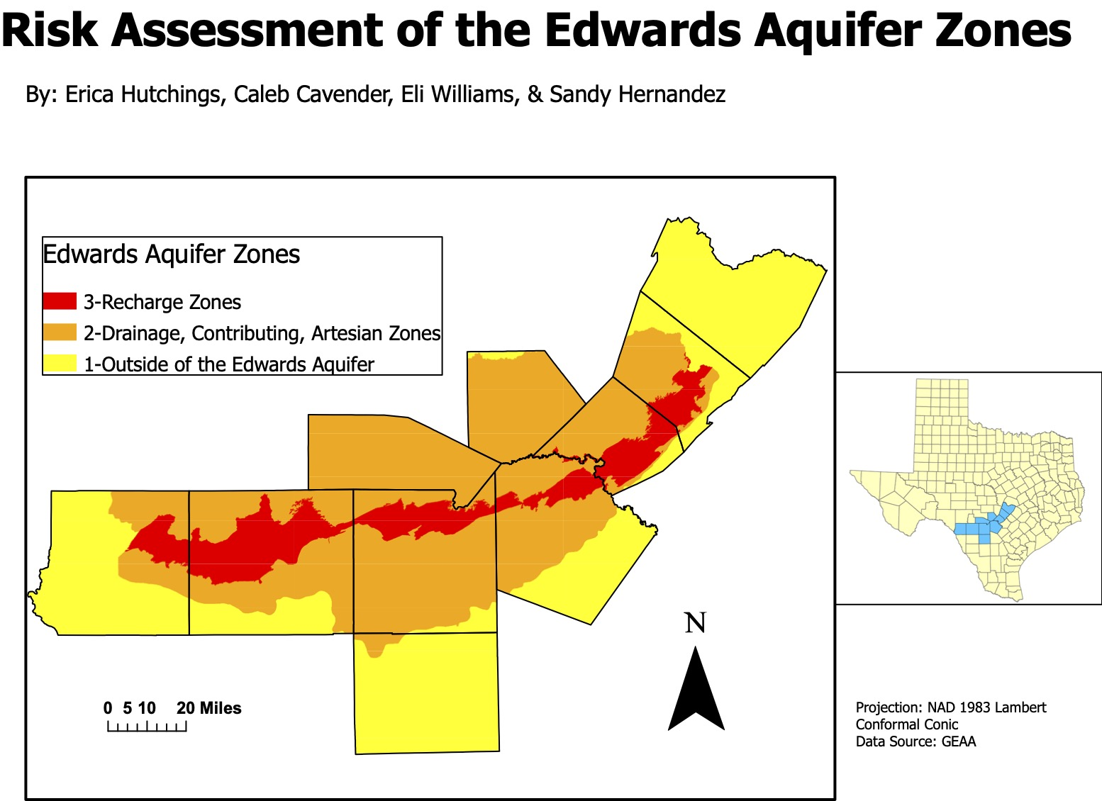
Travis
RESULTS
Hays
Kendall
Comal
Bandera
Bexar
Kinney
Uvalde
Medina
Frio

Slide 10
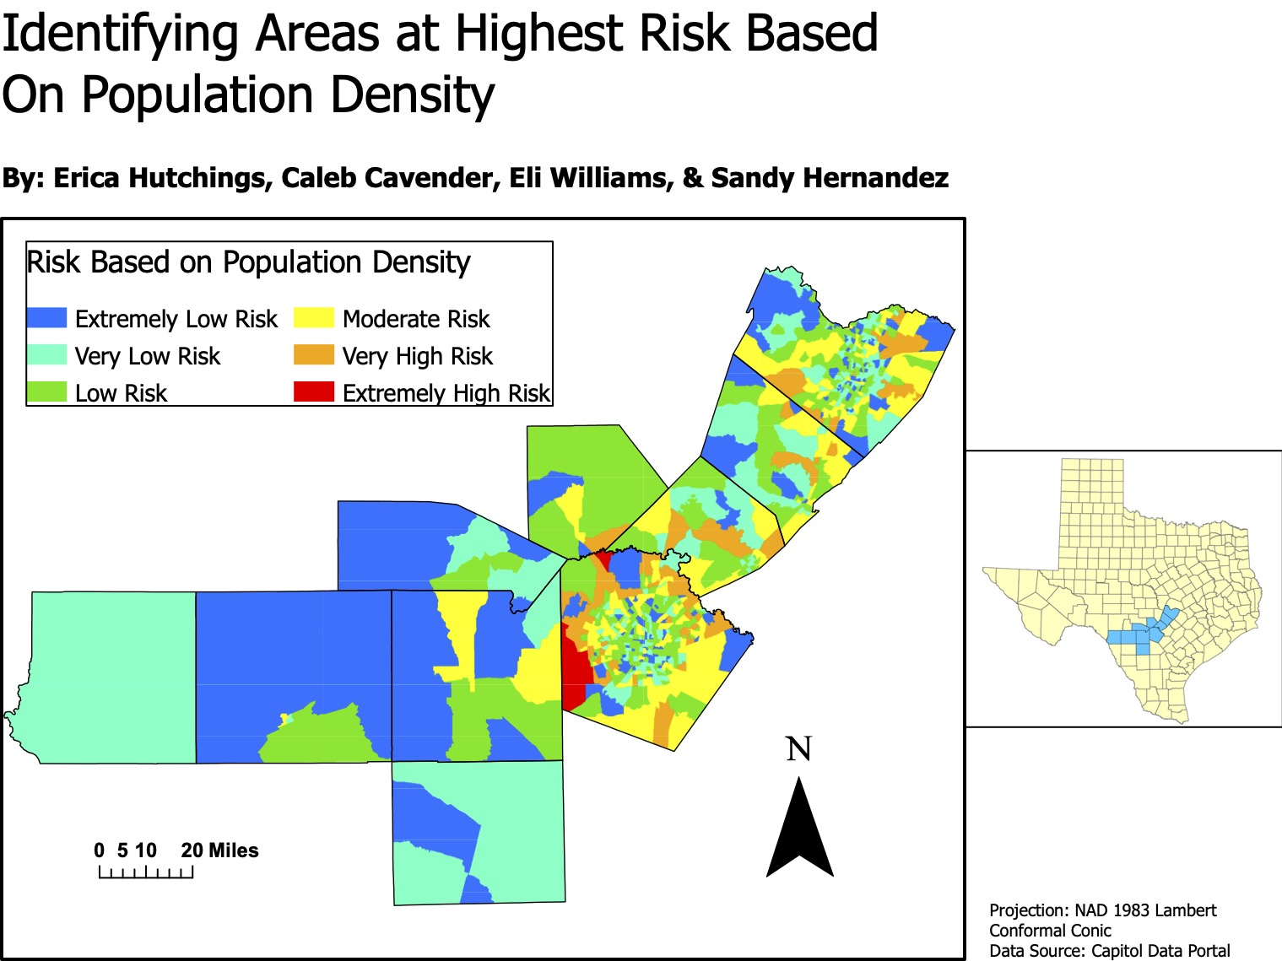
RESULTS

Slide 11
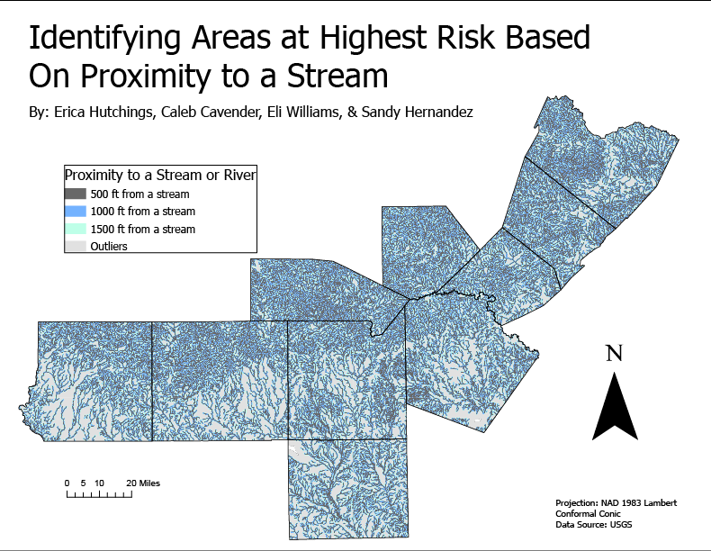
RESULTS

Slide 12
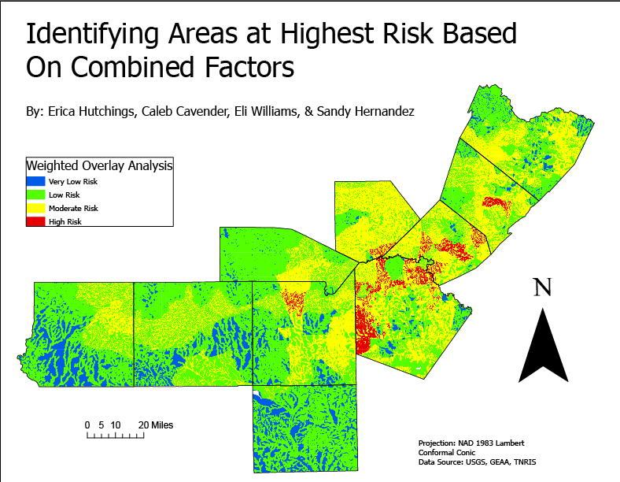
RESULTS

Slide 13
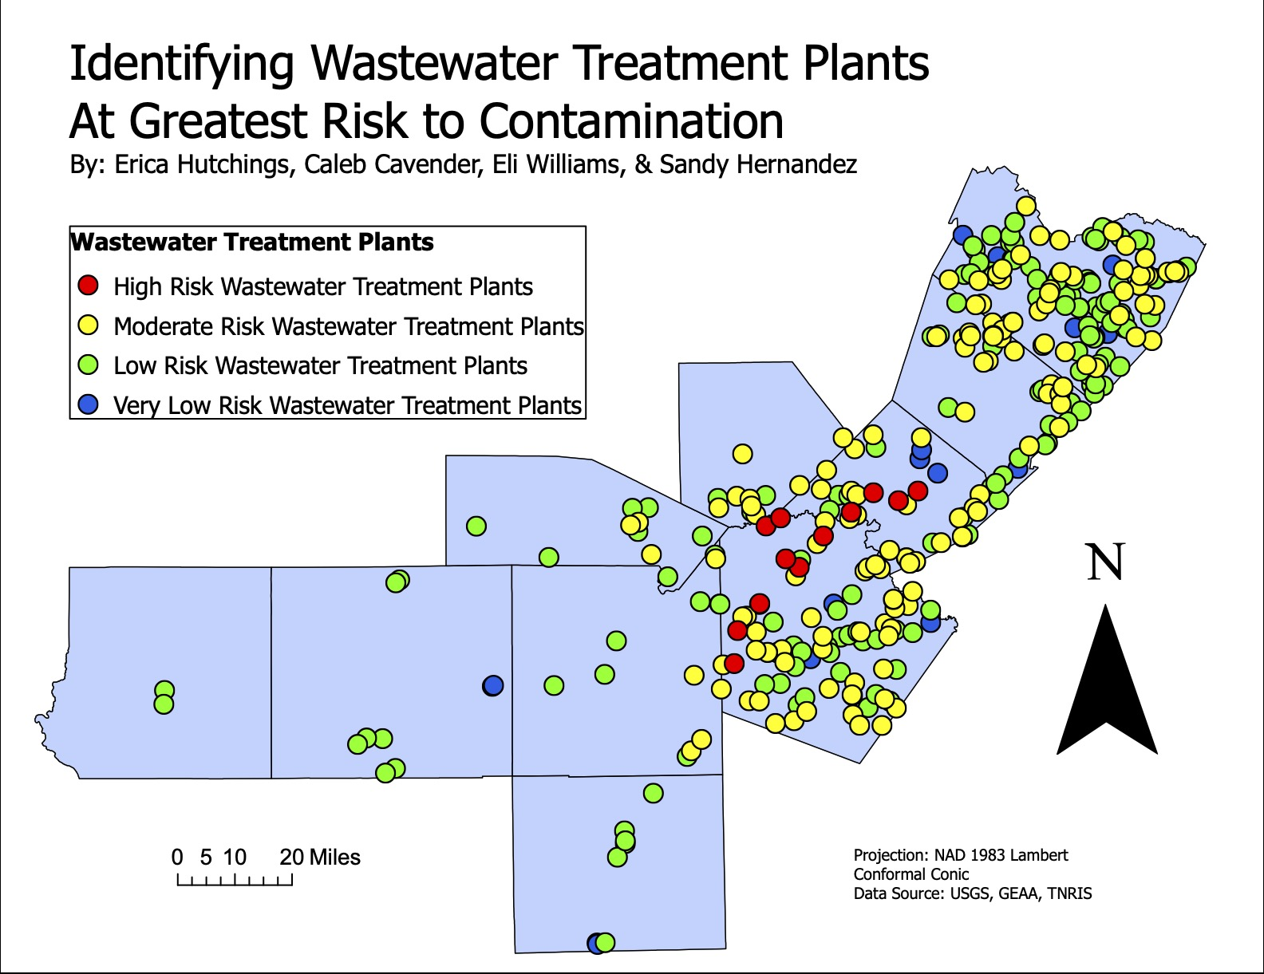
RESULTS

Slide 14
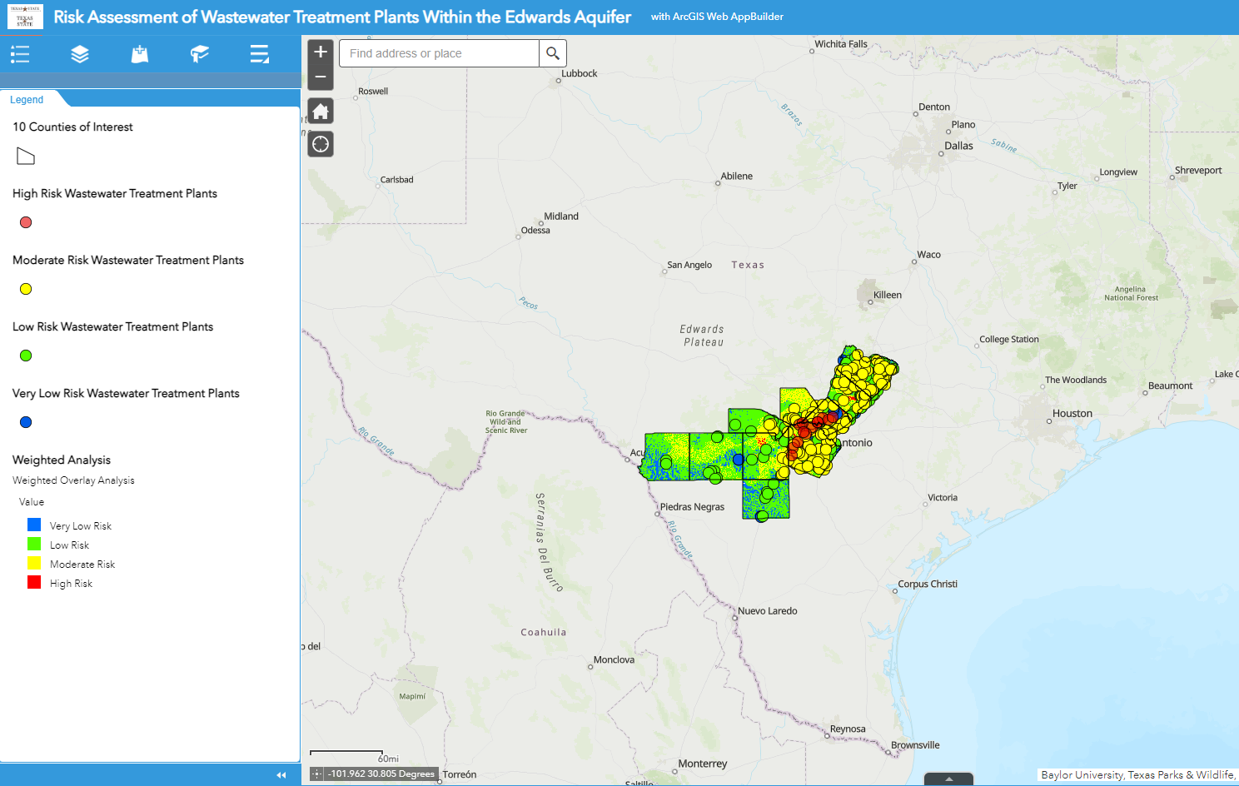
Web Map Application
RESULTS
https://txst.maps.arcgis.com/apps/webappviewer/index.html?id=0095f7f7da484886b67bc4960939c0e4

Slide 15
DISCUSSION
Bexar and Comal counties riskiest
Hays and Travis county pose some risk
TCEQ delays limited deliverable
FOIA?

Slide 16
Conclusion
Things don’t always go as planned
Adapt and come up with a solution
Maps and Interactive Web Map Application
Proved our hypothesis that there are many WWTPs that are a great risk to contaminating the Edwards Aquifer
Thankful for our clients for being understanding
TCEQ dataset

Slide 17
References
Denchak, M., 2016. Water Pollution: Everything You Need to Know. National Resources Defense Council.
https://www.nrdc.org/stories/water-pollution-everything-you-need-know
University of the Basque Country., 2015.Water-treatment plants are not supposed to harm the functioning of river ecosystems. ScienceDaily. https://www.sciencedaily.com/releases/2015/10/151029134654.htm>.
John M. Sharp, Jr., Ronald T. Green, Geary M. Schindel, 2019. "Introduction", The Edwards Aquifer: The Past, Present, and Future of a Vital Water Resource.
Maclay, R., 1995. Geology and Hydrology of the Edwards Aquifer in the San Antonio area, Texas. USGS.
https://pubs.er.usgs.gov/publication/wri954186

Slide 18
Participation
Sandy Hernandez- Project Manager
Erica Hutchings- Web Developer & Editor
Caleb Cavender- GIS Analyst & Designer
Eli Williams- GIS Analyst

Slide 19
Questions?
Comments?
Concerns?

