Slide 1
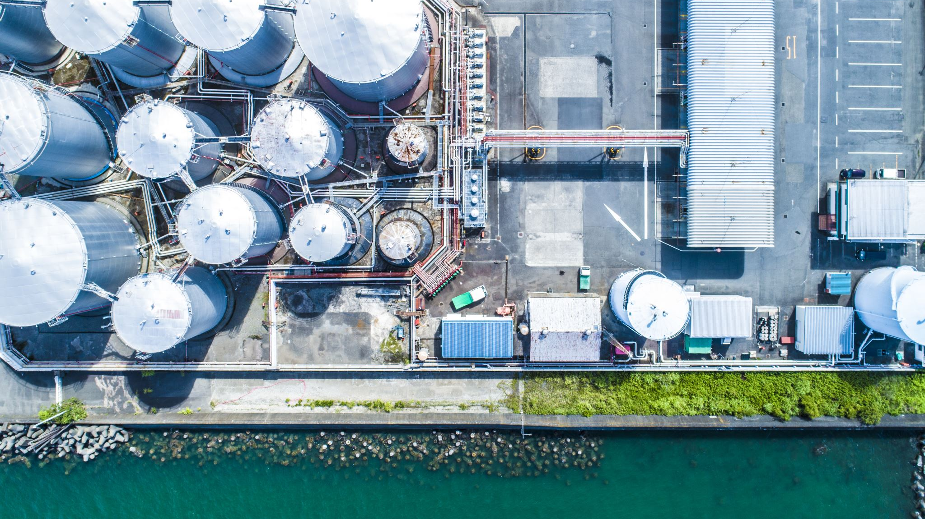


Wastewater Treatment Plants on the Edward’s Aquifer
Presented by:
Tay Floyd
Haley Busse
Tyler Heck

Slide 2
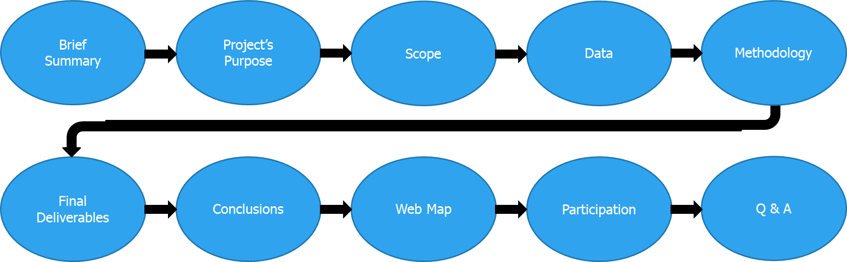
Presentation Overview

Slide 3
Brief Summary
Our AOI was the Edwards Aquifer with additional emphasis of interest being placed on ten counties that surround it, and each WWTP that operates in the area
The Edwards Aquifer is made up of an abundance of karst limestone chambers, holes, and caves
Downsides of its unique permeable structure

Slide 4
Project’s Purpose
Our goal was to identify areas of the aquifer that are at risk of contamination.
With this info, we created an interactive web map that enabled tracking WWTP data with ease
Highlight which WWTPs are most likely to cause issues for the aquifer
Provide this information to the GEAA

Slide 5
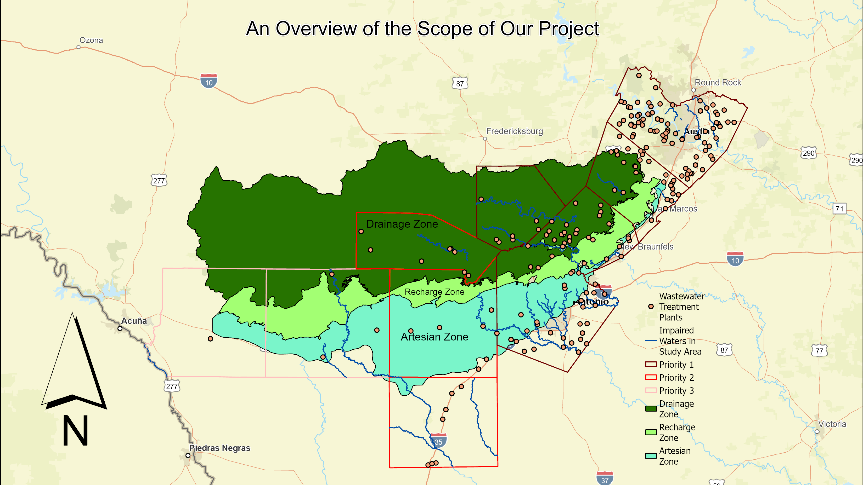

Slide 6
Data
Past Notices of enforcement (NOE)
Ammonia nitrogen
Beneficial Reuse (if any)
Additional Conditions of Permit (if any)
County maps, shapefiles, and quantitative data, which depict locations and vulnerability rankings for wastewater lines
Edwards Aquifer Zones and Regulatory Boundary
Surface water shapefiles
Surface water quality criteria, such as TCEQ/EPA stream impairment status
Available wastewater spills data
Start and permit renewal date of TPDES and TLAP permits
Address / Description of location
Volume of Treatment
Method of Treatment
Phosphorus and Nitrogen discharges permitted
Discharge rate
Carbonaceous biological oxygen demand
Total suspended solids
Past notices of violation (NOV)

Slide 7
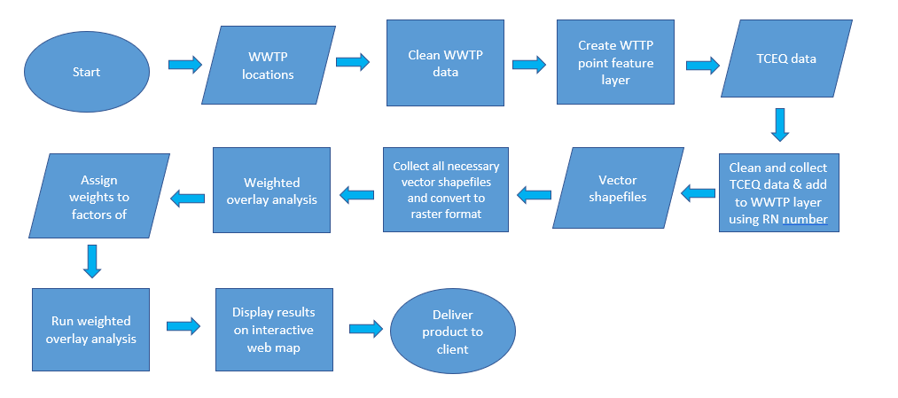
Methodology

Slide 8
Final Deliverables
Map Layers
River Buffers
Weighted Overlay
Rasterized Buffers
Rasterized Study Area
Reclassified Rasters

Slide 9

Conclusions
https://txst.maps.arcgis.com/apps/mapviewer/index.html?webmap=1136af6f185746b6b2a46ba68ec74d6b

Slide 10
Participation
Tyler Heck: Summary, Purpose, Scope, and AOI
Haley Busse: Data and Methodology
Tay Floyd: Final Deliverables and Conclusion

