Slide 1
Transportation, Growth, and Planning
Isaac Gonzalez, Transportation Consultant
Water Wonks | 6/26/2024

Slide 2
Agenda
Growth in the Region
3
Regional Planning
7
Tying in Water Conservation
15
Discussion
30
Save the World???
?

Slide 3
Regional Growth

Slide 4
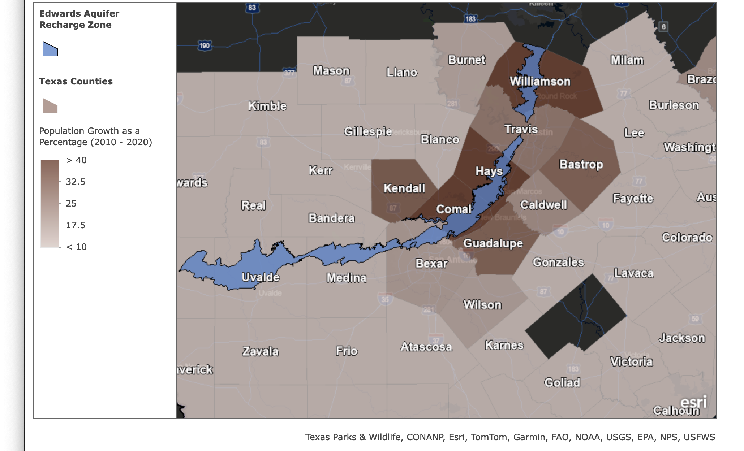
Population Be Growing
3
Population Growth of Texas Counties (%) ¹
Source: 2020 and 2010 U.S. Census

Slide 5
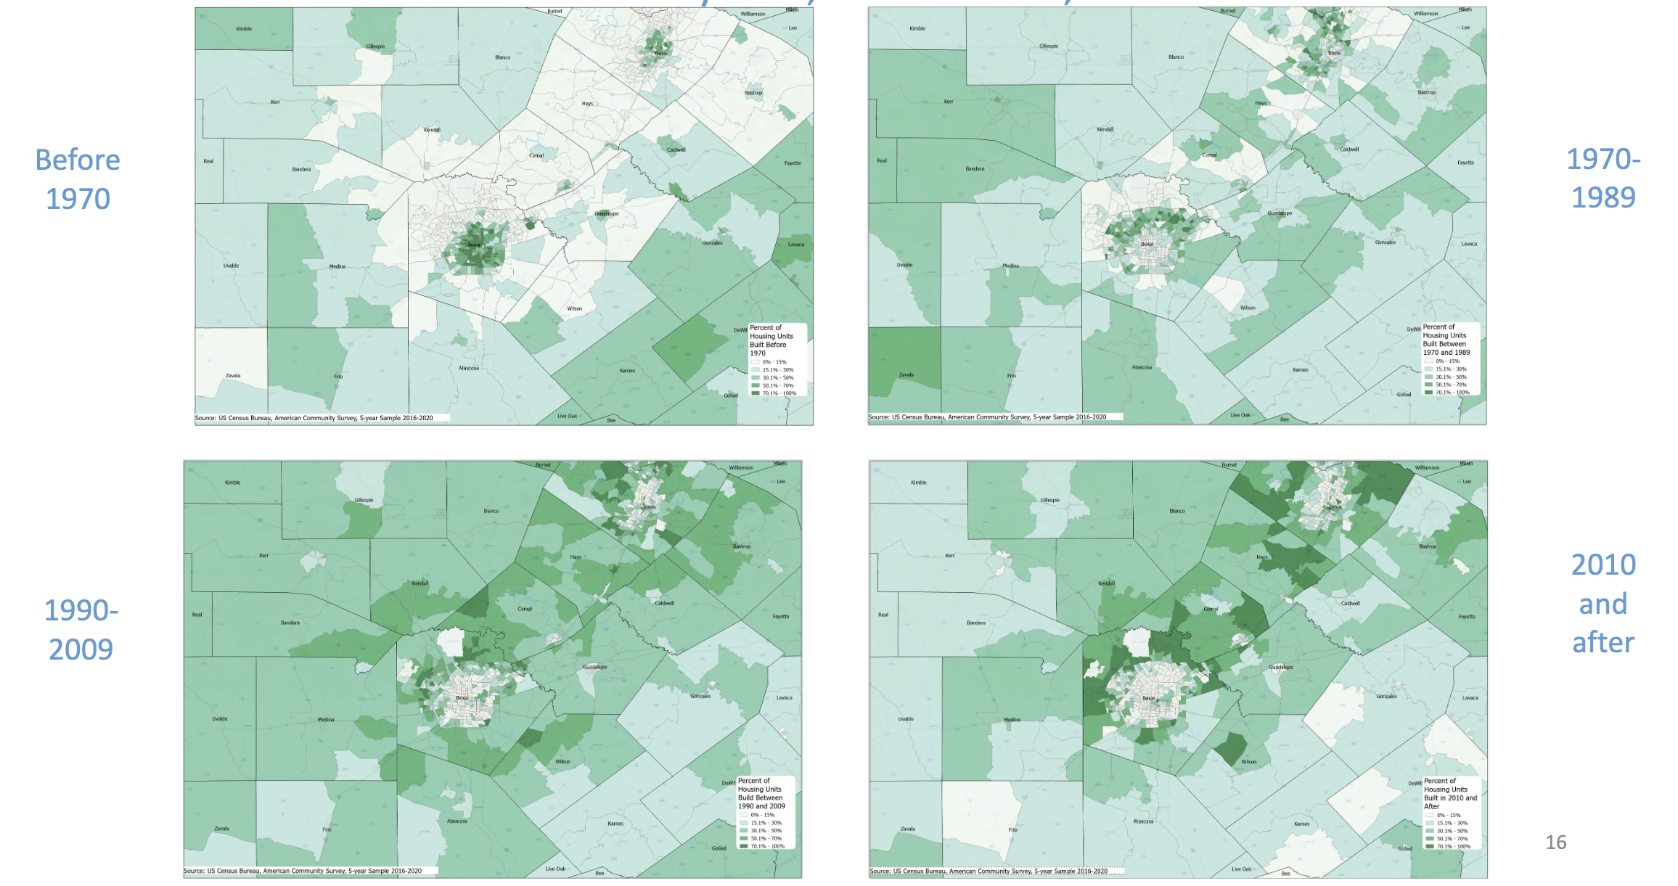
Housing Too
3
Estimated Percent of Housing Built by Time Period ¹
Source: Dr. Helen Yu Presentation to Joint CAMPO-AAMPO Meeting, June 2023

Slide 6
Population Will Continue Growing ¹
3
County | 2020 | 2040 | 2020-2040 (%) | 2060 | 2020-2060 (%)
Bexar | 2,009,324 | 2,599,727 | 29% | 3,102,720 | 54%
Comal | 161,501 | 315,640 | 95% | 584,380 | 262%
Guadalupe | 172,706 | 268,305 | 55% | 387,211 | 124%
Kendall | 44,279 | 70,896 | 60% | 111,448 | 152%
Bastrop | 97,216 | 150,018 | 54% | 223,711 | 130%
Caldwell | 45,883 | 61,689 | 34% | 76,291 | 66%
Guadalupe | 172,706 | 268,305 | 55% | 387,211 | 124%
Hays | 241,067 | 513,812 | 113% | 1,003,130 | 316%
Travis | 1,290,188 | 1,820,417 | 41% | 2,252,137 | 75%
Williamson | 609,017 | 1,065,394 | 75% | 1,682,556 | 176%
Source: Texas Demographics Center, 2022 Population Projections

Slide 7
Regional Planning

Slide 8
State and Local Agencies Plan
Long-Range Transportation Plans (LRTP) have projects that TxDOT/Local Governments want to do between five and 20 years from now.
Short-Range Transportation Implementation Program (STIP) have TxDOT/Local Government projects that will be ready for construction within four (4) years.

Slide 9
Locals Have to Have a Voice
Federal law mandates all urbanized areas with over 50,000 people to have a Metropolitan Planning Organization (MPO).² We’ve got the Alamo Area and Capital Area MPOs (AAMPO and CAMPO).
The MPOs are tasked with developing the regional LRTP and STIP and approving all projects that take place in the region if federal dollars are involved.

Slide 10
Federal Dollars Are Everywhere ³
TxDOT Funding Category | State Dollars? | Federal Dollars?
1. Preventative Maintenance and Rehabilitation | Yes | Yes
2. Metro and Urban Area Corridors | Yes | Yes
3. Non-Traditionally Funded Projects | Yes | No
4. Statewide Connectivity Corridors | Yes | Yes
5. Congestion Mitigation and Air Quality (CMAQ) | No | Yes
6. Structure Replacement (Bridges) | Yes | Yes
7. Metro Mobility and Rehabilitation | No | Yes
8. Safety | Yes | Yes
9. Transportation Alternatives (TA) | No | Yes
10. Supplemental Transportation Projects | Yes | Yes
11. District Discretionary | Yes | Yes
12. Strategic Priority | Yes | Yes

Slide 11
How Dollars are Distributed
Amount of available funds is known 10 years in advance
Yearly breakdown by funding category can be found in TxDOT’s yearly Unified Transportation Program (UTP)
Dollars are further distributed by MPO

Slide 12
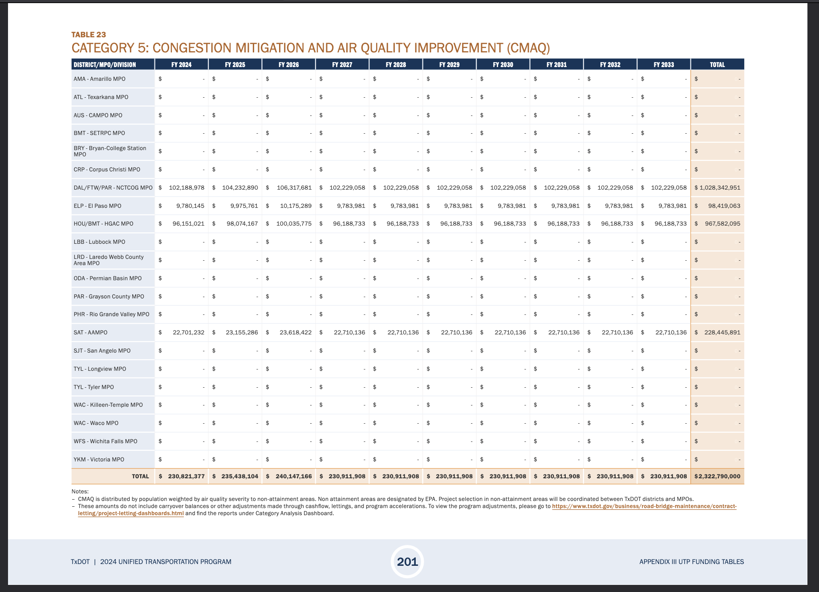
Funding Example (Category 5) ⁴

Slide 13
It’s A Lot of Monies ⁴
Fiscal Year | Amount
2024 | $22,701,232
2025 | $23,155,286
2026 | $23,618,422
2027 | $22,710,136
2028 | $22,710,136
2029 | $22,710,136
2030 | $22,710,136
2031 | $22,710,136
2032 | $22,710,136
2033 | $22,710,136

Slide 14
Here’s the Kicker
Hundreds of millions of dollars are not claimed by any projects yet.

Slide 15
Tying in Water Conservation

Slide 16
Four Key Funding Categories
Category 5 (CMAQ)
Category 7 (Surface Transportation Block Grants (STBG))
Category 9 (Transportation Alternatives (TA))
Category 10 (Carbon Reduction Program (CRP))

Slide 17
CMAQ Has to Reduce Ozone ⁵
Eligible Projects include:
  Bicycle and Pedestrian Facilities
  Engine Retrofits
  Traffic Management Programs
Can only be used in Bexar County

Slide 18
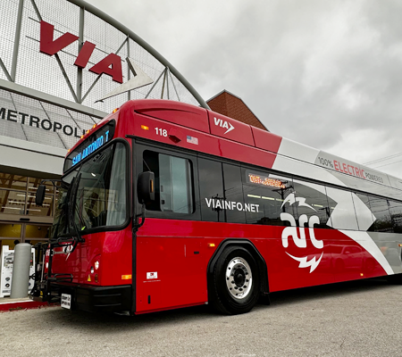
Lots of Flexibility
VIA’s Electric Buses and Diesel Engine Retrofits
TxDOT Adding Turnaround Lanes
CoSA Traffic Signal Optimization

Slide 19
What Else Could I Use It On?
Travel Demand Management Programs (Reducing Trip Generation and Parking Needs)
Public Education and Outreach Programs
Inspections and Maintenance Programs

Slide 20
STBG Can Be Used on Anything*⁶
Eligible Projects include:
  Anything that happens on a road or trail.
*That happens on a road or trail.

Slide 21
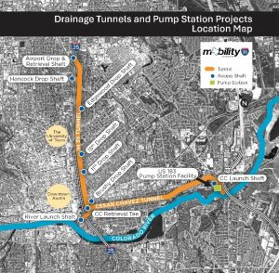
The Most Flexibility
TxDOT’s Drainage Tunnel and Pump System in Austin
Hays County relocating a Union Pacific Rail Siding
Converse Expanding Lanes on Toepperwein Road

Slide 22
What Else Could I Use It On?
Stormwater Mitigation
Rail of Any Sort
Surface Transportation Planning (Land Use Plans, Complete Streets Guidelines, Resiliency Studies)
Nonmotorized-Transportation Activities, including Recreational Trails

Slide 23
TA Can Only Be Used on Alternatives ⁷
Eligible Projects include:
  Bicycle and Pedestrian Facilities
  Recreational Trails
  Safe Routes to School
Nothing Car Related

Slide 24
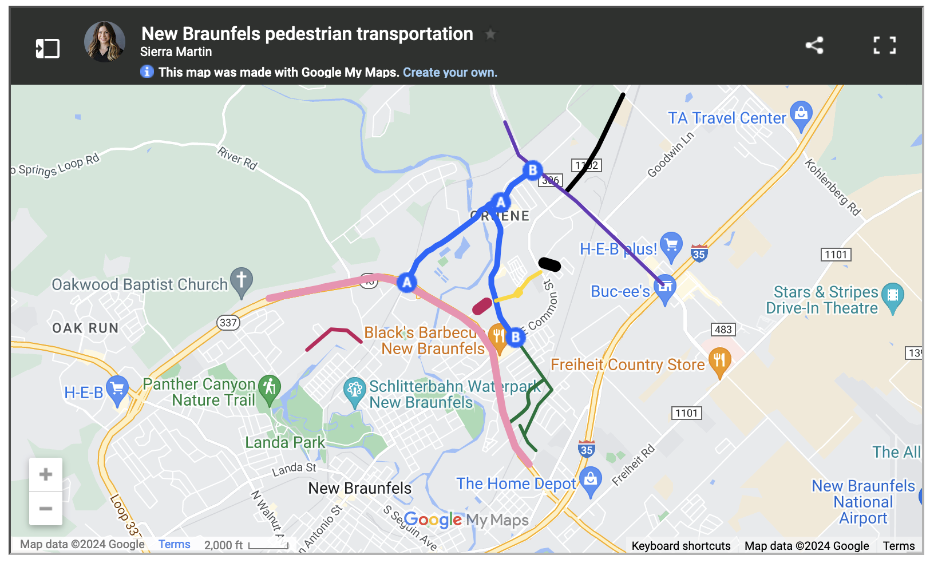
Also Has Lots of Flexibility
New Braunfels Complete Streets in Gruene Historic District
Brooks 7.5 Mile Green Loop Trail
UTSA Shared-Use Paths Around 1604
Source: Sierra Martin, Community Impact ⁸

Slide 25
What Else Could I Use It On?
Stormwater Mitigation
Rails to Trails
Historic Preservation and Rehabilitation of Historic Transportation Facilities
Wildlife/Vegetation Management
Safe Routes for Non-Drivers

Slide 26
CRP Have to Reduce Carbon ⁹
Eligible Projects include:
  Anything that reduces transportation emissions.

Slide 27
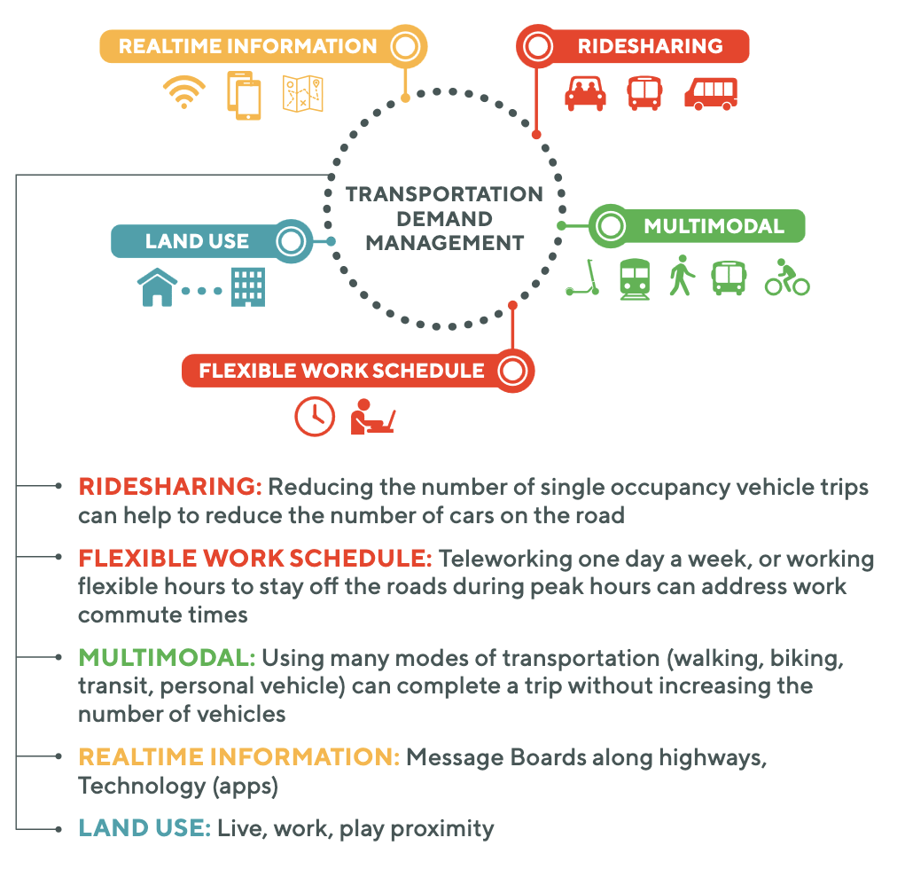
Has Tons of Flexibility
CAMPO’s Travel Demand Management Plan
TxDOT “Green-T” Intersection at SH 46
New Braunfels Pedestrian and Drainage Improvements on Solms Road
Source: CAMPO TDM Plan ¹⁰

Slide 28
What Else Could I Use It On?
Congestion Pricing Program
Project that Supports Alternative Fuels (EV, Hydrogen)
Construction, Planning, and Design of Off-Road Pedestrian Facilities
Public Transportation Project

Slide 29
Non-Profits Can Get In On The Action
Non-Profits and Public Entities can partner with local governments on projects
  Brooks Development Authority
  UTSA
  Great Springs Project

Slide 30
Thank You!
Isaac Gonzalez
isaac@isaacjg.com

Slide 31
References
Yu, Helen. Demographic Trends and Population Projections in the Capital-Alamo Area. https://www.campotexas.org/wp-content/uploads/2023/06/Joint-meeting-presentation.pdf. San Marcos, Texas .
Metropolitan Planning Organization (MPO) | FTA. https://www.transit.dot.gov/regulations-and-guidance/transportation-planning/metropolitan-planning-organization-mpo.
TxDOT. Funding Categories Description. 10 June 2024, https://ftp.txdot.gov/pub/txdot/get-involved/tpp/utp/061024-utp-funding-categories-descriptions.pdf.

Slide 32
References
TxDOT. 2024 Unified Transportation Program, Page 201. 7 July 2023, https://ftp.txdot.gov/pub/txdot/get-involved/tpp/utp/070723-draft-2024utp.pdf.
FHWA. CMAQ Essentials. https://www.fhwa.dot.gov/Environment/air_quality/cmaq/reference/cmaq_essentials/cmaqessentials.pdf.
STBG - Federal-Aid Programs - Federal-Aid Programs and Special Funding - Federal Highway Administration. https://www.fhwa.dot.gov/specialfunding/stp/.
Transportation Alternatives - Environment - FHWA. https://www.fhwa.dot.gov/environment/transportation_alternatives/.

Slide 33
References
Martin, Sierra. “Transportation Projects in New Braunfels Awarded $34.5 Million in Funding from Regional Organization.” Community Impact, 8 Mar. 2024, https://communityimpact.com/austin/new-braunfels/government/2024/03/08/transportation-projects-in-new-braunfels-awarded-345-million-in-funding-from-regional-organization/.
Bipartisan Infrastructure Law - Carbon Reduction Program (CRP) Fact Sheet | Federal Highway Administration. https://www.fhwa.dot.gov/bipartisan-infrastructure-law/crp_fact_sheet.cfm.
CAMPO. Regional Transportation Demand Plan. Aug. 2019, https://www.campotexas.org/wp-content/uploads/2019/09/FINAL-Regional-TDM-Plan.pdf.

