Slide 1
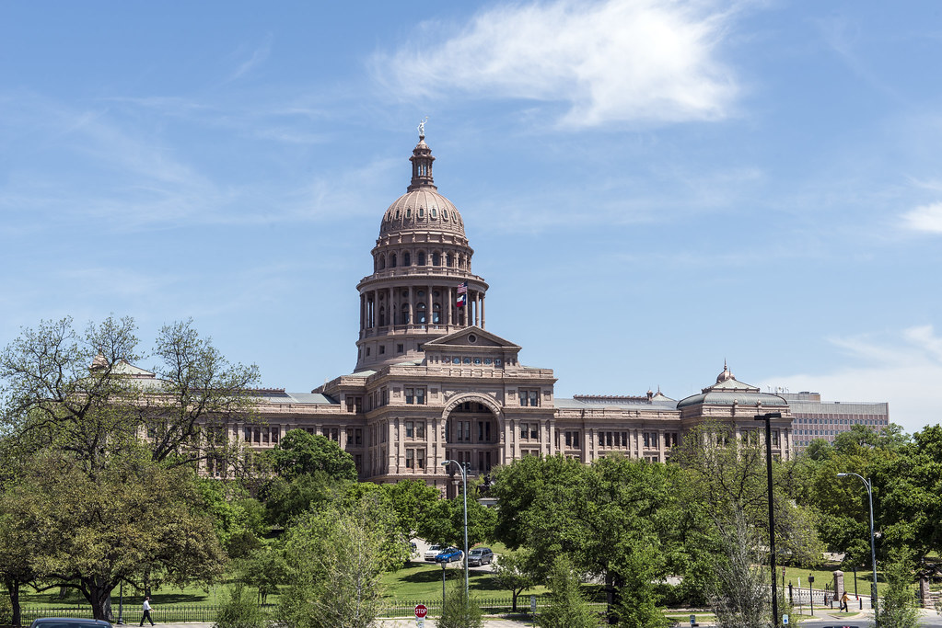
Member Group Meeting Legislative Update June 1, 2023

Slide 2
Interim Legislative Session
88th Regular Legislative Session: January – May 2023
Four 88th Special Legislative Sessions: June – December 2023
Interim Session: 2024
89th Regular Legislative Session: January – May 2025
Notes:
Beginner’s Guide: Interim Hearings at the Texas Legislature | Texas CJE

Slide 3
Interim Legislative Session
Interim Session: leader of each legislative chamber directs existing legislative committees or interim select committees to conduct research on specific topics
Interim Charge: directive to study a certain issue during the interim that is issued by the Lieutenant Governor to a Senate committee or by the Speaker of the House to a House committee
Monitoring vs. Issue
Interim Report: report issued by a committee detailing the committee’s findings and recommendations after study of its interim charges
Notes:
Beginner’s Guide: Interim Hearings at the Texas Legislature | Texas CJE

Slide 4
Interim Session – Senate
Local Government Committee
Extraterritorial Jurisdictions: Study issues related to the implementation of SB 2038 and HB 3053, 88th Legislature, and make recommendations to secure and enhance the protection of landowners’ property rights.
Housing Affordability: Study issues related to housing, including housing supply, homelessness, and methods of providing and financing affordable housing. Make recommendations to reduce regulatory barriers, strengthen property rights, and improve transparency and accountability in public programs for housing.
No hearing scheduled yet

Slide 5
Interim Session – Senate
Natural Resources and Economic Development Committee
Overcoming Federal Incompetence: Consider the impact to the Texas economy from federal interference including, but not limited to, restricting liquefied natural gas exports, supply chain limitations, a net-zero carbon agenda, and other air emission provisions. Report on what impact these federal interferences will have on the Texas economy and workforce, and make recommendations to minimize the damage to Texas.
Hearing: Thursday, June 13, 2024 at 10:00am in Hearing Room E1.028

Slide 6
Interim Session – Senate
Water, Agriculture, and Rural Affairs Committee
Water System Reliability: Evaluate water systems in Texas and identify opportunities to better equip those systems to serve the public. Review the coordination of relevant state agencies dealing with Texas water issues and identify opportunities for improved coordination and effectiveness.
Hearing: Tuesday, September 3, 2024 at 10:00am in Hearing Room E1.012

Slide 7
Interim Session – Senate
Water, Agriculture, and Rural Affairs Committee
Monitoring: Monitor the implementation of legislation passed by the 88th Legislature, as well as relevant agencies and programs under the committee’s jurisdiction. Specifically, make recommendations for any legislation needed to improve, enhance, or complete implementation of the following:
Senate Bill 28: relating to financial assistance provided and programs administered by the Texas Water Development Board
Senate Bill 1289: relating to the disposal of reclaimed wastewater
Senate Bill 1648: relating to the Centennial Parks Conservation Fund
Hearing: Tuesday, September 3, 2024 at 10:00am in Hearing Room E1.012

Slide 8
Interim Session – House
Committee on Agriculture and Livestock
Monitoring: Monitor the agencies and programs under the Committee’s jurisdiction and oversee the implementation of relevant legislation passed by the 88th Legislature. Conduct active oversight of all associated rulemaking and other governmental actions taken to ensure the intended legislative outcome of all legislation, including the following:
HB 1750: related to the application of certain city requirements to agricultural operations
HB 2308: related to nuisance actions and other actions against agricultural operations
No hearing scheduled yet

Slide 9
Interim Session – House
Committee on Culture, Recreation and Tourism
Conservation of Texas Farm and Ranch Lands: Evaluate the purpose and effectiveness of the Texas Farm and Ranch Lands Conservation Program. Identify the trends and impacts of land fragmentation given the state’s rapid population growth and proud legacy of private land stewardship and evaluate the risks of increased foreign ownership of Texas land resulting from fragmentation. Examine the ecological and economic benefits of existing land conservation programs and the potential future role of strategic conservation initiatives to assist in the preservation of critical natural resources for the benefit of Texans in future generations.
No hearing scheduled yet

Slide 10
Interim Session – House
Committee on Defense and Veterans Affairs
Strength of Texas Military Bases: Review the federal criteria for considering and recommending base closure or realignment and evaluate the strength of Texas Military Bases under the scoring system utilized by the U.S. Department of Defense. Make recommendations to mitigate the risk of realignments or closures of military installations in Texas.
No hearing scheduled yet

Slide 11
Interim Session – House
Committee on Land and Resource Management
Monitoring: Monitor the agencies and programs under the Committee’s jurisdiction and oversee the implementation of relevant legislation. Conduct active oversight of all associated rulemaking and other governmental actions taken to ensure the intended legislative outcome of all legislation, including the following:
HB 14: relating to third-party review of plats and property development plans, permits, and similar documents and the inspection of an improvement related to such a document
No hearing scheduled yet

Slide 12
Interim Session – House
Committee on Land and Resource Management
Monitoring: Monitor the agencies and programs under the Committee’s jurisdiction and oversee the implementation of relevant legislation. Conduct active oversight of all associated rulemaking and other governmental actions taken to ensure the intended legislative outcome of all legislation, including the following:
SB 929: relating to the notices and compensation a municipality must provide before revoking the right to use property for a use that was allowed before the adoption of or change to a zoning regulation or boundary
SB 2038: relating to release of an area from a municipality’s extraterritorial jurisdiction by petition or election
No hearing scheduled yet

Slide 13
Interim Session – House
Committee on Land and Resource Management
Housing affordability: Examine factors affecting housing attainability and affordability in Texas, including state and local laws impacting supply and demand for housing, barriers to construction resulting from zoning practices, and the availability and costs of housing inputs.
No hearing scheduled yet

Slide 14
Interim Session – House
Committee on Natural Resources
Monitoring: Monitor the agencies and programs under the Committee’s jurisdiction and oversee the implementation of relevant legislation. Conduct active oversight of all associated rulemaking and other governmental actions taken to ensure the intended legislative outcome of all legislation, including the following:
SB 28: relating to financial assistance provided and programs administered by the Texas Water Development Board
No hearing scheduled yet

Slide 15
Interim Session – House
Committee on Natural Resources
Water Reuse Expansion: Examine opportunities to expand the reuse of waters in Texas as an additional water supply and identify funding deficiencies for water reuse projects and regulatory impediments that make expansion of water reuse difficult in Texas.
No hearing scheduled yet

Slide 16
Interim Session – House
Committee on Natural Resources
Reliability of Clean Water Access: Evaluate the causes, durations, and incidence of boil water notices issued by public water systems. Identify solutions to keep critical water infrastructure online during public water system failures and consider whether policy changes are necessary to prevent interruption to the public’s access to clean, reliable drinking water.
No hearing scheduled yet

Slide 17
Interim Session – House
Committee on Natural Resources
Groundwater infrastructure: Examine Texas groundwater data infrastructure, data collection, and monitoring practices and identify policy solutions for improvement in the areas of understanding local groundwater conditions; groundwater modeling for planning and decision-making; and resource management.
No hearing scheduled yet

Slide 18
Resources
Senate Interim Charges:
https://www.ltgov.texas.gov/wp-content/uploads/2024/04/2024-Interim-Legislative-Charges.pdf
House Interim Charges:
https://www.house.texas.gov/_media/pdf/interim-charges-88thLeg.pdf
Texas Legislature Online:
https://capitol.texas.gov/Home.aspx
→ Create an account and sign up for alerts under My TLO tab

Slide 19
