Slide 1



Overview of TCEQ Permitting:
Wastewater Permits
Nathan Glavy, Technical Director, Greater Edwards Aquifer Alliance (GEAA)

Slide 2
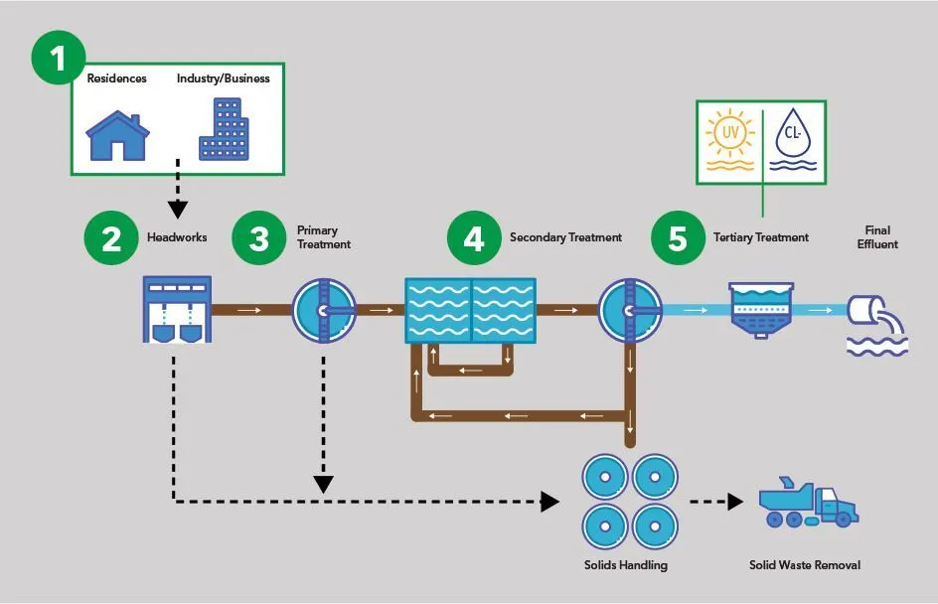
Why Engage in Wastewater Permitting
Have your voice HEARD
Opportunity to ask questions and voice concerns associated with permit
Clarification on permit logistics
Nutrient concerns & concentrations from wastewater effluent
Recommend improved measures
  Beneficial Reuse, Higher-Class Wastewater Operator, etc.
Hold TCEQ accountable

Slide 3
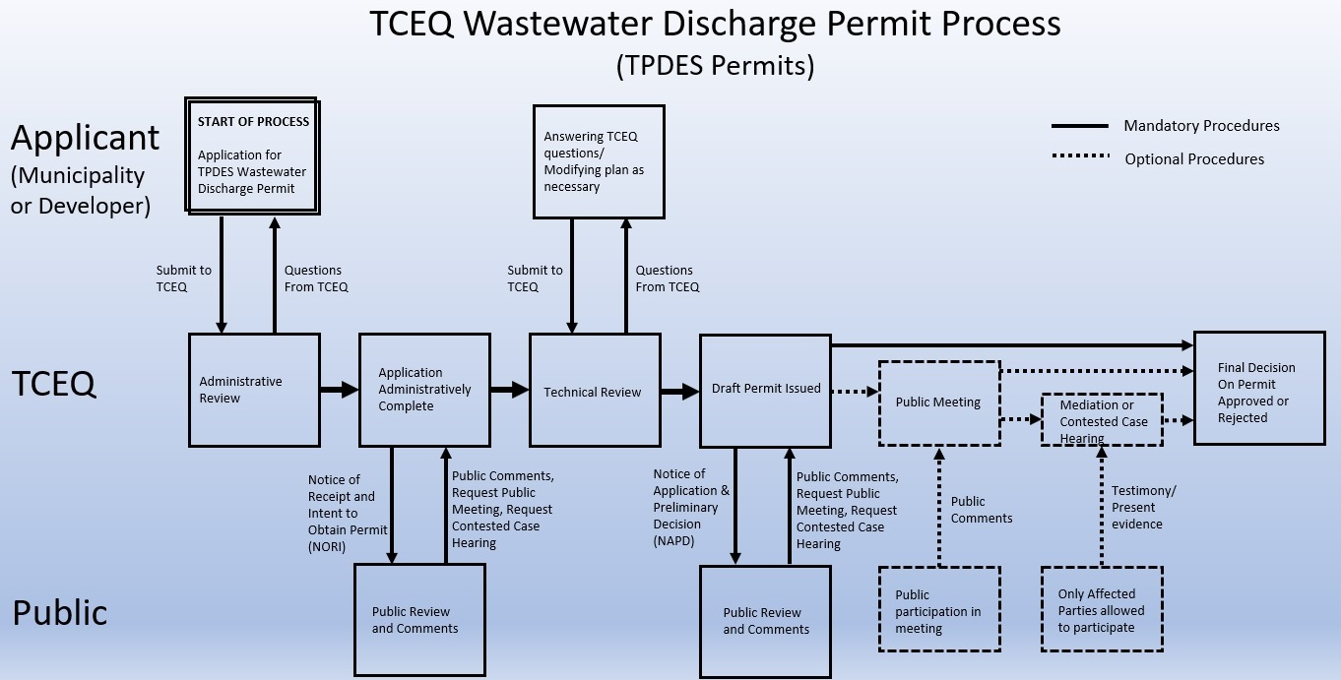
TCEQ Wastewater Permitting Process
Phase 1
Phase 2
Phase 3

Slide 4
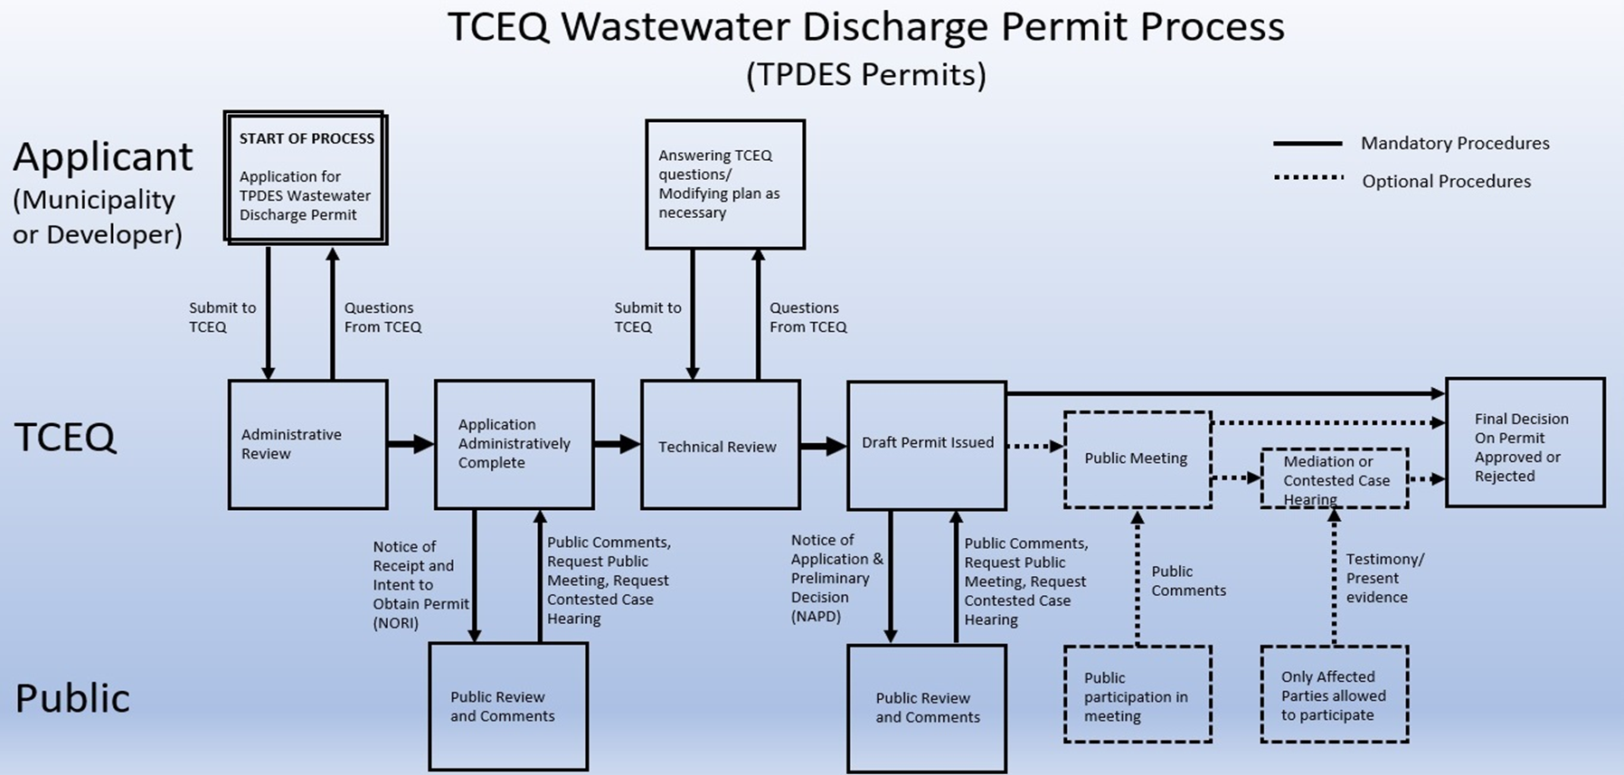
Phase 1: Permit Reviewing
Administrative Review
Verifies all submitted information is present.
Enters Notice of Receipt of Application and Intent to Obtain Permit (NORI) upon completion
  First Public Notice, First opportunity to submit public comments.
Technical Review
TCEQ staff review of state and federal regulatory requirements
Enters Notice of Application and Preliminary Decision (NAPD) upon completion

Slide 5
Phase 2: Draft Permit & Public Meeting
NAPD Phase
Second Opportunity for Public Comment
A draft permit gets issued based off of application information and TCEQ Review
Critical Step: Public involvement influences next steps
  30 day deadline from the last publication date of the NAPD Technical Review
  Moves to public meeting or final permit decision

Slide 6
Phase 2: Draft Permit & Public Meeting
Public Meeting
Enable the public to learn about the application, ask questions of the applicant and the TCEQ, and offer formal comments.
No decision to approve or deny an application is made at a public meeting.
2 Main Events during a Public Meeting:
1) Informal Q&A
2) Formal Comments for TCEQ Record
  Most important event of the meeting
Note: A public meeting is not a requirement in the TPDES process. TCEQ will hold a meeting if:
A) A legislator from the area requests one, or
B) There is significant interest in an application
A request for a public meeting must be submitted to TCEQ and specify that it is a request for a “public meeting.”
Once public meeting is concluded, public comment period ends

Slide 7
Phase 3: TCEQ Decision & Hearing(s)
TCEQ Decision
After public comment period concludes, TCEQ staff develops a Response to Comments (RTC)
RTC answers all comments addressed in written comments and formal comments during public meeting (if applicable)
RTC highlights any changes made to the TPDES draft permit
RTC gets sent out to mailing list and all commenters
Note: This provides the final 30-day period to protest TCEQ decision

Slide 8
Phase 3: TCEQ Decision & Hearing(s)
Contested Case Hearing
A civil-like trial that brings plaintiffs (affected parties) and defendants (applicant) to the table for discussion on the TPDES permit.
  Hearing conducted by the State Office of Administrative Hearings (SOAH)
All affected parties need to be approved by TCEQ Commissioners via written request within 30 days of the date the final decision letter gets mailed
Affected Party: an individual/group that has a personal interest in the permit and would be adversely affect in a manner not common to the general public
Once TCEQ decision has been released, three possible ways to contest:
Request a contested case hearing,
Request a reconsideration, or
Move to overturn it
Note: Only persons/groups who submitted timely comments during the public comment process can request a contested case hearing

Slide 9
Phase 3: TCEQ Decision & Hearing(s)
Required information for a successful contested case hearing request
The requestor’s name, physical address, and daytime phone number.
The permit application name and number: The Villages at Grape Creek, #WQ0016363001
A written statement requesting a contested case hearing (hearing) and affected party status.
The location of the requestor’s home, business, or property that is affected and its distance from the proposed facility.
A detailed explanation of how the requestor qualifies as an affected party (list reasons that are not common to the general public).
Any relevant factual evidence, such as the information in the application, photos, complaint logs, videos, etc.
A list of disputed factual issues that the requestor would like to raise as part of a contested case hearing.
  Based off comments requestor submitted and utilizing language from the TCEQ RTC.

Slide 10
Next Steps: Public Engagement & Fundraising
Ways the public can engage can :
Submit comments to TCEQ
  If applicable, request affected party status and a contested case hearing
  Important to list out ALL concerns in their comments
Attend the June 13 Public Meeting
  Inn at Barons Creek at 7PM
  Get the local neighbors involved
  Contact local, county, and state reps
  Contact local environmental groups
Make a donation to Pedernales River Alliance (PRA) via GEAA
  Visit www.aquiferalliance.org/donate
  Follow the “Individual Donation” section until you get to the payment screen.
  Note: Look for “Write a Note” on this screen, click on it, and insert “for Pedernales River Alliance” to allocate funds to PRA

Slide 11
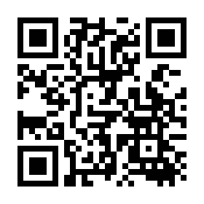

Questions? Thanks!
Donate Tonight!
Nathan Glavy
Technical Director
Greater Edwards Aquifer Alliance (GEAA)
nathan@aquiferalliance.org
210-320-0149
Designate Donation to Pedernales River Alliance

