Slide 1



Overview of TCEQ Permitting:
Wastewater Permits
Nathan Glavy, Technical Director, Greater Edwards Aquifer Alliance (GEAA)

Slide 2
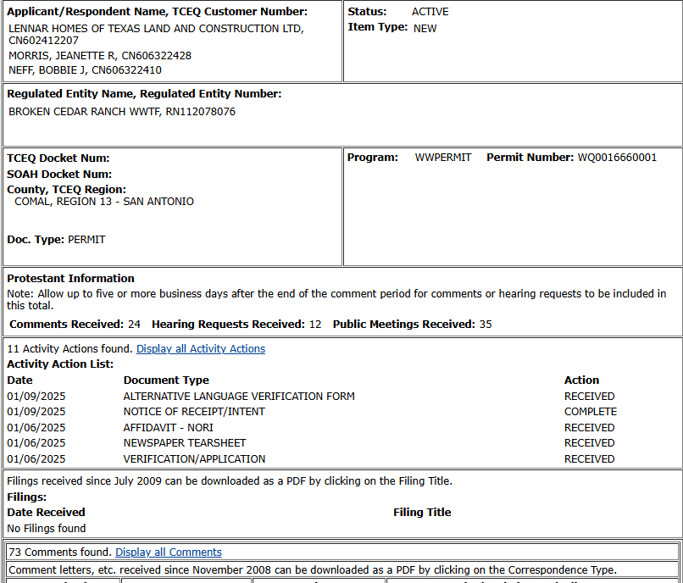
Special Notes for Broken Cedar Ranch WWTF
Texas Water Company Service Notice
“Given current conditions, we must temporarily pause new service commitments…”
Broken Cedar Ranch was named as one of the nine impacted developments
TCEQ Wastewater Application is still listed as ACTIVE
TCEQ Commissioners’ Integrated Database

Slide 3
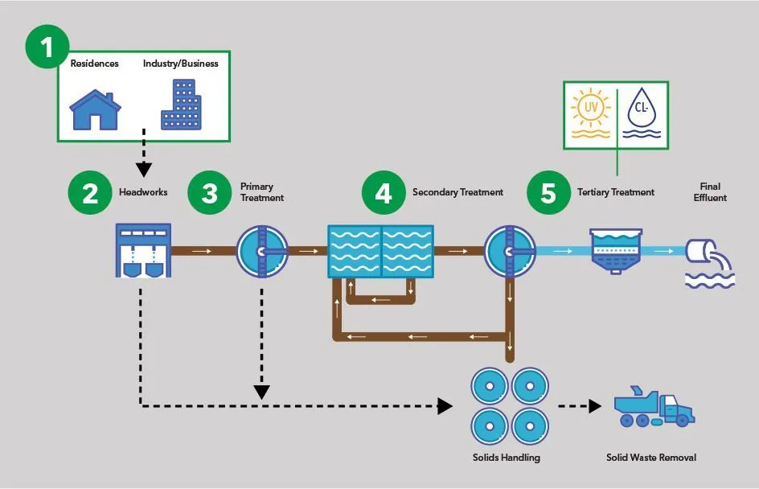
Why Should You Participate?
Opportunity to ask questions and voice concerns associated with the impacts of the permit
Odors, reduced water quality, aesthetic impacts
Have your voice HEARD; it's your right
Makes the process work better
Can help you win real improvements

Slide 4
Overview of Wastewater Permitting Options
Option 1: TPDES or discharge permit
TPDES stands for Texas Pollution Discharge Elimination System
Option 2: TLAP or land application permit
TLAP stands for Texas Land Application Permit
Treat and irrigate effluent on the land
Add-on: Reclaimed water or Chapter 210 Reuse Authorization
With either a TPDES or TLAP, effluent can be used on-demand to irrigate landscapes, flush toilets, fire protection, and more.
Covers all direct discharge into waterbodies: streams, lakes, and bays in the state
Dedicated disposal field, often with a storage/evaporation pond
Optional

Slide 5
Key Players
Applicant
Protestant(s)
Texas Commission on Environmental Quality (TCEQ)
  TCEQ Commissioners*, Chief Clerk, Executive Director (Staff), Office of Public Interest Council (OPIC)
State Office of Administrative Hearings (SOAH)*
  Administrative Law Judge(s) (ALJs)
*Parties get involved in contested wastewater permits

Slide 6

Overview: TCEQ Wastewater Permitting Process
≥ 60 Days
Step 1: Application Received
Administrative Review
Step 2: First Notice (NORI)
Notice Of Receipt & Intent to Obtain a Permit
Step 3: Second Notice (NAPD)
Notice of Application and Preliminary Decision
Step 4: Public Comment Deadline *
Step 5: Response to Comments (RTC)
* Extra Step: Comment deadline extended by a public meeting
TCEQ/Applicant back and forth with Q&As
Public Comment Starts
Technical Review
Draft Permit Issued
Last chance for public comment*
Include ALL questions with specificity
TCEQ explains any changes made to the draft permit
Triggers 30-day deadline to request a contested case hearing
30 Days
180 Days
Step 6: Deadline to Request Contested Case Hearing
Step 7: TCEQ Commissioners Consider Hearing Requests
Responses to Hearing Requests
Step 8: Preliminary Hearing
Step 9: Hearing on Merits and Proposal for Decisions (PFD)
Step 10: TCEQ Commissioners Consider PFD
Can also submit a Request for Reconsideration
If no requests are made, permit will be issued
Replies to Responses
TCEQ Commissioners decides to grant/not grant request(s)
Case moves towards the State Office of Administrative Hearings (SOAH)
Civil bench trial, with expert and fact witnesses, discovery, and legal arguments
SOAH concludes hearing process by issuing PFD
TCEQ considers PFD
Permit will be Adopted, Denied, or Adopted with Changes

Slide 7
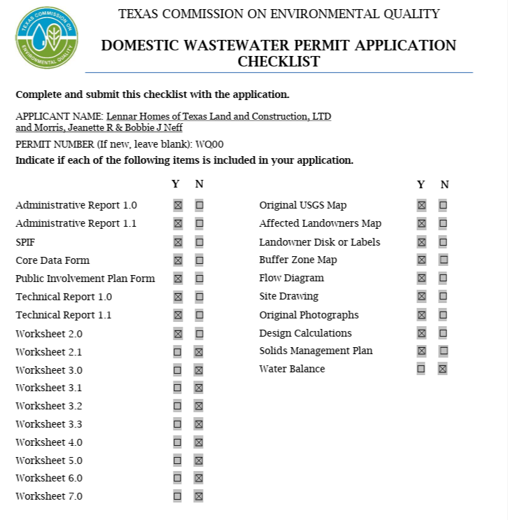
Step 1: Application Received
Applicant submits an application to TCEQ
Administrative review commences
TCEQ staff determines whether all information has been included in the application and fees (if any) have been paid.
Any issues with the initial application: TCEQ will send an applicant a “Notice of Deficiency” letter asking for additional information

Slide 8

Step 2: First Notice (NORI)
NORI: Notice of Receipt of Application and Intent to Obtain Permit
Applicant must publish notice in a newspaper in a) the county or b) city where the facility is to be located.
TCEQ Chief Clerk office will mail notice directly to the adjacent landowners and those one mile downstream
Application will be made available online or in person in the country where the facility is located
Starts Public Comment Period and TCEQ Technical Review
Take note of the WQ#

Slide 9
Public Information Sources
View TCEQ Wastewater Permits Online:
TPDES: https://www.tceq.texas.gov/permitting/wastewater/pending-permits/tpdes-applications
TLAP: https://www.tceq.texas.gov/permitting/wastewater/pending-permits/tlap-applications
TCEQ Commissioners’ Integrated Database (CID) : https://www14.tceq.texas.gov/epic/eCID/index.cfm
Can search and view data from the Chief Clerk about pending matters, view public comments, published notices, and other filings
TCEQ Central Registry: https://www15.tceq.texas.gov/crpub/
Can search for affiliated parties associated with the application, and view compliance history

Slide 10
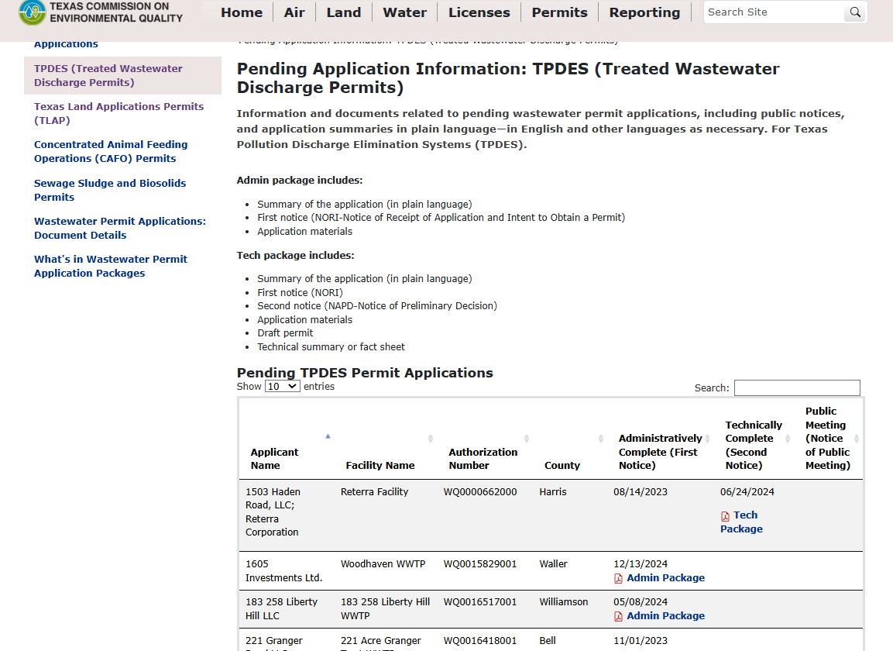
TCEQ Pending TPDES Application Database

Slide 11
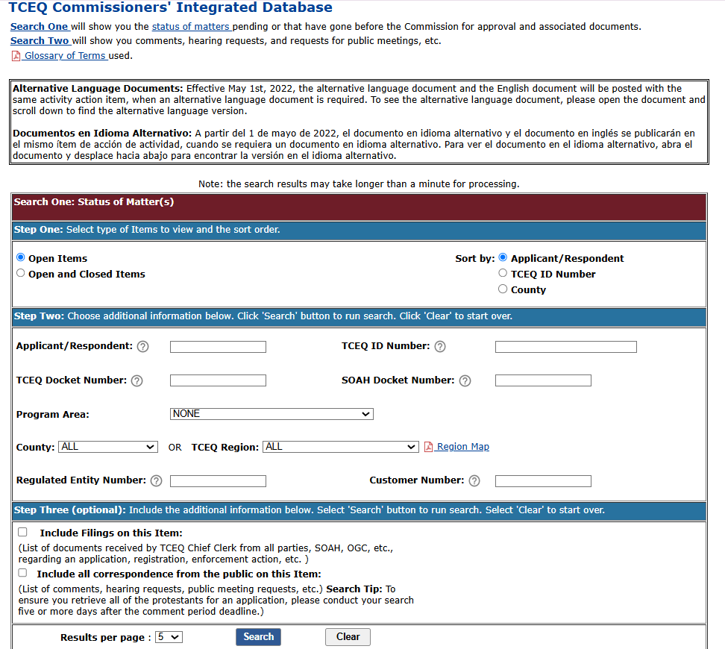
TCEQ Commissioners’ Integrated Database
Type WQ# Here
Check Both Boxes

Slide 12
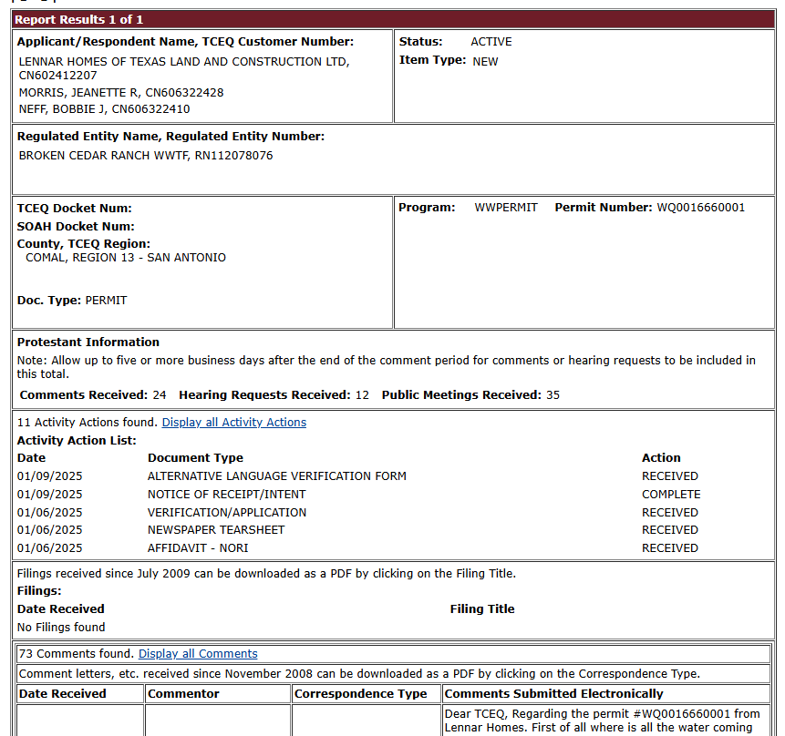
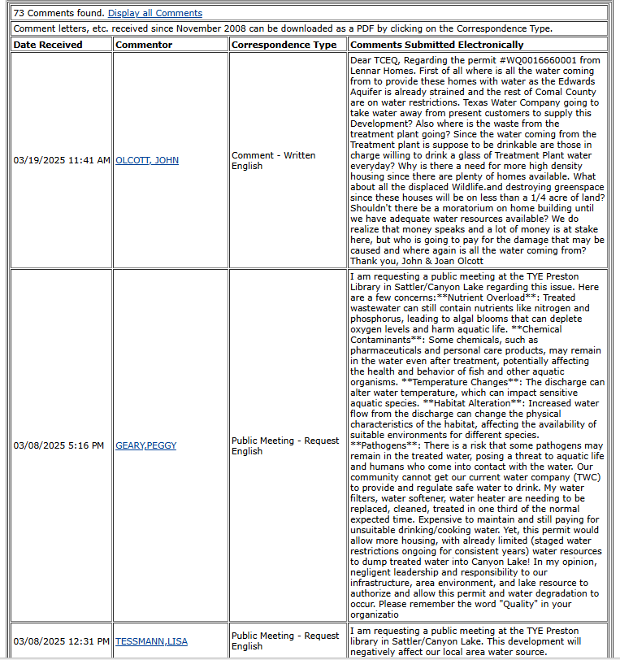
TCEQ Commissioners’ Integrated Database

Slide 13

Step 3:Second Notice (NAPD)
NAPD: Notice of Application and Preliminary Decision and Draft Permit
TCEQ has concluded its technical review, made changes (if any), and has issued a draft permit noting the applicant has met requirements.
Applicant must continue to have the application available for public viewing, along with any revisions and the draft permit.
Applicant must publish notice in the same manner as the first notice.
TCEQ Chief Clerk will also send notice directly to adjacent land owners, those one mile downstream, and those on the mailing list
Note: Date of NAPD starts 30-day public comment deadline*

Slide 14
Step 4: Public Comment Deadline
Include ALL questions, issues, or concerns with specificity
Any person or group who may want to contest the draft permit should submit comments
All public comments and requests must be submitted either:
Electronically:www14.tceq.texas.gov/epic/eComment/
In-Writing, mailed to TCEQ
Office of the Chief Clerk, MC 105
TCEQ
PO Box 13087
Austin, TX 78711
Hand-Delivery
Office of the Chief Clerk
TCEQ
12100 Park 35 Circle, Bldg. F
Austin, TX 78753
Fax: 512-239-3311
  Must also mail or hand-deliver copies
The public comment deadline can be extended if a public meeting is granted

Slide 15
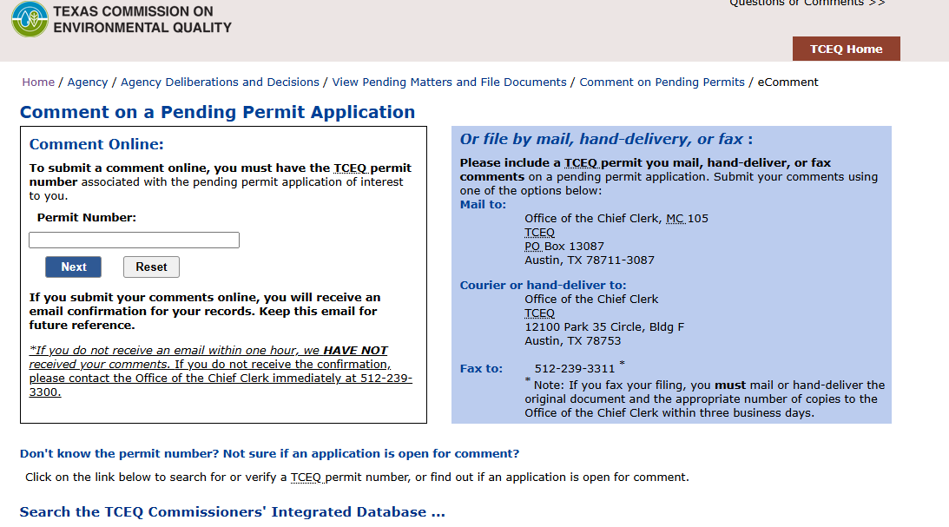
Electronically Submitting Public Comments
Type WQ# Here

Slide 16
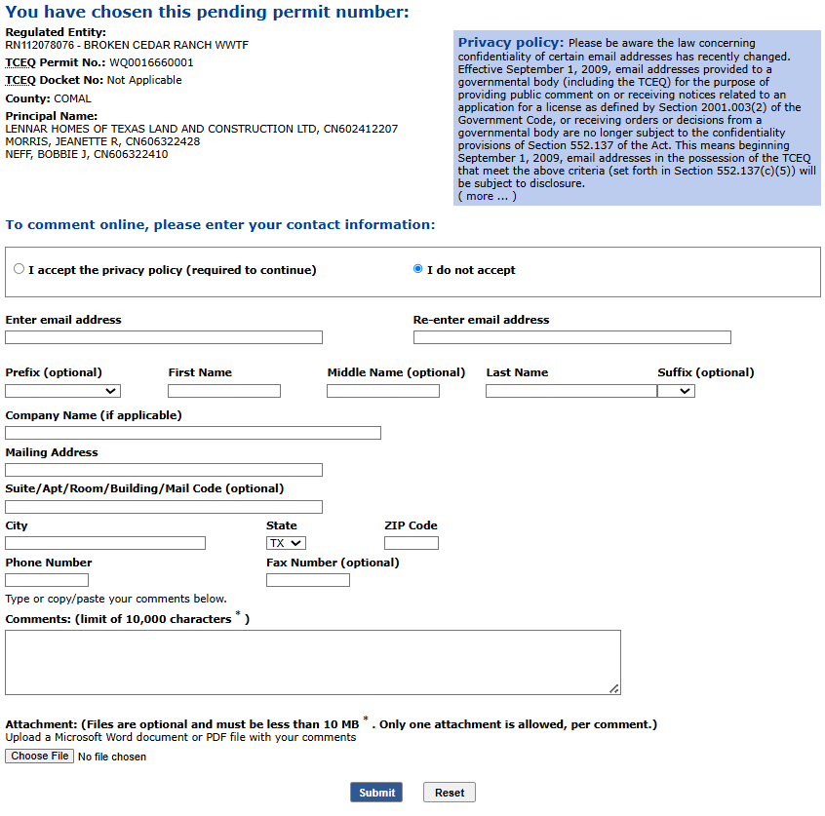
Electronically Submitting Public Comments

Slide 17
What Should I Include In My Comments?
Include ALL questions, issues, or concerns with specificity
  Ask yourself, “How could this permit impact my interests?”
  Want to be added to the mailing list: Comments must include a request to be added to mailing list
  Want to have a public meeting: Comments must include a request for a public meeting
  Want a contested case hearing: Comments must include a request for a contested case hearing
Topics can include (but are not limited to)
  Water quality issues for surface water/ground water supplies (well water)
  Concerns about impacts on recreational ability
  Impacts on financial operations of property; farming, ranching, and other business operations
  Concerns about area’s vegetation, animals, and insects
  Flooding concerns
Voicing all concerns, big or small, is crucial, even if you think it is not important or relevant

Slide 18
Step 4a: Public Meeting
A public meeting will be granted if:
State legislator of the district where this permit facility is located requests one, or
The TCEQ Executive Director determines there is a significant community interest
Granting a public meeting will extend the public comment deadline to the conclusion of the public meeting
Attendees will include: The applicant and/or applicant representative(s), TCEQ staff, and TCEQ OPIC
Two Main Parts:
1)Informal Q&A: Participants can ask questions and receive a response from the TCEQ/Applicant team.
This portion of the meeting is not recorded and does not require a formal response from TCEQ
2) Formal Comment Period: Participants will have 2-3 minutes to voice any comments, questions, or issues; TCEQ/Applicant team will not respond during this portion
  MOST IMPORTANT PART OF MEETING
  This portion is recorded and does require a formal response from TCEQ

Slide 19
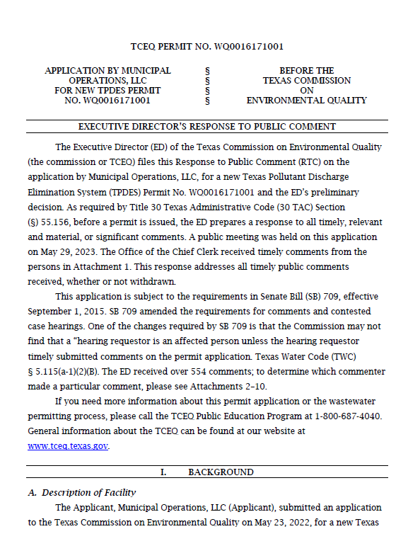
Step 5: Response to Comments (RTC)
After the public comment period concludes, TCEQ will prepare and mail out the Response to Comments (RTC).
TCEQ will respond to each question/comment, often grouping similar questions/comments
TCEQ will explain any changes that were made to the draft permit
Date on the RTC triggers a 30-day deadline to request a contested case hearing

Slide 20
Step 6: Requesting Contested Case Hearing
Only individuals or groups who submitted comments before the public comment deadline can request a contested case hearing
For groups, must have an identified individual(s) who submitted timely comments
A request should include:
All issues of concern you raised in your comments that you may want to raise during a hearing, and
A description of how you would be adversely affected in a way not common to the general public (affected party)
If no requests for a contested case hearing, TCEQ will issue the permit to the applicant.
If there are hearing requests, then TCEQ Commissioners must consider whether to grant a hearing at a Commissioners hearing.
Could also file Request of Reconsideration

Slide 21
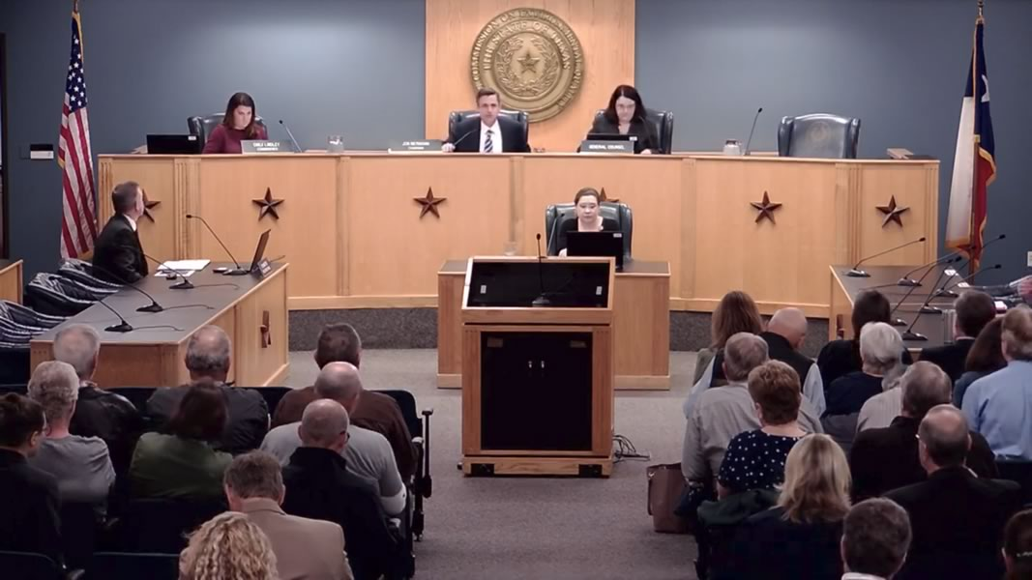
Step 7: TCEQ Commissioners Consider Hearing Requests
Before Commissioners Meeting:
a) Applicant, b) TCEQ Executive Director (ED), and c) TCEQ Office of Public Interest Council (OPIC) have the opportunity to file Responses to hearing requests
Requestors may file replies to the applicant, TCEQ ED, and TCEQ OPIC responses
If Commissioners grant a hearing, they will issue a written order that names a) affected parties and b) lists the disputed issues to be considered

Slide 22

Step 8: Preliminary Hearing
Contested Case Process is handled by the State Office of Administrative Hearings (SOAH).
Notice will go out to provide at least 30 days in advance of the Preliminary Hearing.
An Administrative Law Judge (ALJ) from SOAH will convene a preliminary hearing where they will confirm named parties and set a procedural schedule (based on input from parties).
Must attend preliminary hearing to confirm party status/participation in the hearing process.

Slide 23
Step 9: Hearing on Merits
SOAH Hearing is similar to a civil bench trial, with expert and fact witnesses, discovery, and legal arguments.
3-4 months after the preliminary hearing, the hearing on the merits takes place with live testimony.
After the hearing, parties may file “closing arguments.”
About 60 days after closing arguments, ALJ will issue a Proposal for Decision (PFD) that recommends a) denial of permit, b) granting of permit, or c) granting permit with conditions.

Slide 24
Step 10: TCEQ Commissioners Consider PFD
Commissioners consider the SOAH PFD and may a) adopt, b) reject, or b) modify the PFD.
TCEQ Commissioners will issue a written order expressing their final decision, which will be mailed to all parties.
Based on the decision, a party may file a “Motion for Rehearing.”
If denied, then a party can appeal to the district court.
The entire process can take more than 2 years (start to finish)

Slide 25
Next Steps
Get organized as a community
  GEAA can help facilitate a local community group and offer steps/pointers
  Contact your state legislator
  Determine community goals and objectives
  Think about fundraising efforts
Get comments submitted
  Remember: BE SPECIFIC
  Review the application
  Request a Public Meeting, Mailing List add, and/or contested case hearing
Be on the lookout for TCEQ notices for the next steps
  Next Notice: NAPD Notice

Slide 26
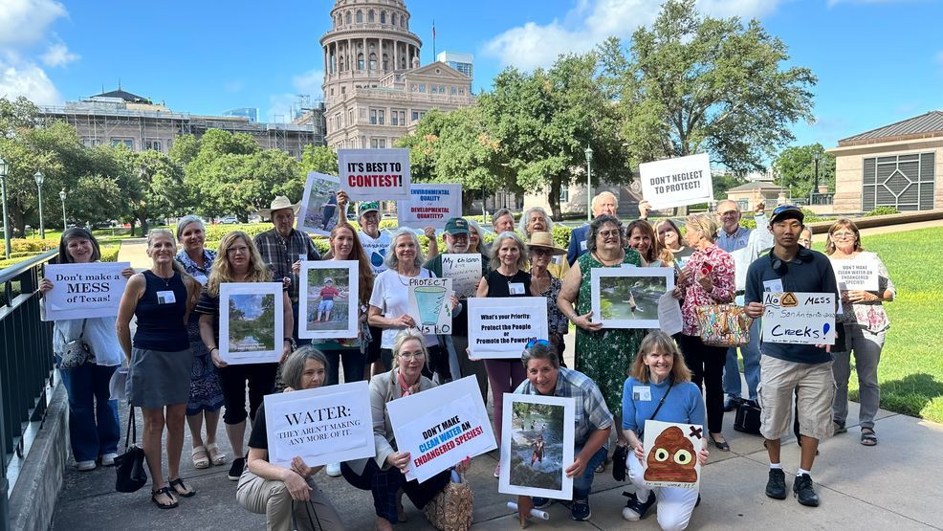
Questions? Thanks!
Nathan Glavy
Technical Director
Greater Edwards Aquifer Alliance (GEAA)
nathan@aquiferalliance.org
210-320-0149
Special Thanks: Lauren Ice, Perales, Allmon and Ice, P.C.

